Slide 1


Angle facts and parallel lines
Pearson Edexcel GCSE Mathematics 1MA1
L025 • Geometry and measures
60 minute lesson | learner resources
Reach for the Star | GCSE Mathematics
★ CONNECT & CHECK 1

Slide 2
The goal and the evidence
Connect & Check → Share → Present → Apply → Recall & Review
Calculate missing angles and justify each step using named angle facts and marked parallel lines.
Explain, apply and check independently.
Reach for the Star | GCSE Mathematics
★ CONNECT & CHECK 2

Slide 3
Starting-point diagnostic
R1–R3 • Attempt without notes
Find 180−65.
Find 360−120−90.
Solve 2x+40=180.
Reach for the Star | GCSE Mathematics
★ CONNECT & CHECK 3

Slide 4
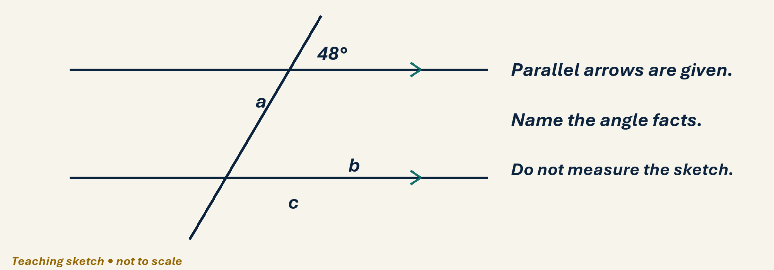
See the geometry
Use the diagram and practical sheet.
Reach for the Star | GCSE Mathematics
★ SHARE 4

Slide 5
Worked example and your turn
D1 • Explain each step
Model: adjacent angles on a straight line are 42° and x°, so x=138°. Now use 73° and y°.
Try the paired problem; check independently.
Reach for the Star | GCSE Mathematics
★ PRESENT 5

Slide 6
Worked example and your turn
D2 • Explain each step
Model: angles at a point are 90°, 140° and x°, so x=130°. Now use 80°, 125° and y°.
Try the paired problem; check independently.
Reach for the Star | GCSE Mathematics
★ PRESENT 6

Slide 7
Worked example and your turn
D3 • Explain each step
Model: one angle at intersecting lines is 62°; its opposite is 62°. Now one is 117°. Find its opposite and an adjacent angle.
Try the paired problem; check independently.
Reach for the Star | GCSE Mathematics
★ PRESENT 7

Slide 8
Worked example and your turn
D4 • Explain each step
Model: alternate angles on parallel lines are equal, so 54° matches 54°. Now an alternate pair is (3x+10)° and 70°. Find x.
Try the paired problem; check independently.
Reach for the Star | GCSE Mathematics
★ PRESENT 8

Slide 9

A method you can explain
Name the fact or construction at each step.
Check against the original question.
Reach for the Star | GCSE Mathematics
★ PRESENT 9

Slide 10
Diagnostic pause
Choose and explain before moving on.
A co-interior pair on parallel lines includes 65°. Other angle? A 65°, B 115°, C 295°.
Use your explanation to decide the next step.
Reach for the Star | GCSE Mathematics
★ CONNECT & CHECK 10

Slide 11
Careful variation
A1 • Show your reasoning
For a given angle of 48° on parallel lines, find a corresponding, alternate and co-interior partner.
Explain your decisions and check the result.
Reach for the Star | GCSE Mathematics
★ APPLY 11

Slide 12
Independent application
A2 • Show your reasoning
A co-interior pair on parallel lines is (2x+20)° and (x+10)°. Find x and both angles.
Explain your decisions and check the result.
Reach for the Star | GCSE Mathematics
★ APPLY 12

Slide 13
Use the method in context
A3 • Show your reasoning
Two straight parallel rails meet a transversal. One acute angle is 64°. Find an obtuse angle at either crossing and explain.
Explain your decisions and check the result.
Reach for the Star | GCSE Mathematics
★ APPLY 13

Slide 14
Intentional practice feedback
Read after attempting A3
116°.
Correct one step and explain the change.
Reach for the Star | GCSE Mathematics
★ APPLY 14

Slide 15
A claim to test
C1 • Show your reasoning
A learner sees two lines that look parallel and copies an alternate angle. Explain why this may fail.
Explain your decisions and check the result.
Reach for the Star | GCSE Mathematics
★ APPLY 15

Slide 16
Deepen the reasoning
C2 • Show your reasoning
Explain why vertically opposite angles are equal using a shared adjacent angle a°.
Explain your decisions and check the result.
Reach for the Star | GCSE Mathematics
★ APPLY 16

Slide 17
Retrieval without notes
Q1–Q3 • Numeric answers
Supplement of 72°, in degrees
Full turn minus 95°, in degrees
Opposite angle to 113°, in degrees
Reach for the Star | GCSE Mathematics
★ RECALL & REVIEW 17

Slide 18
Retrieval without notes
Q4–Q6 • Numeric answers
Alternate to 47° on parallels, degrees
Co-interior partner of 124°, degrees
Solve 3x+15=180
Reach for the Star | GCSE Mathematics
★ RECALL & REVIEW 18

Slide 19
Independent exit evidence
P1 • Without notes • Teacher review
A straight-line pair is 86° and x°. Find x with a reason. [2]
Show working and check your answer.
Reach for the Star | GCSE Mathematics
★ RECALL & REVIEW 19

Slide 20
Independent exit evidence
P2 • Without notes • Teacher review
Alternate angles on marked parallel lines are (4x−5)° and 63°. Find x, showing the equation. [2]
Show working and check your answer.
Reach for the Star | GCSE Mathematics
★ RECALL & REVIEW 20

Slide 21
Feedback and next steps
P3 • Completion is not mastery
Explain one error you have corrected.
Set a fresh question and a delayed check.
Reach for the Star | GCSE Mathematics
★ RECALL & REVIEW 21

Slide 22
Before the next lesson
L026: Triangles and polygons
Complete F1 tomorrow without notes.
Attempt F2 and bring one question.
Reach for the Star | GCSE Mathematics
★ APPLY 22

Slide 23

Optional stretch
Two parallel lines have co-interior angles 3x+10 and 2x+20. Find x.
Show a method. Explain a check or counterexample.
L025 · Extension A

Slide 24
Optional deep challenge
A student says alternate angles always add to 180°. Correct the claim.
Show a method. Explain a check or counterexample.
L025 · Extension B

Slide 25
L025 Recall & Review
Angle facts and parallel lines
Fresh evidence: prove the objective
Solve a new question without prompts. Explain one check, then correct one error in your working.
Objective: Calculate missing angles and justify each step using named angle facts and marked parallel lines.
Write the next practice step before you leave. It must test the method again, not simply copy today’s example.
Reach for the Star · GCSE Maths · Recall & Review

Slide 26
Feedback language
Use the full phrases before the abbreviations.
What Went Well (WWW)
Even Better If (EBI)
I selected the correct geometric fact, theorem, formula or transformation and used a clear diagram with appropriate labels and units.
I will name the fact or theorem, show the substitution or construction step and check whether the size, direction and units of the result are reasonable.
Identify the mathematical method, representation, reasoning or check that improved.
Set one precise next-step action and test it on a fresh question.
Reach for the Star · GCSE Maths · Recall & Review

Slide 27
Extension route
Choose this route only after the core evidence is secure.
Stretch
Two parallel lines have co-interior angles 3x+10 and 2x+20. Find x.
Deep challenge
A student says alternate angles always add to 180°. Correct the claim.
Explain your reasoning clearly enough that another learner could check it.
Reach for the Star · GCSE Maths · Recall & Review

