Slide 1


Triangles and polygons
Pearson Edexcel GCSE Mathematics 1MA1
L026 • Geometry and measures
60 minute lesson | learner resources
Reach for the Star | GCSE Mathematics
★ CONNECT & CHECK 1

Slide 2
The goal and the evidence
Connect & Check → Share → Present → Apply → Recall & Review
Derive angle sums and use triangle, quadrilateral and regular-polygon properties to solve problems.
Explain, apply and check independently.
Reach for the Star | GCSE Mathematics
★ CONNECT & CHECK 2

Slide 3
Starting-point diagnostic
R1–R3 • Attempt without notes
Find the supplement of 65°.
Solve 2x+40=180.
Divide 360 by 8.
Reach for the Star | GCSE Mathematics
★ CONNECT & CHECK 3

Slide 4
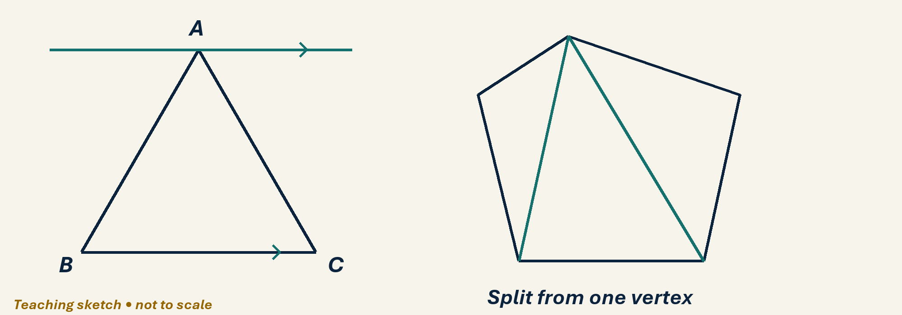
See the geometry
Use the diagram and practical sheet.
Reach for the Star | GCSE Mathematics
★ SHARE 4

Slide 5
Worked example and your turn
D1 • Explain each step
Model: triangle angles 45°, 65°, x° give x=70°. Now use 38°, 77°, y°.
Try the paired problem; check independently.
Reach for the Star | GCSE Mathematics
★ PRESENT 5

Slide 6
Worked example and your turn
D2 • Explain each step
Model: isosceles apex 40° gives base angles 70°. Now the apex is 56°.
Try the paired problem; check independently.
Reach for the Star | GCSE Mathematics
★ PRESENT 6

Slide 7
Worked example and your turn
D3 • Explain each step
Model: a pentagon splits into 3 triangles, sum 540°. Find the sum for a heptagon.
Try the paired problem; check independently.
Reach for the Star | GCSE Mathematics
★ PRESENT 7

Slide 8
Worked example and your turn
D4 • Explain each step
Model: regular octagon exterior 45°, interior 135°. Find both for a regular decagon.
Try the paired problem; check independently.
Reach for the Star | GCSE Mathematics
★ PRESENT 8

Slide 9

A method you can explain
Name the fact or construction at each step.
Check against the original question.
Reach for the Star | GCSE Mathematics
★ PRESENT 9

Slide 10
Diagnostic pause
Choose and explain before moving on.
A regular hexagon interior angle is A 60°, B 120°, C 720°.
Use your explanation to decide the next step.
Reach for the Star | GCSE Mathematics
★ CONNECT & CHECK 10

Slide 11
Careful variation
A1 • Show your reasoning
Find interior sums for 4, 5 and 6 sides. Explain the constant increase.
Explain your decisions and check the result.
Reach for the Star | GCSE Mathematics
★ APPLY 11

Slide 12
Independent application
A2 • Show your reasoning
A regular polygon has exterior angle 24°. Find its sides and interior angle.
Explain your decisions and check the result.
Reach for the Star | GCSE Mathematics
★ APPLY 12

Slide 13
Use the method in context
A3 • Show your reasoning
In a parallelogram one angle is 68°. Find the other three and justify.
Explain your decisions and check the result.
Reach for the Star | GCSE Mathematics
★ APPLY 13

Slide 14
Intentional practice feedback
Read after attempting A3
112°, 68°, 112°.
Correct one step and explain the change.
Reach for the Star | GCSE Mathematics
★ APPLY 14

Slide 15
A claim to test
C1 • Show your reasoning
All rhombuses are squares. Disprove the claim using angle properties.
Explain your decisions and check the result.
Reach for the Star | GCSE Mathematics
★ APPLY 15

Slide 16
Deepen the reasoning
C2 • Show your reasoning
Can a regular polygon have exterior angle 50°? Explain.
Explain your decisions and check the result.
Reach for the Star | GCSE Mathematics
★ APPLY 16

Slide 17
Retrieval without notes
Q1–Q3 • Numeric answers
Triangle: 35°,65°, third in degrees
Isosceles apex 32°, base in degrees
Pentagon angle sum, degrees
Reach for the Star | GCSE Mathematics
★ RECALL & REVIEW 17

Slide 18
Retrieval without notes
Q4–Q6 • Numeric answers
Regular hexagon interior, degrees
Regular polygon exterior 20°: sides
Solve 4x=180
Reach for the Star | GCSE Mathematics
★ RECALL & REVIEW 18

Slide 19
Independent exit evidence
P1 • Without notes • Teacher review
An isosceles triangle has apex angle 74°. Find each base angle with working. [2]
Show working and check your answer.
Reach for the Star | GCSE Mathematics
★ RECALL & REVIEW 19

Slide 20
Independent exit evidence
P2 • Without notes • Teacher review
A regular polygon has interior angle 150°. Find the number of sides. [2]
Show working and check your answer.
Reach for the Star | GCSE Mathematics
★ RECALL & REVIEW 20

Slide 21
Feedback and next steps
P3 • Completion is not mastery
Explain one error you have corrected.
Set a fresh question and a delayed check.
Reach for the Star | GCSE Mathematics
★ RECALL & REVIEW 21

Slide 22
Before the next lesson
L027: Congruence and geometric reasoning
Complete F1 tomorrow without notes.
Attempt F2 and bring one question.
Reach for the Star | GCSE Mathematics
★ APPLY 22

Slide 23

Optional stretch
Find each interior angle of a regular 15-sided polygon.
Show a method. Explain a check or counterexample.
L026 · Extension A

Slide 24
Optional deep challenge
A regular polygon has interior angle 165°. Find its number of sides.
Show a method. Explain a check or counterexample.
L026 · Extension B

Slide 25
L026 Recall & Review
Triangles and polygons
Fresh evidence: prove the objective
Solve a new question without prompts. Explain one check, then correct one error in your working.
Objective: Derive angle sums and use triangle, quadrilateral and regular-polygon properties to solve problems.
Write the next practice step before you leave. It must test the method again, not simply copy today’s example.
Reach for the Star · GCSE Maths · Recall & Review

Slide 26
Feedback language
Use the full phrases before the abbreviations.
What Went Well (WWW)
Even Better If (EBI)
I selected the correct geometric fact, theorem, formula or transformation and used a clear diagram with appropriate labels and units.
I will name the fact or theorem, show the substitution or construction step and check whether the size, direction and units of the result are reasonable.
Identify the mathematical method, representation, reasoning or check that improved.
Set one precise next-step action and test it on a fresh question.
Reach for the Star · GCSE Maths · Recall & Review

Slide 27
Extension route
Choose this route only after the core evidence is secure.
Stretch
Find each interior angle of a regular 15-sided polygon.
Deep challenge
A regular polygon has interior angle 165°. Find its number of sides.
Explain your reasoning clearly enough that another learner could check it.
Reach for the Star · GCSE Maths · Recall & Review

