Slide 1


Congruence and geometric reasoning
Pearson Edexcel GCSE Mathematics 1MA1
L027 • Geometry and measures
60 minute lesson | learner resources
Reach for the Star | GCSE Mathematics
★ CONNECT & CHECK 1

Slide 2
The goal and the evidence
Connect & Check → Share → Present → Apply → Recall & Review
Select a valid triangle congruence criterion and use corresponding parts to build a short proof.
Explain, apply and check independently.
Reach for the Star | GCSE Mathematics
★ CONNECT & CHECK 2

Slide 3
Starting-point diagnostic
R1–R3 • Attempt without notes
Find the third triangle angle when two are 50° and 70°.
An isosceles triangle has base angles 65°. Find its apex.
State an opposite-angle property of a parallelogram.
Reach for the Star | GCSE Mathematics
★ CONNECT & CHECK 3

Slide 4
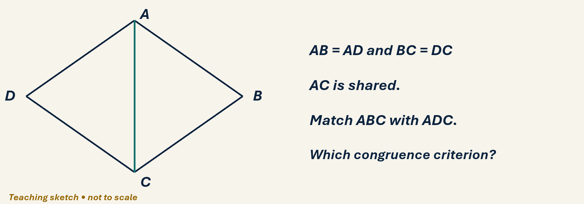
See the geometry
Use the diagram and practical sheet.
Reach for the Star | GCSE Mathematics
★ SHARE 4

Slide 5
Worked example and your turn
D1 • Explain each step
Model: matching side triples 3,4,5 cm prove SSS. Now both triangles have sides 5,6,7 cm. Name the criterion.
Try the paired problem; check independently.
Reach for the Star | GCSE Mathematics
★ PRESENT 5

Slide 6
Worked example and your turn
D2 • Explain each step
Model: sides 4,6 cm and included 50° prove SAS. Now sides 5,8 cm and included 70° match.
Try the paired problem; check independently.
Reach for the Star | GCSE Mathematics
★ PRESENT 6

Slide 7
Worked example and your turn
D3 • Explain each step
Model: angles 40°,60° and their included 7 cm side prove ASA. Now angles 35°,80° and their included 6 cm side match.
Try the paired problem; check independently.
Reach for the Star | GCSE Mathematics
★ PRESENT 7

Slide 8
Worked example and your turn
D4 • Explain each step
Model: right triangles with hypotenuse 13 cm and leg 5 cm satisfy RHS. Now hypotenuse 10 cm and leg 6 cm match.
Try the paired problem; check independently.
Reach for the Star | GCSE Mathematics
★ PRESENT 8

Slide 9

A method you can explain
Name the fact or construction at each step.
Check against the original question.
Reach for the Star | GCSE Mathematics
★ PRESENT 9

Slide 10
Diagnostic pause
Choose and explain before moving on.
Two triangles have equal corresponding angles only. Congruent? A always, B not necessarily.
Use your explanation to decide the next step.
Reach for the Star | GCSE Mathematics
★ CONNECT & CHECK 10

Slide 11
Careful variation
A1 • Show your reasoning
Classify: (i) three matching sides (ii) two sides and included angle (iii) right angle, hypotenuse and one side.
Explain your decisions and check the result.
Reach for the Star | GCSE Mathematics
★ APPLY 11

Slide 12
Independent application
A2 • Show your reasoning
ABCD is a parallelogram with diagonal AC. Explain why triangles ABC and CDA are congruent.
Explain your decisions and check the result.
Reach for the Star | GCSE Mathematics
★ APPLY 12

Slide 13
Use the method in context
A3 • Show your reasoning
AB=AD and BC=DC in a kite ABCD. Diagonal AC is drawn. Prove angle BAC equals CAD.
Explain your decisions and check the result.
Reach for the Star | GCSE Mathematics
★ APPLY 13

Slide 14
Intentional practice feedback
Read after attempting A3
AB=AD, BC=DC, AC shared; ABC and ADC congruent by SSS, so matching angles BAC and CAD are equal.
Correct one step and explain the change.
Reach for the Star | GCSE Mathematics
★ APPLY 14

Slide 15
A claim to test
C1 • Show your reasoning
Two equilateral triangles have sides 3 cm and 5 cm. What does this show about AAA?
Explain your decisions and check the result.
Reach for the Star | GCSE Mathematics
★ APPLY 15

Slide 16
Deepen the reasoning
C2 • Show your reasoning
Why is saying the triangles look equal not a proof? Improve the statement using the kite in A3.
Explain your decisions and check the result.
Reach for the Star | GCSE Mathematics
★ APPLY 16

Slide 17
Retrieval without notes
Q1–Q3 • Numeric answers
Number of matching side pairs in SSS
Degrees in a right angle
Third angle after 35° and 80°, degrees
Reach for the Star | GCSE Mathematics
★ RECALL & REVIEW 17

Slide 18
Retrieval without notes
Q4–Q6 • Numeric answers
Triangle sides 5, 5, 6 cm: perimeter in cm
Triangle scaled 2: length 7 becomes
Regular hexagon exterior in degrees
Reach for the Star | GCSE Mathematics
★ RECALL & REVIEW 18

Slide 19
Independent exit evidence
P1 • Without notes • Teacher review
Triangles ABC and DEF have AB=DE, BC=EF and AC=DF. Name the criterion and the angle corresponding to ABC. [2]
Show working and check your answer.
Reach for the Star | GCSE Mathematics
★ RECALL & REVIEW 19

Slide 20
Independent exit evidence
P2 • Without notes • Teacher review
Right triangles have equal hypotenuses and one equal corresponding leg. Explain why they are congruent. [2]
Show working and check your answer.
Reach for the Star | GCSE Mathematics
★ RECALL & REVIEW 20

Slide 21
Feedback and next steps
P3 • Completion is not mastery
Explain one error you have corrected.
Set a fresh question and a delayed check.
Reach for the Star | GCSE Mathematics
★ RECALL & REVIEW 21

Slide 22
Before the next lesson
L028: Constructions and loci
Complete F1 tomorrow without notes.
Attempt F2 and bring one question.
Reach for the Star | GCSE Mathematics
★ APPLY 22

Slide 23

Optional stretch
State a valid congruence test for sides 5,7,8 cm in two triangles and explain.
Show a method. Explain a check or counterexample.
L027 · Extension A

Slide 24
Optional deep challenge
Two triangles have equal side lengths 5 and 7 cm and a non-included equal angle. Must they be congruent?
Show a method. Explain a check or counterexample.
L027 · Extension B

Slide 25
L027 Recall & Review
Congruence and geometric reasoning
Fresh evidence: prove the objective
Solve a new question without prompts. Explain one check, then correct one error in your working.
Objective: Select a valid triangle congruence criterion and use corresponding parts to build a short proof.
Write the next practice step before you leave. It must test the method again, not simply copy today’s example.
Reach for the Star · GCSE Maths · Recall & Review

Slide 26
Feedback language
Use the full phrases before the abbreviations.
What Went Well (WWW)
Even Better If (EBI)
I selected the correct geometric fact, theorem, formula or transformation and used a clear diagram with appropriate labels and units.
I will name the fact or theorem, show the substitution or construction step and check whether the size, direction and units of the result are reasonable.
Identify the mathematical method, representation, reasoning or check that improved.
Set one precise next-step action and test it on a fresh question.
Reach for the Star · GCSE Maths · Recall & Review

Slide 27
Extension route
Choose this route only after the core evidence is secure.
Stretch
State a valid congruence test for sides 5,7,8 cm in two triangles and explain.
Deep challenge
Two triangles have equal side lengths 5 and 7 cm and a non-included equal angle. Must they be congruent?
Explain your reasoning clearly enough that another learner could check it.
Reach for the Star · GCSE Maths · Recall & Review

