Slide 1


Constructions and loci
Pearson Edexcel GCSE Mathematics 1MA1
L028 • Geometry and measures
60 minute lesson | learner resources
Reach for the Star | GCSE Mathematics
★ CONNECT & CHECK 1

Slide 2
The goal and the evidence
Connect & Check → Share → Present → Apply → Recall & Review
Use ruler and compass constructions and interpret loci as sets of points satisfying distance conditions.
Explain, apply and check independently.
Reach for the Star | GCSE Mathematics
★ CONNECT & CHECK 2

Slide 3
Starting-point diagnostic
R1–R3 • Attempt without notes
How many degrees is a perpendicular angle?
What is half of 8 cm?
Explain equidistant from A and B.
Reach for the Star | GCSE Mathematics
★ CONNECT & CHECK 3

Slide 4
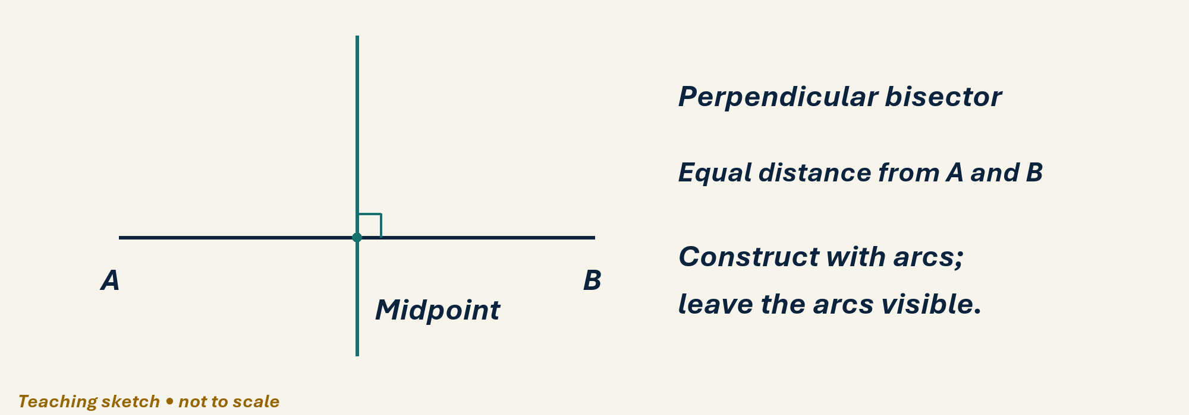
See the geometry
Use the diagram and practical sheet.
Reach for the Star | GCSE Mathematics
★ SHARE 4

Slide 5
Worked example and your turn
D1 • Explain each step
Model: draw AB=6 cm; equal arcs of radius greater than 3 cm intersect above and below. Join intersections. Now construct the perpendicular bisector of AB=8 cm.
Try the paired problem; check independently.
Reach for the Star | GCSE Mathematics
★ PRESENT 5

Slide 6
Worked example and your turn
D2 • Explain each step
Model: equal marks on both rays and equal arcs bisect a 60° angle into 30°. Now draw a 70° angle with a protractor, then bisect it using compass arcs.
Try the paired problem; check independently.
Reach for the Star | GCSE Mathematics
★ PRESENT 6

Slide 7
Worked example and your turn
D3 • Explain each step
Model: points exactly 2 cm from O lie on a radius-2 circle. Draw the locus exactly 3 cm from P.
Try the paired problem; check independently.
Reach for the Star | GCSE Mathematics
★ PRESENT 7

Slide 8
Worked example and your turn
D4 • Explain each step
Model: points 2 cm from a straight line form two parallel lines. Draw points no more than 1 cm from a line.
Try the paired problem; check independently.
Reach for the Star | GCSE Mathematics
★ PRESENT 8

Slide 9

A method you can explain
Name the fact or construction at each step.
Check against the original question.
Reach for the Star | GCSE Mathematics
★ PRESENT 9

Slide 10
Diagnostic pause
Choose and explain before moving on.
Points exactly 3 cm from O form A a disc, B a circle circumference, C a line.
Use your explanation to decide the next step.
Reach for the Star | GCSE Mathematics
★ CONNECT & CHECK 10

Slide 11
Careful variation
A1 • Show your reasoning
Use the practical sheet: construct a perpendicular from an off-line point P to line l. Keep arcs and label the foot.
Explain your decisions and check the result.
Reach for the Star | GCSE Mathematics
★ APPLY 11

Slide 12
Independent application
A2 • Show your reasoning
Draw A and B 6 cm apart. Construct points exactly 4 cm from each. How many are there?
Explain your decisions and check the result.
Reach for the Star | GCSE Mathematics
★ APPLY 12

Slide 13
Use the method in context
A3 • Show your reasoning
A sensor must be no more than 3 cm from O and equidistant from A and B. Describe how to construct the permitted set.
Explain your decisions and check the result.
Reach for the Star | GCSE Mathematics
★ APPLY 13

Slide 14
Intentional practice feedback
Read after attempting A3
Intersect the closed radius-3 disc with the perpendicular bisector of AB.
Correct one step and explain the change.
Reach for the Star | GCSE Mathematics
★ APPLY 14

Slide 15
A claim to test
C1 • Show your reasoning
A learner draws one arc intersection and joins it to A to bisect AB. Explain the error.
Explain your decisions and check the result.
Reach for the Star | GCSE Mathematics
★ APPLY 15

Slide 16
Deepen the reasoning
C2 • Show your reasoning
A and B are 8 cm apart. How many points are exactly 3 cm from each? Explain.
Explain your decisions and check the result.
Reach for the Star | GCSE Mathematics
★ APPLY 16

Slide 17
Retrieval without notes
Q1–Q3 • Numeric answers
Midpoint distance for segment 10 cm
Bisect 80°: each angle in degrees
Radius 3 cm: diameter in cm
Reach for the Star | GCSE Mathematics
★ RECALL & REVIEW 17

Slide 18
Retrieval without notes
Q4–Q6 • Numeric answers
Perpendicular angle in degrees
A,B 6 cm apart; radius-4 circles: intersections
A,B 8 cm apart; radius-3 circles: intersections
Reach for the Star | GCSE Mathematics
★ RECALL & REVIEW 18

Slide 19
Independent exit evidence
P1 • Without notes • Teacher review
Describe the locus equidistant from two fixed points A and B, with both defining properties. [2]
Show working and check your answer.
Reach for the Star | GCSE Mathematics
★ RECALL & REVIEW 19

Slide 20
Independent exit evidence
P2 • Without notes • Teacher review
A and B are 6 cm apart. How many points are exactly 3 cm from each? Explain. [2]
Show working and check your answer.
Reach for the Star | GCSE Mathematics
★ RECALL & REVIEW 20

Slide 21
Feedback and next steps
P3 • Completion is not mastery
Explain one error you have corrected.
Set a fresh question and a delayed check.
Reach for the Star | GCSE Mathematics
★ RECALL & REVIEW 21

Slide 22
Before the next lesson
L029: Coordinates and transformations
Complete F1 tomorrow without notes.
Attempt F2 and bring one question.
Reach for the Star | GCSE Mathematics
★ APPLY 22

Slide 23

Optional stretch
Construct the perpendicular bisector of an 8 cm segment. How far is its midpoint from either endpoint?
Show a method. Explain a check or counterexample.
L028 · Extension A

Slide 24
Optional deep challenge
A point is 3 cm from A and 4 cm from B. Describe the intersection of its loci.
Show a method. Explain a check or counterexample.
L028 · Extension B

Slide 25
L028 Recall & Review
Constructions and loci
Fresh evidence: prove the objective
Solve a new question without prompts. Explain one check, then correct one error in your working.
Objective: Use ruler and compass constructions and interpret loci as sets of points satisfying distance conditions.
Write the next practice step before you leave. It must test the method again, not simply copy today’s example.
Reach for the Star · GCSE Maths · Recall & Review

Slide 26
Feedback language
Use the full phrases before the abbreviations.
What Went Well (WWW)
Even Better If (EBI)
I selected the correct geometric fact, theorem, formula or transformation and used a clear diagram with appropriate labels and units.
I will name the fact or theorem, show the substitution or construction step and check whether the size, direction and units of the result are reasonable.
Identify the mathematical method, representation, reasoning or check that improved.
Set one precise next-step action and test it on a fresh question.
Reach for the Star · GCSE Maths · Recall & Review

Slide 27
Extension route
Choose this route only after the core evidence is secure.
Stretch
Construct the perpendicular bisector of an 8 cm segment. How far is its midpoint from either endpoint?
Deep challenge
A point is 3 cm from A and 4 cm from B. Describe the intersection of its loci.
Explain your reasoning clearly enough that another learner could check it.
Reach for the Star · GCSE Maths · Recall & Review

