Slide 1


Coordinates and transformations
Pearson Edexcel GCSE Mathematics 1MA1
L029 • Geometry and measures
60 minute lesson | learner resources
Reach for the Star | GCSE Mathematics
★ CONNECT & CHECK 1

Slide 2
The goal and the evidence
Connect & Check → Share → Present → Apply → Recall & Review
Transform points and shapes by translation, reflection and rotation, and describe each transformation completely.
Explain, apply and check independently.
Reach for the Star | GCSE Mathematics
★ CONNECT & CHECK 2

Slide 3
Starting-point diagnostic
R1–R3 • Attempt without notes
Plot (−2,3): which direction is x from the origin?
Find −2+5.
How many degrees is a quarter turn?
Reach for the Star | GCSE Mathematics
★ CONNECT & CHECK 3

Slide 4
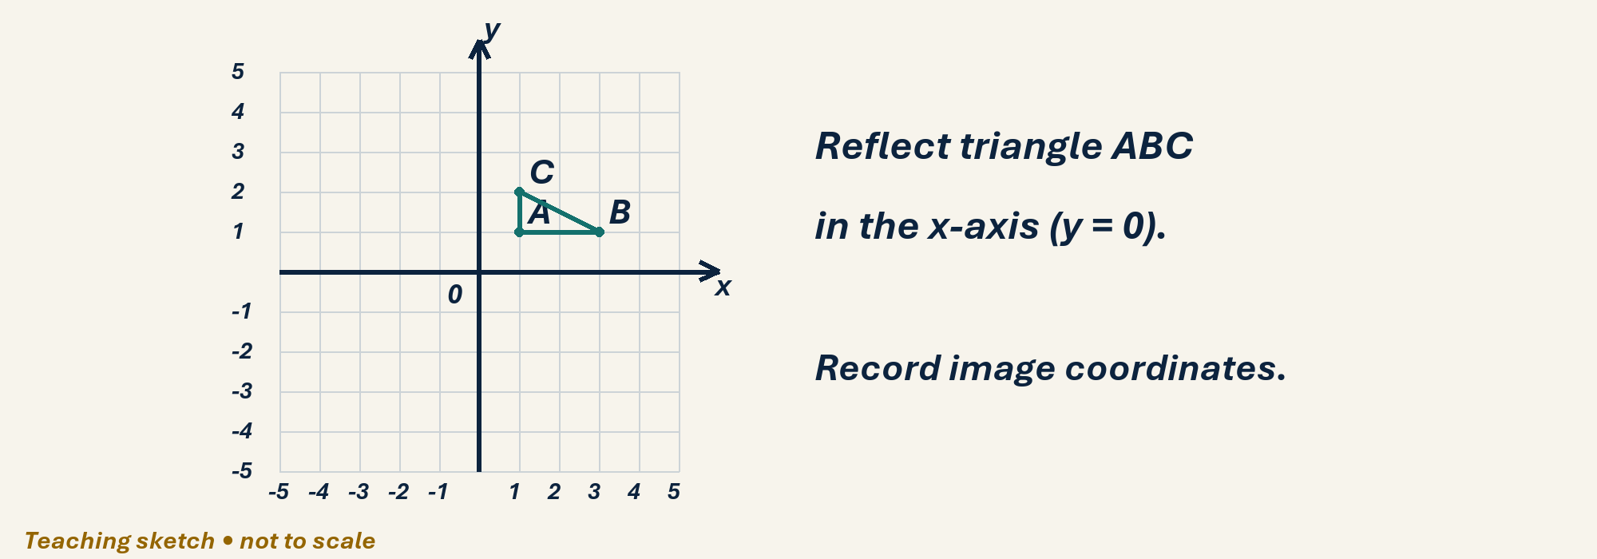
See the geometry
Use the diagram and practical sheet.
Reach for the Star | GCSE Mathematics
★ SHARE 4

Slide 5
Worked example and your turn
D1 • Explain each step
Model: (1,2)+(3,−1)=(4,1). Translate (−2,4) by (5,−3).
Try the paired problem; check independently.
Reach for the Star | GCSE Mathematics
★ PRESENT 5

Slide 6
Worked example and your turn
D2 • Explain each step
Model: reflect (2,3) in x=0 to (−2,3). Reflect (−4,1) in x=0.
Try the paired problem; check independently.
Reach for the Star | GCSE Mathematics
★ PRESENT 6

Slide 7
Worked example and your turn
D3 • Explain each step
Model: reflect (4,2) in x=1 to (−2,2). Reflect (3,−1) in x=1.
Try the paired problem; check independently.
Reach for the Star | GCSE Mathematics
★ PRESENT 7

Slide 8
Worked example and your turn
D4 • Explain each step
Model: 90° anticlockwise about origin sends (2,1) to (−1,2). Rotate (3,−2) the same way.
Try the paired problem; check independently.
Reach for the Star | GCSE Mathematics
★ PRESENT 8

Slide 9

A method you can explain
Name the fact or construction at each step.
Check against the original question.
Reach for the Star | GCSE Mathematics
★ PRESENT 9

Slide 10
Diagnostic pause
Choose and explain before moving on.
Reflect (3,2) in the y-axis. A (3,−2), B (−3,2), C (2,3).
Use your explanation to decide the next step.
Reach for the Star | GCSE Mathematics
★ CONNECT & CHECK 10

Slide 11
Careful variation
A1 • Show your reasoning
Translate (2,−1) by (3,0), (0,3), then (3,3), each from the original point.
Explain your decisions and check the result.
Reach for the Star | GCSE Mathematics
★ APPLY 11

Slide 12
Independent application
A2 • Show your reasoning
Triangle A(1,1), B(3,1), C(1,2): reflect in y=0. Give image vertices and check one side.
Explain your decisions and check the result.
Reach for the Star | GCSE Mathematics
★ APPLY 12

Slide 13
Use the method in context
A3 • Show your reasoning
Triangle A(1,1), B(3,1), C(1,2) moves to (−1,4),(1,4),(−1,5). Describe the transformation.
Explain your decisions and check the result.
Reach for the Star | GCSE Mathematics
★ APPLY 13

Slide 14
Intentional practice feedback
Read after attempting A3
Translation vector (−2,3).
Correct one step and explain the change.
Reach for the Star | GCSE Mathematics
★ APPLY 14

Slide 15
A claim to test
C1 • Show your reasoning
A point lies on the mirror line. Does it move under reflection? Explain.
Explain your decisions and check the result.
Reach for the Star | GCSE Mathematics
★ APPLY 15

Slide 16
Deepen the reasoning
C2 • Show your reasoning
Compare rotating (2,3) by 90° clockwise and 90° anticlockwise about the origin. Explain why the direction must be stated.
Explain your decisions and check the result.
Reach for the Star | GCSE Mathematics
★ APPLY 16

Slide 17
Retrieval without notes
Q1–Q3 • Numeric answers
x of (−2,4)+(5,−3)
y of (−2,4)+(5,−3)
x of reflection of (4,2) in x=1
Reach for the Star | GCSE Mathematics
★ RECALL & REVIEW 17

Slide 18
Retrieval without notes
Q4–Q6 • Numeric answers
y after (3,−2) turns 90° anticlockwise at origin
Clockwise half-turn in degrees
Supplement of 112°, degrees
Reach for the Star | GCSE Mathematics
★ RECALL & REVIEW 18

Slide 19
Independent exit evidence
P1 • Without notes • Teacher review
Reflect (5,−2) in x=2. Give image and explain the distance check. [2]
Show working and check your answer.
Reach for the Star | GCSE Mathematics
★ RECALL & REVIEW 19

Slide 20
Independent exit evidence
P2 • Without notes • Teacher review
Rotate (2,4) through 90° clockwise about origin. State the image and rule. [2]
Show working and check your answer.
Reach for the Star | GCSE Mathematics
★ RECALL & REVIEW 20

Slide 21
Feedback and next steps
P3 • Completion is not mastery
Explain one error you have corrected.
Set a fresh question and a delayed check.
Reach for the Star | GCSE Mathematics
★ RECALL & REVIEW 21

Slide 22
Before the next lesson
L030: Enlargement and scale factors
Complete F1 tomorrow without notes.
Attempt F2 and bring one question.
Reach for the Star | GCSE Mathematics
★ APPLY 22

Slide 23
Combining transformations
Higher alternative • Model • 3 min
(2, 3) → (−2, 3) → (−2, −3)
Two axis reflections → half-turn about O.
Reach for the Star | GCSE Mathematics
★ APPLY 23

Slide 24
Does the order matter?
Higher alternative • H1–H2 • 3 min
Translate, then reflect. Reverse the order.
Track the intermediate point each time.
Reach for the Star | GCSE Mathematics
★ APPLY 24

Slide 25
Independent Higher evidence
HX1 • 2 marks • 2 min
Reflect (3, 5) in x = 0, then y = 0.
State the image and a single transformation.
Reach for the Star | GCSE Mathematics
★ APPLY 25

Slide 26
Independent Higher evidence
HX2 • 2 marks • 2 min
Translation (2, 0) and reflection in x = 0
Use (1, 1) to test whether order matters.
Reach for the Star | GCSE Mathematics
★ APPLY 26

Slide 27

Optional stretch
Translate (−3,4) by (5,−7) and reflect the result in the x-axis.
Show a method. Explain a check or counterexample.
L029 · Extension A

Slide 28
Optional deep challenge
Do reflection and translation always commute? Use a point and transformations as a counterexample.
Show a method. Explain a check or counterexample.
L029 · Extension B

Slide 29
L029 Recall & Review
Coordinates and transformations
Fresh evidence: prove the objective
Solve a new question without prompts. Explain one check, then correct one error in your working.
Objective: Transform points and shapes by translation, reflection and rotation, and describe each transformation completely.
Write the next practice step before you leave. It must test the method again, not simply copy today’s example.
Reach for the Star · GCSE Maths · Recall & Review

Slide 30
Feedback language
Use the full phrases before the abbreviations.
What Went Well (WWW)
Even Better If (EBI)
I selected the correct geometric fact, theorem, formula or transformation and used a clear diagram with appropriate labels and units.
I will name the fact or theorem, show the substitution or construction step and check whether the size, direction and units of the result are reasonable.
Identify the mathematical method, representation, reasoning or check that improved.
Set one precise next-step action and test it on a fresh question.
Reach for the Star · GCSE Maths · Recall & Review

Slide 31
Extension route
Choose this route only after the core evidence is secure.
Stretch
Translate (−3,4) by (5,−7) and reflect the result in the x-axis.
Deep challenge
Do reflection and translation always commute? Use a point and transformations as a counterexample.
Explain your reasoning clearly enough that another learner could check it.
Reach for the Star · GCSE Maths · Recall & Review

