Slide 1


Enlargement and scale factors
Pearson Edexcel GCSE Mathematics 1MA1
L030 • Geometry and measures
60 minute lesson | learner resources
Reach for the Star | GCSE Mathematics
★ CONNECT & CHECK 1

Slide 2
The goal and the evidence
Connect & Check → Share → Present → Apply → Recall & Review
Enlarge shapes from a stated centre, including positive fractional factors, and explain how centre and factor determine the image.
Explain, apply and check independently.
Reach for the Star | GCSE Mathematics
★ CONNECT & CHECK 2

Slide 3
Starting-point diagnostic
R1–R3 • Attempt without notes
Find half of 6.
Translate (1,1) by (2,3).
A side grows from 3 cm to 9 cm. Find the multiplier.
Reach for the Star | GCSE Mathematics
★ CONNECT & CHECK 3

Slide 4
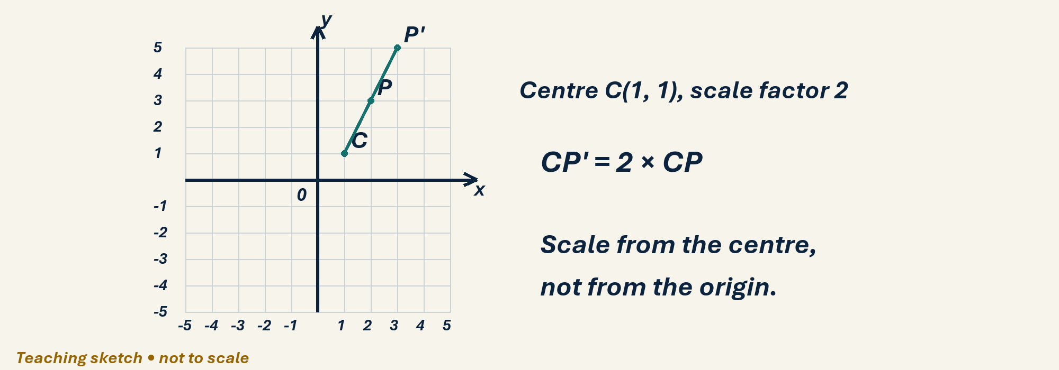
See the geometry
Use the diagram and practical sheet.
Reach for the Star | GCSE Mathematics
★ SHARE 4

Slide 5
Worked example and your turn
D1 • Explain each step
Model: centre origin, k=2 sends (2,1) to (4,2). Enlarge (3,2) by k=3 about origin.
Try the paired problem; check independently.
Reach for the Star | GCSE Mathematics
★ PRESENT 5

Slide 6
Worked example and your turn
D2 • Explain each step
Model: centre origin, k=1/2 sends (6,4) to (3,2). Enlarge (8,6) by k=1/2.
Try the paired problem; check independently.
Reach for the Star | GCSE Mathematics
★ PRESENT 6

Slide 7
Worked example and your turn
D3 • Explain each step
Model: C(1,1), P(3,1), k=2 gives P′(5,1). Now C(1,1), P(2,3), k=2.
Try the paired problem; check independently.
Reach for the Star | GCSE Mathematics
★ PRESENT 7

Slide 8
Worked example and your turn
D4 • Explain each step
Model: side 4→10 gives k=2.5. A matching side is 6→9. Find k and the image of a 4 cm side.
Try the paired problem; check independently.
Reach for the Star | GCSE Mathematics
★ PRESENT 8

Slide 9

A method you can explain
Name the fact or construction at each step.
Check against the original question.
Reach for the Star | GCSE Mathematics
★ PRESENT 9

Slide 10
Diagnostic pause
Choose and explain before moving on.
Centre (1,1), point (3,1), factor 2. Image A (6,2), B (5,1), C (4,1).
Use your explanation to decide the next step.
Reach for the Star | GCSE Mathematics
★ CONNECT & CHECK 10

Slide 11
Careful variation
A1 • Show your reasoning
Centre origin: enlarge (4,2) with k=2, k=1, k=1/2. Compare positions.
Explain your decisions and check the result.
Reach for the Star | GCSE Mathematics
★ APPLY 11

Slide 12
Independent application
A2 • Show your reasoning
Triangle (1,1),(3,1),(1,2), centre origin, k=2. Give image vertices and a side-length check.
Explain your decisions and check the result.
Reach for the Star | GCSE Mathematics
★ APPLY 12

Slide 13
Use the method in context
A3 • Show your reasoning
Centre C(1,1), triangle P(2,1),Q(4,1),R(2,3), k=1/2. Find all image vertices.
Explain your decisions and check the result.
Reach for the Star | GCSE Mathematics
★ APPLY 13

Slide 14
Intentional practice feedback
Read after attempting A3
P′(1.5,1), Q′(2.5,1), R′(1.5,2).
Correct one step and explain the change.
Reach for the Star | GCSE Mathematics
★ APPLY 14

Slide 15
A claim to test
C1 • Show your reasoning
A factor 1/2 makes every angle half as large. Explain the error.
Explain your decisions and check the result.
Reach for the Star | GCSE Mathematics
★ APPLY 15

Slide 16
Deepen the reasoning
C2 • Show your reasoning
A shape is enlarged by factor 3/4. Its image has a side of length 9 cm. Find the original side and explain why it must be longer.
Explain your decisions and check the result.
Reach for the Star | GCSE Mathematics
★ APPLY 16

Slide 17
Retrieval without notes
Q1–Q3 • Numeric answers
x of (3,2), origin, factor 2
y of (8,6), origin, factor 1/2
Factor for side 4→10
Reach for the Star | GCSE Mathematics
★ RECALL & REVIEW 17

Slide 18
Retrieval without notes
Q4–Q6 • Numeric answers
Image length of 12 at factor 1/4
x of P(3,1), centre (1,1), factor 2
Original length if image is 3 and factor 1/2
Reach for the Star | GCSE Mathematics
★ RECALL & REVIEW 18

Slide 19
Independent exit evidence
P1 • Without notes • Teacher review
Enlarge P(2,3) by factor 2 about C(1,1), showing displacement. [2]
Show working and check your answer.
Reach for the Star | GCSE Mathematics
★ RECALL & REVIEW 19

Slide 20
Independent exit evidence
P2 • Without notes • Teacher review
A 10 cm side becomes 4 cm. Find the scale factor and the image of a 15 cm side. [2]
Show working and check your answer.
Reach for the Star | GCSE Mathematics
★ RECALL & REVIEW 20

Slide 21
Feedback and next steps
P3 • Completion is not mastery
Explain one error you have corrected.
Set a fresh question and a delayed check.
Reach for the Star | GCSE Mathematics
★ RECALL & REVIEW 21

Slide 22
Before the next lesson
L031: Bearings and scale drawings
Complete F1 tomorrow without notes.
Attempt F2 and bring one question.
Reach for the Star | GCSE Mathematics
★ APPLY 22

Slide 23
Negative enlargement
Higher alternative • Model • 3 min
C(1, 1), P(3, 2), factor −2
(2, 1) → (−4, −2); P′ = (−3, −1)
Reach for the Star | GCSE Mathematics
★ APPLY 23

Slide 24
Reverse direction from the centre
Higher alternative • H1–H2 • 3 min
Negative factor: opposite side of centre.
Length ratio uses the positive magnitude.
Reach for the Star | GCSE Mathematics
★ APPLY 24

Slide 25
Independent Higher evidence
HX1 • 2 marks • 2 min
C(1, 1), P(3, 4), scale factor −2
Show the displacement and image.
Reach for the Star | GCSE Mathematics
★ APPLY 25

Slide 26
Independent Higher evidence
HX2 • 2 marks • 2 min
Does factor −1 make lengths negative?
Explain and describe the image position.
Reach for the Star | GCSE Mathematics
★ APPLY 26

Slide 27

Optional stretch
Enlarge a rectangle 3 cm by 5 cm by factor 2.5. Find new area.
Show a method. Explain a check or counterexample.
L030 · Extension A

Slide 28
Optional deep challenge
An enlargement factor is −2 about the origin. Where does (3,−4) map, and what happens to orientation?
Show a method. Explain a check or counterexample.
L030 · Extension B

Slide 29
L030 Recall & Review
Enlargement and scale factors
Fresh evidence: prove the objective
Solve a new question without prompts. Explain one check, then correct one error in your working.
Objective: Enlarge shapes from a stated centre, including positive fractional factors, and explain how centre and factor determine the image.
Write the next practice step before you leave. It must test the method again, not simply copy today’s example.
Reach for the Star · GCSE Maths · Recall & Review

Slide 30
Feedback language
Use the full phrases before the abbreviations.
What Went Well (WWW)
Even Better If (EBI)
I selected the correct geometric fact, theorem, formula or transformation and used a clear diagram with appropriate labels and units.
I will name the fact or theorem, show the substitution or construction step and check whether the size, direction and units of the result are reasonable.
Identify the mathematical method, representation, reasoning or check that improved.
Set one precise next-step action and test it on a fresh question.
Reach for the Star · GCSE Maths · Recall & Review

Slide 31
Extension route
Choose this route only after the core evidence is secure.
Stretch
Enlarge a rectangle 3 cm by 5 cm by factor 2.5. Find new area.
Deep challenge
An enlargement factor is −2 about the origin. Where does (3,−4) map, and what happens to orientation?
Explain your reasoning clearly enough that another learner could check it.
Reach for the Star · GCSE Maths · Recall & Review

