Slide 1


Bearings and scale drawings
Pearson Edexcel GCSE Mathematics 1MA1
L031 • Geometry and measures
60 minute lesson | learner resources
Reach for the Star | GCSE Mathematics
★ CONNECT & CHECK 1

Slide 2
The goal and the evidence
Connect & Check → Share → Present → Apply → Recall & Review
Interpret three-figure bearings and construct scale drawings with accurate distance and direction.
Explain, apply and check independently.
Reach for the Star | GCSE Mathematics
★ CONNECT & CHECK 2

Slide 3
Starting-point diagnostic
R1–R3 • Attempt without notes
Convert 1 km to metres.
At 1 cm:2 km, what real distance is 3 cm?
Find 180+65.
Reach for the Star | GCSE Mathematics
★ CONNECT & CHECK 3

Slide 4
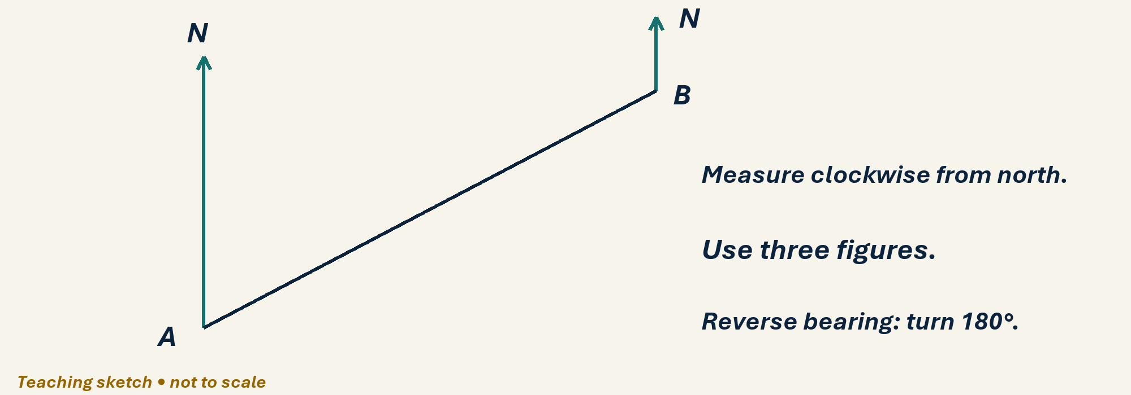
See the geometry
Use the diagram and practical sheet.
Reach for the Star | GCSE Mathematics
★ SHARE 4

Slide 5
Worked example and your turn
D1 • Explain each step
Model: east is bearing 090°. State bearings of south and west.
Try the paired problem; check independently.
Reach for the Star | GCSE Mathematics
★ PRESENT 5

Slide 6
Worked example and your turn
D2 • Explain each step
Model: forward 060° reverses to 240°. Reverse bearing 125°.
Try the paired problem; check independently.
Reach for the Star | GCSE Mathematics
★ PRESENT 6

Slide 7
Worked example and your turn
D3 • Explain each step
Model: forward 230° reverses to 050°. Reverse bearing 310°.
Try the paired problem; check independently.
Reach for the Star | GCSE Mathematics
★ PRESENT 7

Slide 8
Worked example and your turn
D4 • Explain each step
Model: scale 1 cm:2 km makes 6 km into 3 cm. Draw an 8 km route at bearing 060° using this scale.
Try the paired problem; check independently.
Reach for the Star | GCSE Mathematics
★ PRESENT 8

Slide 9

A method you can explain
Name the fact or construction at each step.
Check against the original question.
Reach for the Star | GCSE Mathematics
★ PRESENT 9

Slide 10
Diagnostic pause
Choose and explain before moving on.
Bearing from A to B is 070°. Bearing B to A? A 110°, B 250°, C 290°.
Use your explanation to decide the next step.
Reach for the Star | GCSE Mathematics
★ CONNECT & CHECK 10

Slide 11
Careful variation
A1 • Show your reasoning
At 1 cm:2 km, find paper lengths for 4, 6 and 10 km.
Explain your decisions and check the result.
Reach for the Star | GCSE Mathematics
★ APPLY 11

Slide 12
Independent application
A2 • Show your reasoning
At scale 1:50 000, a route measures 7.2 cm. Find its real length in kilometres.
Explain your decisions and check the result.
Reach for the Star | GCSE Mathematics
★ APPLY 12

Slide 13
Use the method in context
A3 • Show your reasoning
A boat travels 6 km on bearing 090°, then 4 km on bearing 000°. Draw at 1 cm:2 km; estimate direct distance and bearing from start.
Explain your decisions and check the result.
Reach for the Star | GCSE Mathematics
★ APPLY 13

Slide 14
Intentional practice feedback
Read after attempting A3
About 7.2 km and 056°.
Correct one step and explain the change.
Reach for the Star | GCSE Mathematics
★ APPLY 14

Slide 15
A claim to test
C1 • Show your reasoning
A learner gives 360−70=290° as the reverse of 070°. Explain using compass directions.
Explain your decisions and check the result.
Reach for the Star | GCSE Mathematics
★ APPLY 15

Slide 16
Deepen the reasoning
C2 • Show your reasoning
Two pupils use 1 cm:1 km and 1 cm:2 km for the same route. Should the measured bearing change? Explain.
Explain your decisions and check the result.
Reach for the Star | GCSE Mathematics
★ APPLY 16

Slide 17
Retrieval without notes
Q1–Q3 • Numeric answers
Bearing of east, numeric degrees
Reverse of 070°, numeric degrees
Reverse of 310°, numeric degrees
Reach for the Star | GCSE Mathematics
★ RECALL & REVIEW 17

Slide 18
Retrieval without notes
Q4–Q6 • Numeric answers
km represented by 4 cm at 1 cm:2 km
cm for 10 km at 1 cm:2 km
Metres in 2.5 km
Reach for the Star | GCSE Mathematics
★ RECALL & REVIEW 18

Slide 19
Independent exit evidence
P1 • Without notes • Teacher review
The bearing from A to B is 245°. Find B to A and explain. [2]
Show working and check your answer.
Reach for the Star | GCSE Mathematics
★ RECALL & REVIEW 19

Slide 20
Independent exit evidence
P2 • Without notes • Teacher review
A scale 1:25 000 route is 8 cm. Find its real length in km, showing conversion. [2]
Show working and check your answer.
Reach for the Star | GCSE Mathematics
★ RECALL & REVIEW 20

Slide 21
Feedback and next steps
P3 • Completion is not mastery
Explain one error you have corrected.
Set a fresh question and a delayed check.
Reach for the Star | GCSE Mathematics
★ RECALL & REVIEW 21

Slide 22
Before the next lesson
L032: Geometry checkpoint and feedback
Complete F1 tomorrow without notes.
Attempt F2 and bring one question.
Reach for the Star | GCSE Mathematics
★ APPLY 22

Slide 23

Optional stretch
A map scale is 1 cm:4 km. Two points are 7.5 cm apart. Find actual distance.
Show a method. Explain a check or counterexample.
L031 · Extension A

Slide 24
Optional deep challenge
The bearing of B from A is 065°. Find the bearing of A from B.
Show a method. Explain a check or counterexample.
L031 · Extension B

Slide 25
L031 Recall & Review
Bearings and scale drawings
Fresh evidence: prove the objective
Solve a new question without prompts. Explain one check, then correct one error in your working.
Objective: Interpret three-figure bearings and construct scale drawings with accurate distance and direction.
Write the next practice step before you leave. It must test the method again, not simply copy today’s example.
Reach for the Star · GCSE Maths · Recall & Review

Slide 26
Feedback language
Use the full phrases before the abbreviations.
What Went Well (WWW)
Even Better If (EBI)
I selected the correct geometric fact, theorem, formula or transformation and used a clear diagram with appropriate labels and units.
I will name the fact or theorem, show the substitution or construction step and check whether the size, direction and units of the result are reasonable.
Identify the mathematical method, representation, reasoning or check that improved.
Set one precise next-step action and test it on a fresh question.
Reach for the Star · GCSE Maths · Recall & Review

Slide 27
Extension route
Choose this route only after the core evidence is secure.
Stretch
A map scale is 1 cm:4 km. Two points are 7.5 cm apart. Find actual distance.
Deep challenge
The bearing of B from A is 065°. Find the bearing of A from B.
Explain your reasoning clearly enough that another learner could check it.
Reach for the Star · GCSE Maths · Recall & Review

