Slide 1


Geometry checkpoint and feedback
Pearson Edexcel GCSE Mathematics 1MA1
L032 • Geometry and measures
60 minute lesson | learner resources
Reach for the Star | GCSE Mathematics
★ CONNECT & CHECK 1

Slide 2
The goal and the evidence
Connect & Check → Share → Present → Apply → Recall & Review
Use independent geometry evidence to identify misconceptions, complete a targeted repair and demonstrate transfer.
Explain, apply and check independently.
Reach for the Star | GCSE Mathematics
★ CONNECT & CHECK 2

Slide 3
Starting-point diagnostic
R1–R3 • Attempt without notes
Find a co-interior partner of 118° on parallel lines.
Reflect (5,1) in x=2.
At scale 1:50 000, convert 6 cm to km.
Reach for the Star | GCSE Mathematics
★ CONNECT & CHECK 3

Slide 4
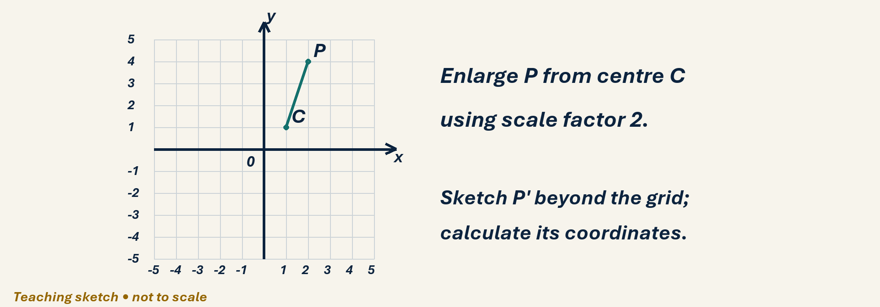
See the geometry
Use the diagram and practical sheet.
Reach for the Star | GCSE Mathematics
★ SHARE 4

Slide 5
Worked example and your turn
D1 • Explain each step
Model repair: co-interior 130° leaves 50°, not 130°. Now find the partner of 107°.
Try the paired problem; check independently.
Reach for the Star | GCSE Mathematics
★ PRESENT 5

Slide 6
Worked example and your turn
D2 • Explain each step
Model repair: reflect (4,2) in x=1 gives (−2,2). Now reflect (6,−1) in x=2.
Try the paired problem; check independently.
Reach for the Star | GCSE Mathematics
★ PRESENT 6

Slide 7
Worked example and your turn
D3 • Explain each step
Model repair: reverse 230° is 050°, not 130°. Now reverse 285°.
Try the paired problem; check independently.
Reach for the Star | GCSE Mathematics
★ PRESENT 7

Slide 8
Worked example and your turn
D4 • Explain each step
Model repair: 1 cm:2 km means 7 cm is 14 km. Now 1 cm:3 km; find real distance for 4.5 cm.
Try the paired problem; check independently.
Reach for the Star | GCSE Mathematics
★ PRESENT 8

Slide 9

A method you can explain
Name the fact or construction at each step.
Check against the original question.
Reach for the Star | GCSE Mathematics
★ PRESENT 9

Slide 10
Diagnostic pause
Choose and explain before moving on.
A learner finds 60° but writes angles around a point total 180°. Is the reasoning secure? A yes, B no.
Use your explanation to decide the next step.
Reach for the Star | GCSE Mathematics
★ CONNECT & CHECK 10

Slide 11
Careful variation
A1 • Show your reasoning
Triangle angles 42°,68°,x°; regular hexagon interior y°; co-interior partner z° of 72°. Find x,y,z with reasons.
Explain your decisions and check the result.
Reach for the Star | GCSE Mathematics
★ APPLY 11

Slide 12
Independent application
A2 • Show your reasoning
Enlarge (3,2) by k=2 about (1,1), then describe why (6,4) is wrong.
Explain your decisions and check the result.
Reach for the Star | GCSE Mathematics
★ APPLY 12

Slide 13
Use the method in context
A3 • Show your reasoning
At scale 1:25 000 a path is 12 cm long on bearing 065°. Find real length and reverse bearing.
Explain your decisions and check the result.
Reach for the Star | GCSE Mathematics
★ APPLY 13

Slide 14
Intentional practice feedback
Read after attempting A3
3 km; 245°.
Correct one step and explain the change.
Reach for the Star | GCSE Mathematics
★ APPLY 14

Slide 15
A claim to test
C1 • Show your reasoning
A learner scores full retrieval points immediately after reading feedback. What further evidence would support retained learning?
Explain your decisions and check the result.
Reach for the Star | GCSE Mathematics
★ APPLY 15

Slide 16
Deepen the reasoning
C2 • Show your reasoning
Two triangles have angles 40°,60°,80°. Can you claim congruence? Give a reason or counterexample.
Explain your decisions and check the result.
Reach for the Star | GCSE Mathematics
★ APPLY 16

Slide 17
Retrieval without notes
Q1–Q3 • Numeric answers
Co-interior partner of 118°, degrees
Regular hexagon interior, degrees
Reverse bearing 285°, numeric degrees
Reach for the Star | GCSE Mathematics
★ RECALL & REVIEW 17

Slide 18
Retrieval without notes
Q4–Q6 • Numeric answers
km for 6 cm at 1:50 000
x of reflection (5,1) in x=2
Triangle third: 42°,68°, degrees
Reach for the Star | GCSE Mathematics
★ RECALL & REVIEW 18

Slide 19
Independent exit evidence
P1 • Without notes • Teacher review
A regular polygon has exterior angle 30°. Find sides and interior angle. [2]
Show working and check your answer.
Reach for the Star | GCSE Mathematics
★ RECALL & REVIEW 19

Slide 20
Independent exit evidence
P2 • Without notes • Teacher review
Enlarge (2,4) by k=2 about (1,1), showing displacement. [2]
Show working and check your answer.
Reach for the Star | GCSE Mathematics
★ RECALL & REVIEW 20

Slide 21
Feedback and next steps
P3 • Completion is not mastery
Explain one error you have corrected.
Set a fresh question and a delayed check.
Reach for the Star | GCSE Mathematics
★ RECALL & REVIEW 21

Slide 22
Before the next lesson
L033: Perimeter and compound area
Complete F1 tomorrow without notes.
Attempt F2 and bring one question.
Reach for the Star | GCSE Mathematics
★ APPLY 22

Slide 23

Optional stretch
A regular hexagon has side 6 cm. Find perimeter and each exterior angle.
Show a method. Explain a check or counterexample.
L032 · Extension A

Slide 24
Optional deep challenge
A shape is enlarged by factor 3 and its original perimeter is 18 cm. A learner says new area is three times. Correct the reasoning.
Show a method. Explain a check or counterexample.
L032 · Extension B

Slide 25
L032 Recall & Review
Geometry checkpoint and feedback
Fresh evidence: prove the objective
Solve a new question without prompts. Explain one check, then correct one error in your working.
Objective: Use independent geometry evidence to identify misconceptions, complete a targeted repair and demonstrate transfer.
Write the next practice step before you leave. It must test the method again, not simply copy today’s example.
Reach for the Star · GCSE Maths · Recall & Review

Slide 26
Feedback language
Use the full phrases before the abbreviations.
What Went Well (WWW)
Even Better If (EBI)
I used my working and assessment evidence to identify the exact mathematical step that was secure and the specific misconception that needs attention.
I will correct one precise step, explain why the correction works and complete a fresh delayed question without the original scaffold.
Identify the mathematical method, representation, reasoning or check that improved.
Set one precise next-step action and test it on a fresh question.
Reach for the Star · GCSE Maths · Recall & Review

Slide 27
Extension route
Choose this route only after the core evidence is secure.
Stretch
A regular hexagon has side 6 cm. Find perimeter and each exterior angle.
Deep challenge
A shape is enlarged by factor 3 and its original perimeter is 18 cm. A learner says new area is three times. Correct the reasoning.
Explain your reasoning clearly enough that another learner could check it.
Reach for the Star · GCSE Maths · Recall & Review

