Slide 1


Perimeter and compound area
Pearson Edexcel GCSE Mathematics 1MA1
L033 • Geometry and measures
60 minute lesson | learner resources
Reach for the Star | GCSE Mathematics
★ CONNECT & CHECK 1

Slide 2
The goal and the evidence
Connect & Check → Share → Present → Apply → Recall & Review
Calculate perimeters and areas of compound rectilinear shapes, triangles, parallelograms and trapezia with correct units.
Explain, apply and check independently.
Reach for the Star | GCSE Mathematics
★ CONNECT & CHECK 2

Slide 3
Starting-point diagnostic
R1–R3 • Attempt without notes
Find perimeter of a 6 cm by 4 cm rectangle.
Find its area.
Convert 1 cm² to mm².
Reach for the Star | GCSE Mathematics
★ CONNECT & CHECK 3

Slide 4
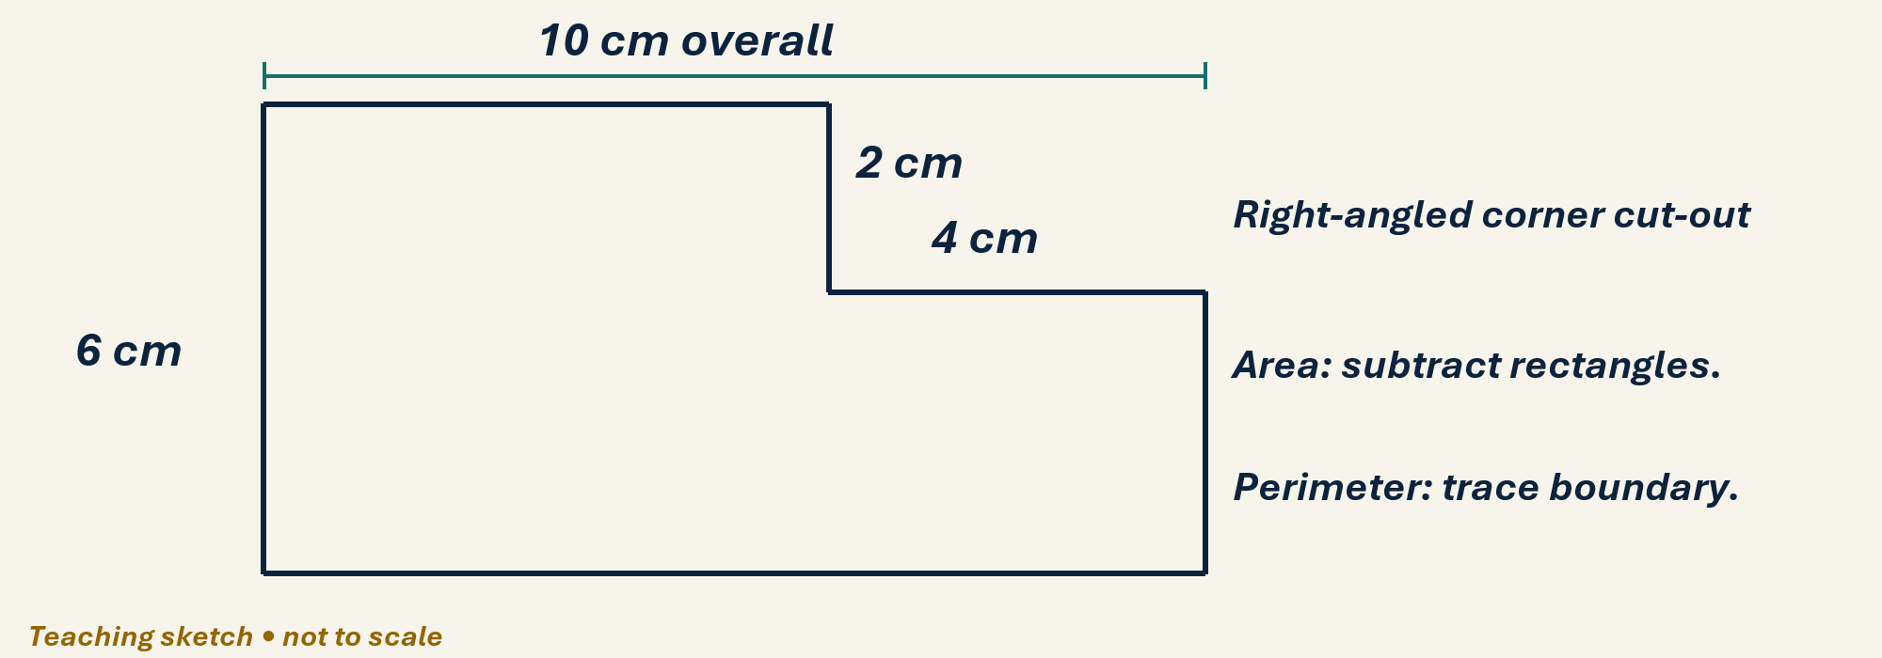
See the geometry
Use the diagram and practical sheet.
Reach for the Star | GCSE Mathematics
★ SHARE 4

Slide 5
Worked example and your turn
D1 • Explain each step
Model: rectangle 8×5 cm with a 3×2 cm corner removed has area 40−6=34 cm². Now 10×6 cm minus a 4×2 cm corner.
Try the paired problem; check independently.
Reach for the Star | GCSE Mathematics
★ PRESENT 5

Slide 6
Worked example and your turn
D2 • Explain each step
Model: triangle base 8 cm, height 3 cm has area 12 cm². Now base 10 cm, perpendicular height 7 cm.
Try the paired problem; check independently.
Reach for the Star | GCSE Mathematics
★ PRESENT 6

Slide 7
Worked example and your turn
D3 • Explain each step
Model: parallelogram base 6 cm, height 4 cm has area 24 cm². Now base 9 cm, height 5 cm.
Try the paired problem; check independently.
Reach for the Star | GCSE Mathematics
★ PRESENT 7

Slide 8
Worked example and your turn
D4 • Explain each step
Model: trapezium parallel sides 4,8 cm and height 3 cm has area 18 cm². Now sides 5,9 cm, height 4 cm.
Try the paired problem; check independently.
Reach for the Star | GCSE Mathematics
★ PRESENT 8

Slide 9

A method you can explain
Name the fact or construction at each step.
Check against the original question.
Reach for the Star | GCSE Mathematics
★ PRESENT 9

Slide 10
Diagnostic pause
Choose and explain before moving on.
A triangle has base 8 cm, perpendicular height 3 cm, sloping side 5 cm. Area? A 12, B 20, C 24 cm².
Use your explanation to decide the next step.
Reach for the Star | GCSE Mathematics
★ CONNECT & CHECK 10

Slide 11
Careful variation
A1 • Show your reasoning
With base 8 cm and height 5 cm, compare rectangle/parallelogram area with triangle area.
Explain your decisions and check the result.
Reach for the Star | GCSE Mathematics
★ APPLY 11

Slide 12
Independent application
A2 • Show your reasoning
For a 10×6 cm rectangle with a 4×2 cm corner removed, find area and perimeter.
Explain your decisions and check the result.
Reach for the Star | GCSE Mathematics
★ APPLY 12

Slide 13
Use the method in context
A3 • Show your reasoning
A floor is an 8 m by 5 m rectangle with a 3 m by 2 m corner missing. Tiles cover 0.5 m² each. Find tiles needed, ignoring waste.
Explain your decisions and check the result.
Reach for the Star | GCSE Mathematics
★ APPLY 13

Slide 14
Intentional practice feedback
Read after attempting A3
34 m²; 68 tiles.
Correct one step and explain the change.
Reach for the Star | GCSE Mathematics
★ APPLY 14

Slide 15
A claim to test
C1 • Show your reasoning
A square and rectangle have the same perimeter. Must their areas match? Give a counterexample.
Explain your decisions and check the result.
Reach for the Star | GCSE Mathematics
★ APPLY 15

Slide 16
Deepen the reasoning
C2 • Show your reasoning
Removing a rectangular corner always reduces perimeter. Test a 10×6 rectangle with a 4×2 corner removed.
Explain your decisions and check the result.
Reach for the Star | GCSE Mathematics
★ APPLY 16

Slide 17
Retrieval without notes
Q1–Q3 • Numeric answers
Area 6×4 rectangle, in cm²
Perimeter 6×4 rectangle, in cm
Triangle b=10,h=7: area in cm²
Reach for the Star | GCSE Mathematics
★ RECALL & REVIEW 17

Slide 18
Retrieval without notes
Q4–Q6 • Numeric answers
Trapezium a=5,b=9,h=4: area in cm²
Area 10×6 minus 4×2, in cm²
mm² in 1 cm²
Reach for the Star | GCSE Mathematics
★ RECALL & REVIEW 18

Slide 19
Independent exit evidence
P1 • Without notes • Teacher review
Find the area of a trapezium with parallel sides 6,10 cm and height 5 cm. Show working. [2]
Show working and check your answer.
Reach for the Star | GCSE Mathematics
★ RECALL & REVIEW 19

Slide 20
Independent exit evidence
P2 • Without notes • Teacher review
A 9×6 cm rectangle has a 2×3 cm corner removed. Find its area and perimeter. [2]
Show working and check your answer.
Reach for the Star | GCSE Mathematics
★ RECALL & REVIEW 20

Slide 21
Feedback and next steps
P3 • Completion is not mastery
Explain one error you have corrected.
Set a fresh question and a delayed check.
Reach for the Star | GCSE Mathematics
★ RECALL & REVIEW 21

Slide 22
Before the next lesson
L034: Circles arcs and sectors
Complete F1 tomorrow without notes.
Attempt F2 and bring one question.
Reach for the Star | GCSE Mathematics
★ APPLY 22

Slide 23

Optional stretch
A rectangle 12 cm by 8 cm has a 3 cm by 2 cm corner cut out. Find area and perimeter.
Show a method. Explain a check or counterexample.
L033 · Extension A

Slide 24
Optional deep challenge
Two shapes each have area 36 cm². Must their perimeters be equal? Give a counterexample.
Show a method. Explain a check or counterexample.
L033 · Extension B

Slide 25
L033 Recall & Review
Perimeter and compound area
Fresh evidence: prove the objective
Solve a new question without prompts. Explain one check, then correct one error in your working.
Objective: Calculate perimeters and areas of compound rectilinear shapes, triangles, parallelograms and trapezia with correct units.
Write the next practice step before you leave. It must test the method again, not simply copy today’s example.
Reach for the Star · GCSE Maths · Recall & Review

Slide 26
Feedback language
Use the full phrases before the abbreviations.
What Went Well (WWW)
Even Better If (EBI)
I selected the correct geometric fact, theorem, formula or transformation and used a clear diagram with appropriate labels and units.
I will name the fact or theorem, show the substitution or construction step and check whether the size, direction and units of the result are reasonable.
Identify the mathematical method, representation, reasoning or check that improved.
Set one precise next-step action and test it on a fresh question.
Reach for the Star · GCSE Maths · Recall & Review

Slide 27
Extension route
Choose this route only after the core evidence is secure.
Stretch
A rectangle 12 cm by 8 cm has a 3 cm by 2 cm corner cut out. Find area and perimeter.
Deep challenge
Two shapes each have area 36 cm². Must their perimeters be equal? Give a counterexample.
Explain your reasoning clearly enough that another learner could check it.
Reach for the Star · GCSE Maths · Recall & Review

