Slide 1


Circles arcs and sectors
Pearson Edexcel GCSE Mathematics 1MA1
L034 • Geometry and measures
60 minute lesson | learner resources
Reach for the Star | GCSE Mathematics
★ CONNECT & CHECK 1

Slide 2
The goal and the evidence
Connect & Check → Share → Present → Apply → Recall & Review
Calculate circle circumference and area, arc length and sector area, distinguishing curved length from the full sector perimeter.
Explain, apply and check independently.
Reach for the Star | GCSE Mathematics
★ CONNECT & CHECK 2

Slide 3
Starting-point diagnostic
R1–R3 • Attempt without notes
Radius 5 cm: find diameter.
What fraction of a full turn is 90°?
Find 6².
Reach for the Star | GCSE Mathematics
★ CONNECT & CHECK 3

Slide 4
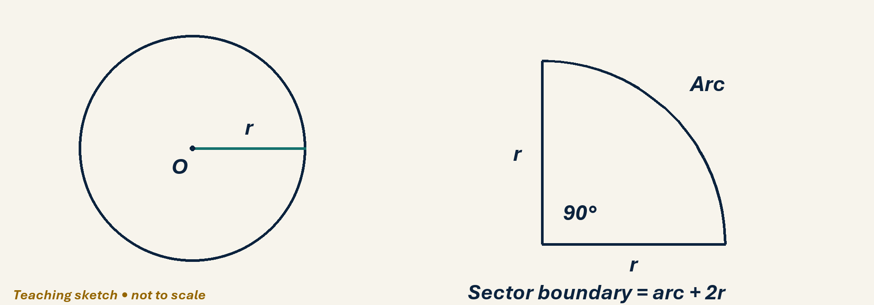
See the geometry
Use the diagram and practical sheet.
Reach for the Star | GCSE Mathematics
★ SHARE 4

Slide 5
Worked example and your turn
D1 • Explain each step
Model: r=3 gives C=6π cm. Now diameter=10 cm; give exact circumference.
Try the paired problem; check independently.
Reach for the Star | GCSE Mathematics
★ PRESENT 5

Slide 6
Worked example and your turn
D2 • Explain each step
Model: r=3 gives area 9π cm². Now diameter=8 cm; give exact area.
Try the paired problem; check independently.
Reach for the Star | GCSE Mathematics
★ PRESENT 6

Slide 7
Worked example and your turn
D3 • Explain each step
Model: r=6, θ=90° gives arc (1/4)×12π=3π cm. Now r=6, θ=120°.
Try the paired problem; check independently.
Reach for the Star | GCSE Mathematics
★ PRESENT 7

Slide 8
Worked example and your turn
D4 • Explain each step
Model: r=6, θ=90° gives area 9π cm². Now r=6, θ=120°; find sector area and perimeter.
Try the paired problem; check independently.
Reach for the Star | GCSE Mathematics
★ PRESENT 8

Slide 9

A method you can explain
Name the fact or construction at each step.
Check against the original question.
Reach for the Star | GCSE Mathematics
★ PRESENT 9

Slide 10
Diagnostic pause
Choose and explain before moving on.
A quarter-circle sector has r=4 cm. Its perimeter is A 2π, B 2π+8, C 4π cm.
Use your explanation to decide the next step.
Reach for the Star | GCSE Mathematics
★ CONNECT & CHECK 10

Slide 11
Careful variation
A1 • Show your reasoning
For r=4 cm, find circumference, semicircle arc and quarter-circle arc exactly.
Explain your decisions and check the result.
Reach for the Star | GCSE Mathematics
★ APPLY 11

Slide 12
Independent application
A2 • Show your reasoning
A sector has r=8 cm and θ=90°. Find area and perimeter exactly.
Explain your decisions and check the result.
Reach for the Star | GCSE Mathematics
★ APPLY 12

Slide 13
Use the method in context
A3 • Show your reasoning
A circular pond has diameter 10 m. Find fencing for the whole edge, to 1 decimal place, and area to 1 decimal place.
Explain your decisions and check the result.
Reach for the Star | GCSE Mathematics
★ APPLY 13

Slide 14
Intentional practice feedback
Read after attempting A3
31.4 m; 78.5 m².
Correct one step and explain the change.
Reach for the Star | GCSE Mathematics
★ APPLY 14

Slide 15
A claim to test
C1 • Show your reasoning
Doubling radius doubles both circumference and area. Assess the claim.
Explain your decisions and check the result.
Reach for the Star | GCSE Mathematics
★ APPLY 15

Slide 16
Deepen the reasoning
C2 • Show your reasoning
A semicircular garden of radius 3 m needs a fence round its full boundary. Explain why 3π m is insufficient.
Explain your decisions and check the result.
Reach for the Star | GCSE Mathematics
★ APPLY 16

Slide 17
Retrieval without notes
Q1–Q3 • Numeric answers
Diameter for radius 7 cm
Radius for diameter 18 cm
Fraction of full circle for 120°
Reach for the Star | GCSE Mathematics
★ RECALL & REVIEW 17

Slide 18
Retrieval without notes
Q4–Q6 • Numeric answers
Coefficient of π in area for r=5
Coefficient of π in circumference for d=12
Coefficient of π in quarter arc for r=8
Reach for the Star | GCSE Mathematics
★ RECALL & REVIEW 18

Slide 19
Independent exit evidence
P1 • Without notes • Teacher review
Find sector area for r=6 cm and angle 60°, exactly. Show method. [2]
Show working and check your answer.
Reach for the Star | GCSE Mathematics
★ RECALL & REVIEW 19

Slide 20
Independent exit evidence
P2 • Without notes • Teacher review
Find perimeter of a quarter-circle sector with radius 6 cm, exactly. [2]
Show working and check your answer.
Reach for the Star | GCSE Mathematics
★ RECALL & REVIEW 20

Slide 21
Feedback and next steps
P3 • Completion is not mastery
Explain one error you have corrected.
Set a fresh question and a delayed check.
Reach for the Star | GCSE Mathematics
★ RECALL & REVIEW 21

Slide 22
Before the next lesson
L035: Prisms and cylinders
Complete F1 tomorrow without notes.
Attempt F2 and bring one question.
Reach for the Star | GCSE Mathematics
★ APPLY 22

Slide 23

Optional stretch
A sector has radius 9 cm and angle 80°. Find arc length and area exactly.
Show a method. Explain a check or counterexample.
L034 · Extension A

Slide 24
Optional deep challenge
A learner finds the perimeter of a semicircle of radius 5 cm as 5π cm. Explain the missing part.
Show a method. Explain a check or counterexample.
L034 · Extension B

Slide 25
L034 Recall & Review
Circles arcs and sectors
Fresh evidence: prove the objective
Solve a new question without prompts. Explain one check, then correct one error in your working.
Objective: Calculate circle circumference and area, arc length and sector area, distinguishing curved length from the full sector perimeter.
Write the next practice step before you leave. It must test the method again, not simply copy today’s example.
Reach for the Star · GCSE Maths · Recall & Review

Slide 26
Feedback language
Use the full phrases before the abbreviations.
What Went Well (WWW)
Even Better If (EBI)
I selected the correct geometric fact, theorem, formula or transformation and used a clear diagram with appropriate labels and units.
I will name the fact or theorem, show the substitution or construction step and check whether the size, direction and units of the result are reasonable.
Identify the mathematical method, representation, reasoning or check that improved.
Set one precise next-step action and test it on a fresh question.
Reach for the Star · GCSE Maths · Recall & Review

Slide 27
Extension route
Choose this route only after the core evidence is secure.
Stretch
A sector has radius 9 cm and angle 80°. Find arc length and area exactly.
Deep challenge
A learner finds the perimeter of a semicircle of radius 5 cm as 5π cm. Explain the missing part.
Explain your reasoning clearly enough that another learner could check it.
Reach for the Star · GCSE Maths · Recall & Review

