Slide 1

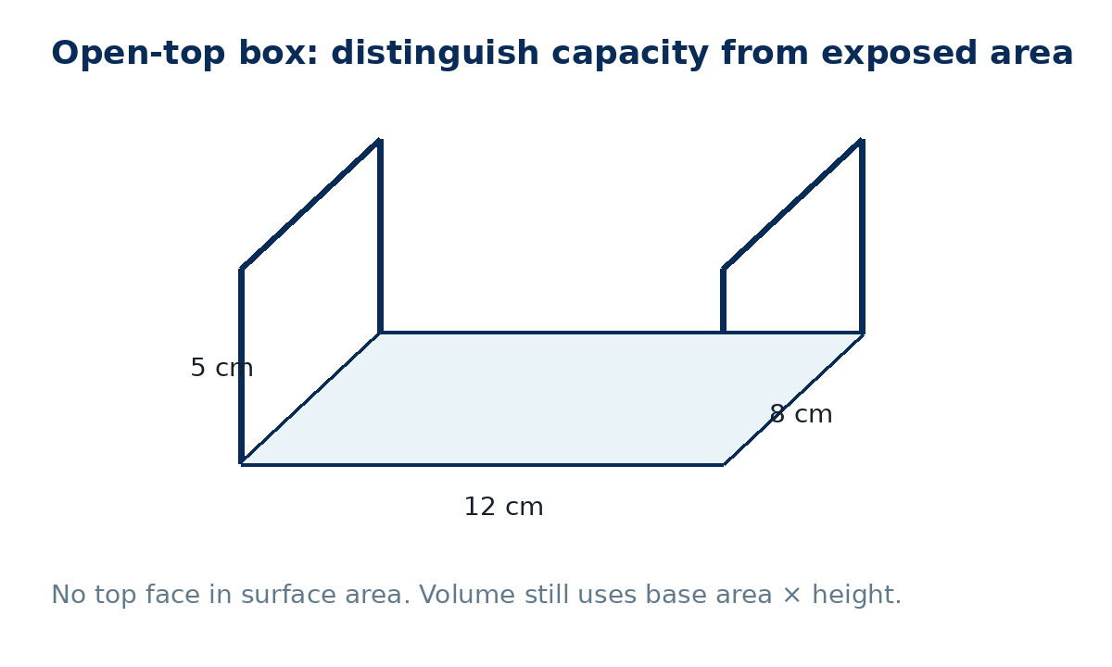
SURFACE AREA
AND VOLUME
GCSE Mathematics 1MA1 · L036 · 60 minutes
Week 12 · Reach for the Star Gold Standard

Slide 2
Objective and lesson route
Connect & Check
By the end of the lesson you will:
Running order
• find surface area from nets/faces
• find volume from an appropriate formula
• distinguish exposed area from capacity
• use square and cubic units correctly
• Connect & Check · 5 min
• Share · 5 min
• Present · 12 min
• Apply · 25 min
• Recall & Review · 8 min
NC = non-calculator · C = calculator. Keep π exact unless a decimal answer is requested.
GCSE Mathematics 1MA1 · L036 · Surface area and volume
2

Slide 3
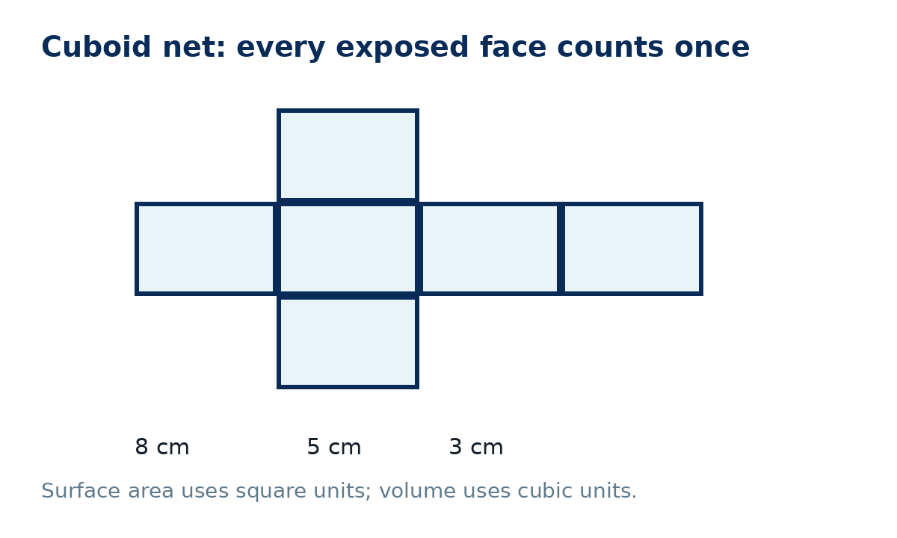
Baseline: what do you already know?
Connect & Check
Work independently · 5 minutes
• C1 [NC] A cuboid is 8 cm × 5 cm × 3 cm. Find its volume.
• C2 Explain the difference between surface area and volume. Include the type of units for each.
Keep this response. You will compare it with the exit task.
GCSE Mathematics 1MA1 · L036 · Surface area and volume
3

Slide 4
Choose your route
Share
Same destination. Different journey.
A · Visual
B · Method
C · Explain
Sketch/label a net before calculating.
Use a face table or formula; explain each term.
Start by stating which faces count and why.
Compare your route with a partner: what evidence would prove the objective?
GCSE Mathematics 1MA1 · L036 · Surface area and volume
4

Slide 5
Model 1: count exposed faces
Present
Cuboid 8 × 5 × 3
• Surface area = 2(lw + lh + wh)
• = 2(40 + 24 + 15)
• = 158 cm²
• Volume = lwh = 120 cm³
Check: square units for faces; cubic units for space.
GCSE Mathematics 1MA1 · L036 · Surface area and volume
5

Slide 6
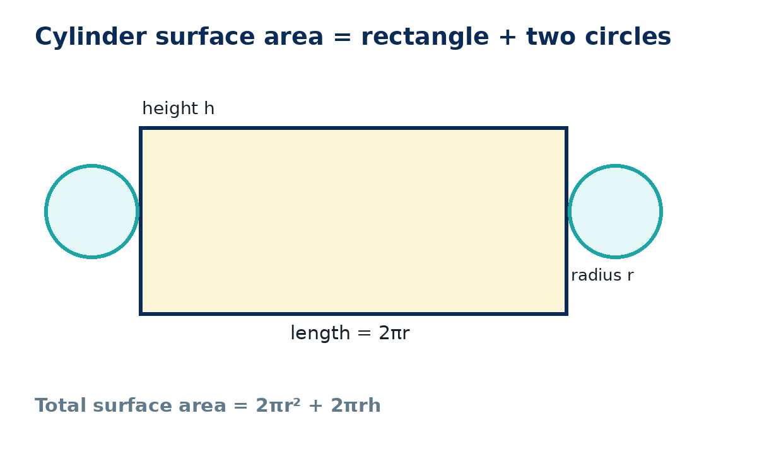
Model 2: unwrap a cylinder
Present
Closed cylinder
• two circles: 2πr²
• curved rectangle: 2πrh
• TSA = 2πr² + 2πrh
• Volume = πr²h
Radius 4 cm, height 9 cm → TSA = 104π cm²; V = 144π cm³.
GCSE Mathematics 1MA1 · L036 · Surface area and volume
6

Slide 7
Which method is correct?
Present
A learner says a closed cylinder has surface area 2πrh.
What have they forgotten?
• Identify the missing part.
• Explain why it must be included.
• Write the corrected formula.
Answer: the two circular ends · TSA = 2πr² + 2πrh
GCSE Mathematics 1MA1 · L036 · Surface area and volume
7

Slide 8
Supported practice
Apply
A1 [NC]
A cuboid is 10 cm × 6 cm × 4 cm. Find its total surface area.
Scaffold: 2(lw + lh + wh)
A2 [NC]
The same cuboid has volume 240 cm³. Explain why the units are cubic, not square.
When both are secure, remove the scaffold.
GCSE Mathematics 1MA1 · L036 · Surface area and volume
8

Slide 9
Independent practice: scaffold removed
Apply
A3 [C]
Closed cylinder: r = 3.5 cm, h = 12 cm. Find total surface area and volume to 1 d.p.
A4 [NC]
Open-top box: 12 cm × 8 cm × 5 cm. Find exposed surface area and capacity.
Show a separate check for each answer.
GCSE Mathematics 1MA1 · L036 · Surface area and volume
9

Slide 10
Exam-style practice
Apply
E1 [C] · 4 marks
A closed cylinder has radius 5 cm and height 7 cm. A learner uses 2πrh for its surface area. Explain the error and calculate the correct total surface area in terms of π.
E2 [NC] · 5 marks
A cuboid has volume 360 cm³. Its base is 12 cm by 5 cm. Find its height, then find its total surface area.
Exam tip: write the structure/formula before substituting. Units are part of the mathematical communication.
GCSE Mathematics 1MA1 · L036 · Surface area and volume
10

Slide 11
Stretch and deep challenge
Apply
Stretch [NC]
A closed cuboid has volume 120 cm³ and dimensions 4 cm × 5 cm × h. Find h and its total surface area.
Deep challenge [C]
A cylinder has radius r and height 2r. Express total surface area and volume in terms of r. What happens to each if r is doubled?
Do not rush to a decimal: reason algebraically.
GCSE Mathematics 1MA1 · L036 · Surface area and volume
11

Slide 12
Self-mark and repair
Apply
Use the teacher check to identify the first decision that went wrong.
• Was the solid open or closed?
• Did you count each required face once?
• Did you use radius rather than diameter?
• Did you keep square units for area and cubic units for volume?
• Did you round only at the end?
Repair one answer, then complete a fresh matched question without prompts.
GCSE Mathematics 1MA1 · L036 · Surface area and volume
12

Slide 13
Independent exit evidence
Recall & Review
Without notes · 5 minutes
A closed cuboid measures 9 cm × 4 cm × 2 cm.
• Find its total surface area.
• Find its volume.
• Use correct units.
• Show one check.
This is fresh evidence against the objective.
GCSE Mathematics 1MA1 · L036 · Surface area and volume
13

Slide 14
Distance travelled
Recall & Review
Compare Connect & Check with your exit evidence.
WWW
What is now more accurate, complete or clearly communicated?
EBI
What one action will improve your next surface-area/volume problem?
Record your next practice target in the workbook.
GCSE Mathematics 1MA1 · L036 · Surface area and volume
14

Slide 15
Core answers
Teacher check
• C1 120 cm³
• P1 surface area 158 cm²; volume 120 cm³
• P2 TSA 104π cm²; V 144π cm³
• A1 248 cm²
• A3 ≈ 340.9 cm²; ≈ 461.8 cm³
• A4 296 cm²; 480 cm³
• E1 120π cm²; two circular ends were omitted
• E2 h = 6 cm; surface area = 324 cm²
• Stretch: h = 6 cm; SA = 148 cm²
• Deep challenge: SA = 6πr²; V = 2πr³; doubling r ×4 area and ×8 volume
• Exit: 124 cm²; 72 cm³
GCSE Mathematics 1MA1 · L036 · Surface area and volume
15

Slide 16
Before the next lesson
Recall & Review
Next: plans, elevations and measures
Preparation
Sketch the front, side and plan views of four unit cubes arranged as a 2×2 square on the base.
Bring one question from today’s lesson that you still want to test.
GCSE Mathematics 1MA1 · L036 · Surface area and volume
16

Slide 17
L036 teacher notes
• Baseline misconception: cm² vs cm³ / omitted faces.
• Route choice changes the journey, not the evidence.
• Remove scaffolds before A3.
• Keep exact π until final rounding.
• Exit evidence should be fresh and independent.
Next lesson: L037 Plans, elevations and measures

Slide 18

L036 Recall & Review
Surface area and volume
Fresh evidence: prove the objective
Solve a new question without prompts. Explain one check, then correct one error in your working.
Objective: Find surface area and volume using appropriate nets and formulae.
Write the next practice step before you leave. It must test the method again, not simply copy today’s example.
Reach for the Star · GCSE Maths · Recall & Review

Slide 19
Feedback language
Use the full phrases before the abbreviations.
What Went Well (WWW)
Even Better If (EBI)
I selected the correct geometric fact, theorem, formula or transformation and used a clear diagram with appropriate labels and units.
I will name the fact or theorem, show the substitution or construction step and check whether the size, direction and units of the result are reasonable.
Identify the mathematical method, representation, reasoning or check that improved.
Set one precise next-step action and test it on a fresh question.
Reach for the Star · GCSE Maths · Recall & Review

Slide 20
Extension route
Choose this route only after the core evidence is secure.
Stretch
A closed cuboid has volume 120 cm³ and dimensions 4 cm by 5 cm by h. Find h and surface area.
Deep challenge
A cylinder has radius r and height 2r. Express its total surface area and volume in terms of r.
Explain your reasoning clearly enough that another learner could check it.
Reach for the Star · GCSE Maths · Recall & Review

