Slide 1

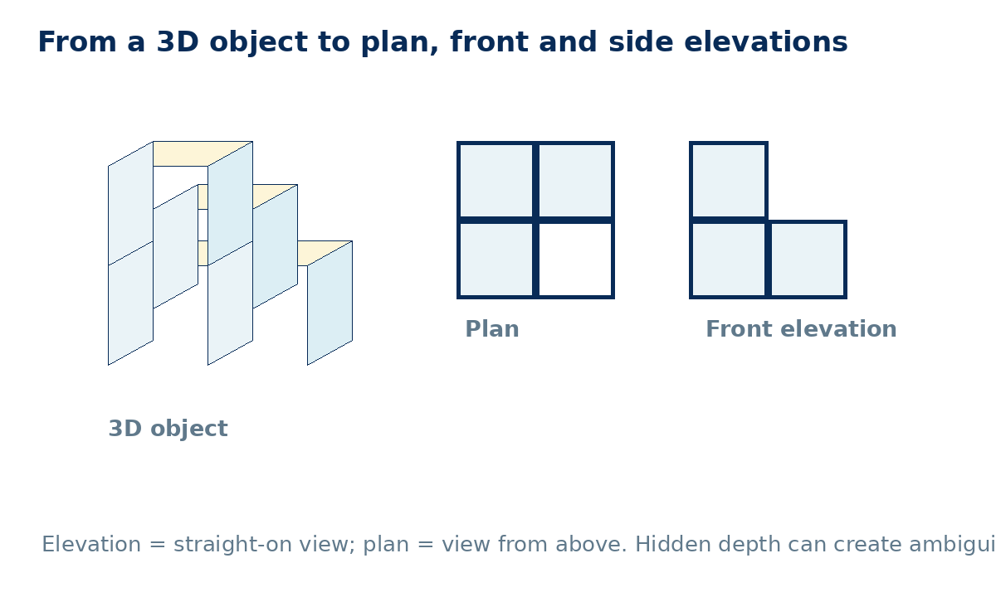
PLANS, ELEVATIONS AND MEASURES
GCSE Mathematics 1MA1 · L037 · 60 minutes
Week 13 · Reach for the Star Gold Standard

Slide 2
Objective and lesson route
Connect & Check
By the end you will:
Running order
• interpret plan, front and side elevations
• connect 2D views to a 3D object
• explain when views do not determine a unique solid
• use scale carefully where specified
• Connect & Check · 5 min
• Share · 5 min
• Present · 12 min
• Apply · 25 min
• Recall & Review · 8 min
Core work is non-calculator. A calculator may be used only for a labelled scale/area check.
GCSE Mathematics 1MA1 · L037 · Plans, elevations and measures
2

Slide 3
Baseline: what do you already know?
Connect & Check
Work independently · 5 minutes
• From above, which information about a solid can a plan show?
• Explain the difference between a plan and a front elevation.
Keep this response for distance-travelled comparison.
GCSE Mathematics 1MA1 · L037 · Plans, elevations and measures
3

Slide 4
Choose your route
Share
Same destination. Different journey.
A · Visual
B · Method
C · Explain
Build or sketch the solid and draw each view.
Use a grid and project heights/widths systematically.
Describe what each viewpoint can and cannot reveal.
Compare evidence with a partner before you continue.
GCSE Mathematics 1MA1 · L037 · Plans, elevations and measures
4

Slide 5
Model: one solid, three views
Present
• Plan looks down from above.
• Front elevation removes depth.
• Side elevation removes width.
• Stacking may be hidden in a plan unless height is encoded.
Ask: what information has been lost in each view?
GCSE Mathematics 1MA1 · L037 · Plans, elevations and measures
5

Slide 6
Worked example
Present
A plan is an L of three unit squares. One occupied square contains a stack two cubes high. What can each view show?
• Plan: occupied positions only.
• Front/side: project maximum column heights from that direction.
• State the named front before drawing.
Check: views must align to the same dimensions.
GCSE Mathematics 1MA1 · L037 · Plans, elevations and measures
6

Slide 7
Misconception check
Present
“If two solids have the same front elevation, they must be the same solid.”
• What information does the front view lose?
• Can cubes move in depth without changing the front projection?
• Construct a counterexample.
Repair: front elevation does not uniquely encode depth.
GCSE Mathematics 1MA1 · L037 · Plans, elevations and measures
7

Slide 8
Supported practice
Apply
A solid has a front elevation with column heights 2, 1 and 1. Sketch one possible arrangement of unit cubes.
Scaffold: draw a grid, mark viewing direction, then project occupied positions/max heights.
A plan occupies an L-shape of three squares. Explain what extra information is needed to determine the solid uniquely.
Remove the scaffold before the next slide.
GCSE Mathematics 1MA1 · L037 · Plans, elevations and measures
8

Slide 9
Independent practice: scaffold removed
Apply
• Draw the plan, front elevation and side elevation of a 2×2 base where one corner has a second cube stacked on top.
• Two solids have the same front elevation. Give one reason their plans might differ.
Show a separate check or justification.
GCSE Mathematics 1MA1 · L037 · Plans, elevations and measures
9

Slide 10
Exam-style practice
Apply
A rectangular room measures 6 cm by 4 cm on a 1:100 plan. Find the real floor area in m².
A solid has identical front and side elevations, each two squares wide and two squares high. Must the plan be a 2×2 square? Explain with a counterexample or convincing description.
Exam tip: label the view and keep scale units consistent before squaring for area.
GCSE Mathematics 1MA1 · L037 · Plans, elevations and measures
10

Slide 11
Stretch and deep challenge
Apply
Stretch
Sketch two different solids that have the same front elevation but different side elevations.
Deep challenge
Two solids have identical front and side elevations. Must their plans be identical? Explain using a specific arrangement of cubes.
A counterexample is enough to disprove a “must” statement.
GCSE Mathematics 1MA1 · L037 · Plans, elevations and measures
11

Slide 12
Self-mark and repair
Apply
Identify the first decision that went wrong.
• Did you state the viewing direction?
• Did you remove perspective?
• Did you preserve width/height alignment?
• Did you accidentally assume hidden depth/height?
• Did you convert scale lengths before area?
Repair one answer, then solve a fresh matched question without prompts.
GCSE Mathematics 1MA1 · L037 · Plans, elevations and measures
12

Slide 13
Independent exit evidence
Recall & Review
Without notes · 5 minutes
A solid is made from four cubes: three form an L-shape on the base and one is stacked on the corner cube. Describe or sketch its plan and front elevation.
• Give the plan.
• Give a named elevation.
• Explain one hidden feature.
Fresh evidence against the objective.
GCSE Mathematics 1MA1 · L037 · Plans, elevations and measures
13

Slide 14
Distance travelled
Recall & Review
Compare your baseline with the exit evidence.
WWW
What is now more accurate, complete or clearly explained?
EBI
What one action will improve your next answer?
Record the next-practice target in the workbook.
GCSE Mathematics 1MA1 · L037 · Plans, elevations and measures
14

Slide 15
Core answers
Teacher check
• C1 plan shows footprint/positions, not necessarily height
• C2 plan = above; elevation = straight-on named view
• E1 24 m²
• Same front does not force same depth
• Plan may be identical while stacking differs
GCSE Mathematics 1MA1 · L037 · Plans, elevations and measures
15

Slide 16
L037 teacher notes
• Keep viewpoint language explicit.
• Manipulatives are optional scaffolds, not the final evidence.
• Remove perspective from elevations.
• Accept counterexamples for non-uniqueness.
Next: L038 Pythagoras in two dimensions

Slide 17

L037 Recall & Review
Plans elevations and measures
Fresh evidence: prove the objective
Solve a new question without prompts. Explain one check, then correct one error in your working.
Objective: Interpret plans and elevations and connect views to three-dimensional objects.
Write the next practice step before you leave. It must test the method again, not simply copy today’s example.
Reach for the Star · GCSE Maths · Recall & Review

Slide 18
Feedback language
Use the full phrases before the abbreviations.
What Went Well (WWW)
Even Better If (EBI)
I selected the correct geometric fact, theorem, formula or transformation and used a clear diagram with appropriate labels and units.
I will name the fact or theorem, show the substitution or construction step and check whether the size, direction and units of the result are reasonable.
Identify the mathematical method, representation, reasoning or check that improved.
Set one precise next-step action and test it on a fresh question.
Reach for the Star · GCSE Maths · Recall & Review

Slide 19
Extension route
Choose this route only after the core evidence is secure.
Stretch
A scale plan measures 6 cm by 4 cm at 1:100. Find the real floor area in m².
Deep challenge
Two solids have identical front and side elevations. Must their plans be identical? Explain with an example.
Explain your reasoning clearly enough that another learner could check it.
Reach for the Star · GCSE Maths · Recall & Review

