Slide 1

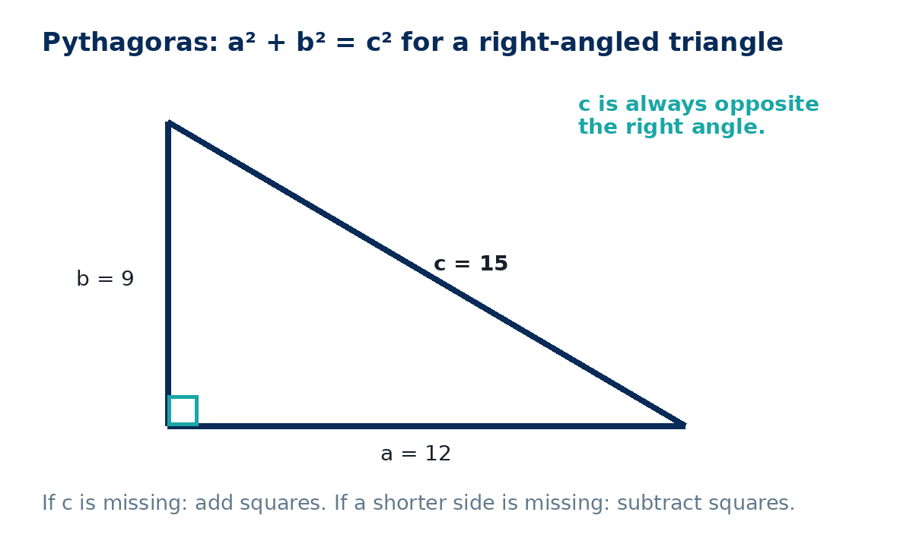
PYTHAGORAS IN TWO DIMENSIONS
GCSE Mathematics 1MA1 · L038 · 60 minutes
Week 13 · Reach for the Star Gold Standard

Slide 2
Objective and lesson route
Connect & Check
By the end you will:
Running order
• identify the hypotenuse reliably
• use a²+b²=c² for a missing length
• subtract squares when a shorter side is missing
• check whether a triangle is right-angled
• Connect & Check · 5 min
• Share · 5 min
• Present · 12 min
• Apply · 25 min
• Recall & Review · 8 min
Core square-number examples may be non-calculator; calculator questions are labelled C. Round only when requested.
GCSE Mathematics 1MA1 · L038 · Pythagoras in two dimensions
2

Slide 3
Baseline: what do you already know?
Connect & Check
Work independently · 5 minutes
• Which side is the hypotenuse in a right-angled triangle?
• Calculate 9², 12² and √225.
Keep this response for distance-travelled comparison.
GCSE Mathematics 1MA1 · L038 · Pythagoras in two dimensions
3

Slide 4
Choose your route
Share
Same destination. Different journey.
A · Visual
B · Method
C · Explain
Annotate the triangle and square each relevant side.
Use a structured a²+b²=c² template.
Explain whether to add or subtract squares and why.
Compare evidence with a partner before you continue.
GCSE Mathematics 1MA1 · L038 · Pythagoras in two dimensions
4

Slide 5
Model: identify c first
Present
• c is opposite the right angle.
• If c is missing, add squared short sides.
• If a short side is missing, subtract from c².
• Take the square root at the end.
the hypotenuse must be the longest side.
GCSE Mathematics 1MA1 · L038 · Pythagoras in two dimensions
5

Slide 6
Worked example
Present
A rectangle measures 9 cm by 12 cm. Find its diagonal.
• The diagonal is the hypotenuse.
• d²=9²+12²=81+144=225.
• d=√225=15 cm.
Check: 15 is longer than both 9 and 12; 9²+12²=15².
GCSE Mathematics 1MA1 · L038 · Pythagoras in two dimensions
6

Slide 7
Misconception check
Present
A learner solves c=√(9+16) for sides 3 cm and 4 cm.
• What should be squared?
• What does the theorem actually say?
• Compare with the known 3-4-5 triangle.
Repair: c=√(3²+4²)=5 cm.
GCSE Mathematics 1MA1 · L038 · Pythagoras in two dimensions
7

Slide 8
Supported practice
Apply
Find the hypotenuse of a right triangle with legs 6 cm and 8 cm.
Scaffold: mark c, write a²+b²=c², substitute, then solve.
A right triangle has hypotenuse 13 cm and one shorter side 5 cm. Find the other side.
Remove the scaffold before the next slide.
GCSE Mathematics 1MA1 · L038 · Pythagoras in two dimensions
8

Slide 9
Independent practice: scaffold removed
Apply
• A ladder reaches 6 m up a wall and its foot is 2.5 m from the wall. Find the ladder length.
• A rectangle is 9 cm by 12 cm. Find its diagonal.
Show a separate check or justification.
GCSE Mathematics 1MA1 · L038 · Pythagoras in two dimensions
9

Slide 10
Exam-style practice
Apply
A rectangular field is 30 m by 40 m. Find the straight-line distance between opposite corners.
A triangle has side lengths 7 cm, 24 cm and 25 cm. Show that it is right-angled.
Exam tip: the equation is evidence; do not give only a calculator answer.
GCSE Mathematics 1MA1 · L038 · Pythagoras in two dimensions
10

Slide 11
Stretch and deep challenge
Apply
Stretch
A 9 cm by 12 cm rectangle is cut along a diagonal. Find the perimeter of one resulting triangle.
Deep challenge
A triangle has sides 8 cm, 15 cm and 17 cm. Prove it is right-angled and find its area.
For a “prove right-angled” question, compare the sum of the two smaller squares with the largest square.
GCSE Mathematics 1MA1 · L038 · Pythagoras in two dimensions
11

Slide 12
Self-mark and repair
Apply
Identify the first decision that went wrong.
• Did you identify the side opposite the right angle?
• Did you square each side length?
• Did you add/subtract in the correct direction?
• Did you take the final square root?
• Is the answer a sensible length?
Repair one answer, then solve a fresh matched question without prompts.
GCSE Mathematics 1MA1 · L038 · Pythagoras in two dimensions
12

Slide 13
Independent exit evidence
Recall & Review
Without notes · 5 minutes
A right triangle has hypotenuse 10 cm and one shorter side 6 cm. Find the other side and show a check.
• Identify c.
• Form the equation.
• Find the length.
• Substitute back as a check.
Fresh evidence against the objective.
GCSE Mathematics 1MA1 · L038 · Pythagoras in two dimensions
13

Slide 14
Distance travelled
Recall & Review
Compare your baseline with the exit evidence.
WWW
What is now more accurate, complete or clearly explained?
EBI
What one action will improve your next answer?
Record the next-practice target in the workbook.
GCSE Mathematics 1MA1 · L038 · Pythagoras in two dimensions
14

Slide 15
Core answers
Teacher check
• C2 81, 144, 15
• P1 15 cm
• A1 10 cm
• A2 12 cm
• A3 6.5 m
• A4 15 cm
• E1 50 m
• E2 right-angled
• Exit 8 cm
GCSE Mathematics 1MA1 · L038 · Pythagoras in two dimensions
15

Slide 16
L038 teacher notes
• Insist on identifying c before calculation.
• Equation before calculator.
• Use subtraction for a missing short side.
• Check by substitution and magnitude.
Next: L039 Trigonometry in right triangles

Slide 17

L038 Recall & Review
Pythagoras in two dimensions
Fresh evidence: prove the objective
Solve a new question without prompts. Explain one check, then correct one error in your working.
Objective: Use Pythagoras to find a missing length in a right-angled triangle.
Write the next practice step before you leave. It must test the method again, not simply copy today’s example.
Reach for the Star · GCSE Maths · Recall & Review

Slide 18
Feedback language
Use the full phrases before the abbreviations.
What Went Well (WWW)
Even Better If (EBI)
I selected the correct geometric fact, theorem, formula or transformation and used a clear diagram with appropriate labels and units.
I will name the fact or theorem, show the substitution or construction step and check whether the size, direction and units of the result are reasonable.
Identify the mathematical method, representation, reasoning or check that improved.
Set one precise next-step action and test it on a fresh question.
Reach for the Star · GCSE Maths · Recall & Review

Slide 19
Extension route
Choose this route only after the core evidence is secure.
Stretch
A rectangle is 9 cm by 12 cm. Find its diagonal and the perimeter of one of the right triangles formed by that diagonal.
Deep challenge
A triangle has sides 8, 15 and 17 cm. Prove it is right-angled and find its area.
Explain your reasoning clearly enough that another learner could check it.
Reach for the Star · GCSE Maths · Recall & Review

