Slide 1

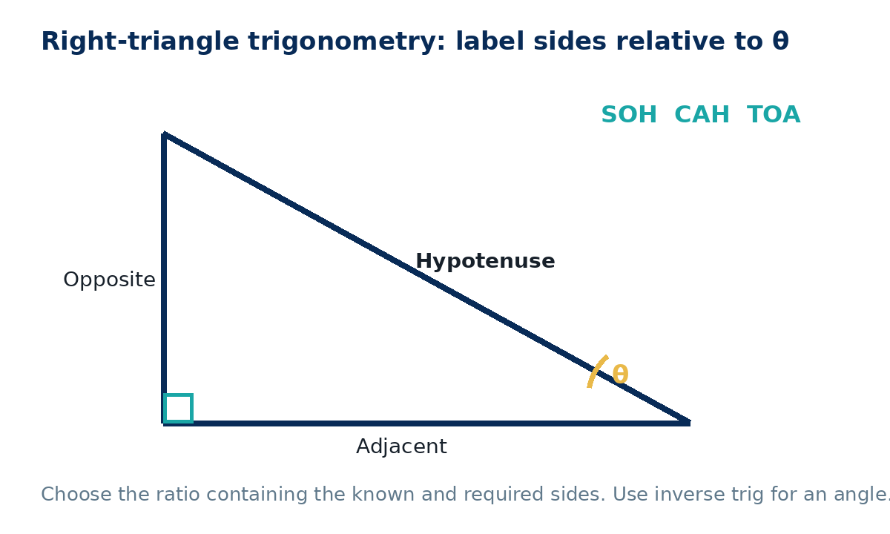
TRIGONOMETRY IN RIGHT TRIANGLES
GCSE Mathematics 1MA1 · L039 · 60 minutes
Week 13 · Reach for the Star Gold Standard

Slide 2
Objective and lesson route
Connect & Check
By the end you will:
Running order
• label opposite, adjacent and hypotenuse relative to θ
• select sine, cosine or tangent
• find a missing side
• use inverse trig to find an angle
• Connect & Check · 5 min
• Share · 5 min
• Present · 12 min
• Apply · 25 min
• Recall & Review · 8 min
Calculator required for trigonometric values. Check degree mode. Keep full precision until the final rounding step.
GCSE Mathematics 1MA1 · L039 · Trigonometry in right triangles
2

Slide 3
Baseline: what do you already know?
Connect & Check
Work independently · 5 minutes
• In a right triangle, which side is always the hypotenuse?
• Relative to an angle θ, explain how to identify the opposite and adjacent sides.
Keep this response for distance-travelled comparison.
GCSE Mathematics 1MA1 · L039 · Trigonometry in right triangles
3

Slide 4
Choose your route
Share
Same destination. Different journey.
A · Visual
B · Method
C · Explain
Label O, A, H on the diagram and circle known/required values.
Use SOHCAHTOA as a selection table.
State why one ratio contains exactly the needed sides.
Compare evidence with a partner before you continue.
GCSE Mathematics 1MA1 · L039 · Trigonometry in right triangles
4

Slide 5
Model: label before choosing a ratio
Present
• H is opposite the right angle.
• O is opposite the chosen θ.
• A touches θ but is not H.
• Choose the ratio containing known + required values.
change θ and O/A swap; H stays the same.
GCSE Mathematics 1MA1 · L039 · Trigonometry in right triangles
5

Slide 6
Worked example
Present
Adjacent = 8 cm and θ = 35°. Find the opposite side.
• Relative to θ: A=8, O=x.
• tan35=x/8.
• x=8tan35≈5.60 cm.
Check: positive length; opposite is smaller than adjacent for 35°, which is plausible.
GCSE Mathematics 1MA1 · L039 · Trigonometry in right triangles
6

Slide 7
Misconception check
Present
A learner uses sine when the known sides are opposite and adjacent.
• Which ratio contains O and A?
• What does sine require?
• Write the ratio before substituting.
Repair: use tangent because tanθ=O/A.
GCSE Mathematics 1MA1 · L039 · Trigonometry in right triangles
7

Slide 8
Supported practice
Apply
Angle θ=30°, hypotenuse=10 cm. Find the opposite side.
Scaffold: label H/O/A, circle known + required, choose SOH/CAH/TOA, then rearrange.
Opposite=7 cm, hypotenuse=10 cm. Find θ to 1 d.p.
Remove the scaffold before the next slide.
GCSE Mathematics 1MA1 · L039 · Trigonometry in right triangles
8

Slide 9
Independent practice: scaffold removed
Apply
• Adjacent=12 cm, θ=28°. Find the hypotenuse to 1 d.p.
• Opposite=9 cm, adjacent=14 cm. Find θ to 1 d.p.
Show a separate check or justification.
GCSE Mathematics 1MA1 · L039 · Trigonometry in right triangles
9

Slide 10
Exam-style practice
Apply
A ladder 5.5 m long makes an angle of 68° with the ground. How high up the wall does it reach? Give 2 d.p.
From a point 20 m from the base of a vertical tower, the angle of elevation to the top is 32°. Find the tower height to 1 d.p.
Exam tip: a written trig equation protects method marks even if the calculator step goes wrong.
GCSE Mathematics 1MA1 · L039 · Trigonometry in right triangles
10

Slide 11
Stretch and deep challenge
Apply
Stretch
Two right triangles both have angle 30° but hypotenuses 10 cm and 25 cm. Compare their opposite sides.
Deep challenge
A right triangle has area 30 cm² and one acute angle 40°. Find one possible pair of perpendicular side lengths.
Similar right triangles with the same acute angle preserve side ratios.
GCSE Mathematics 1MA1 · L039 · Trigonometry in right triangles
11

Slide 12
Self-mark and repair
Apply
Identify the first decision that went wrong.
• Is the calculator in degree mode?
• Did you label sides relative to the stated angle?
• Does the chosen ratio contain the known and required sides?
• Did you rearrange before typing?
• Did you round only at the end?
Repair one answer, then solve a fresh matched question without prompts.
GCSE Mathematics 1MA1 · L039 · Trigonometry in right triangles
12

Slide 13
Independent exit evidence
Recall & Review
Without notes · 5 minutes
A right triangle has opposite side 6 cm and adjacent side 11 cm relative to θ. Find θ to 1 d.p. and state the ratio used.
• Label O/A/H.
• State the ratio.
• Use inverse trig.
• Round to 1 d.p.
Fresh evidence against the objective.
GCSE Mathematics 1MA1 · L039 · Trigonometry in right triangles
13

Slide 14
Distance travelled
Recall & Review
Compare your baseline with the exit evidence.
WWW
What is now more accurate, complete or clearly explained?
EBI
What one action will improve your next answer?
Record the next-practice target in the workbook.
GCSE Mathematics 1MA1 · L039 · Trigonometry in right triangles
14

Slide 15
Core answers
Teacher check
• P1 5.60 cm
• A1 5 cm
• A2 44.4°
• A3 13.6 cm
• A4 32.7°
• E1 5.10 m
• E2 12.5 m
• X1 5 cm and 12.5 cm
• Exit 28.6°
GCSE Mathematics 1MA1 · L039 · Trigonometry in right triangles
15

Slide 16
L039 teacher notes
• Check degree mode before any calculation.
• O/A are angle-relative; H is fixed.
• Equation before calculator input.
• Inverse trig finds angles; it is not reciprocal trig.
Next: L040 Cumulative checkpoint 2 and feedback

Slide 17

L039 Recall & Review
Trigonometry in right triangles
Fresh evidence: prove the objective
Solve a new question without prompts. Explain one check, then correct one error in your working.
Objective: Select sine, cosine or tangent to find a right-triangle side or angle.
Write the next practice step before you leave. It must test the method again, not simply copy today’s example.
Reach for the Star · GCSE Maths · Recall & Review

Slide 18
Feedback language
Use the full phrases before the abbreviations.
What Went Well (WWW)
Even Better If (EBI)
I selected the correct geometric fact, theorem, formula or transformation and used a clear diagram with appropriate labels and units.
I will name the fact or theorem, show the substitution or construction step and check whether the size, direction and units of the result are reasonable.
Identify the mathematical method, representation, reasoning or check that improved.
Set one precise next-step action and test it on a fresh question.
Reach for the Star · GCSE Maths · Recall & Review

Slide 19
Extension route
Choose this route only after the core evidence is secure.
Stretch
A right triangle has adjacent side 8 cm and an angle of 35°. Find the opposite side to 2 d.p.
Deep challenge
Two right triangles share angle 30° but have hypotenuses 10 cm and 25 cm. Compare their opposite sides.
Explain your reasoning clearly enough that another learner could check it.
Reach for the Star · GCSE Maths · Recall & Review

