Slide 1

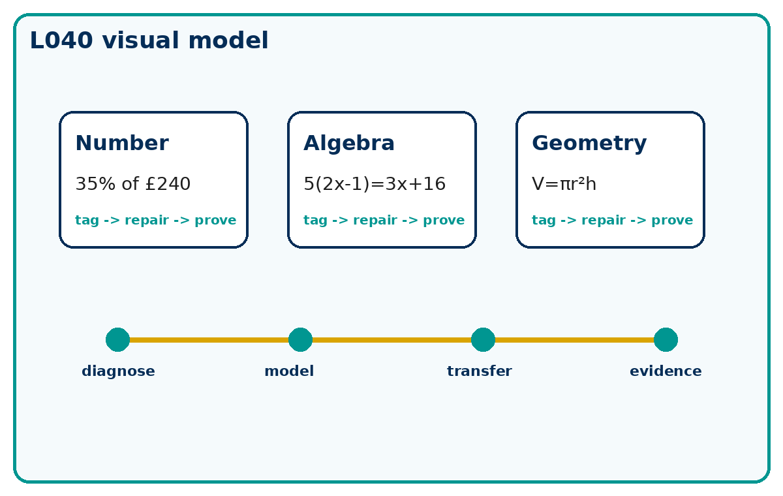
CUMULATIVE CHECKPOINT 2 AND FEEDBACK
GCSE Mathematics 1MA1 · L040 · 60 minutes
Week 14 · Reach for the Star Gold Standard

Slide 2
Objective and lesson route
Connect & Check
Apply and explain earlier number, algebra and geometry independently. Diagnose method errors and complete a targeted repair.
Running order: Connect & Check -> Share -> Present -> Apply -> Recall & Review
Non-calculator first attempt. Calculator permitted only for explicitly labelled check questions.

Slide 3
Baseline: what do you already know?
Connect & Check
Without notes, answer three retrieval questions: one number, one algebra and one geometry.
Tag any uncertainty as method, operation, unit or diagram.

Slide 4
Choose your route
Share
A - Visual: sketch, annotate or use the diagram.
B - Method: table, formula or calculation chain.
C - Explain: sentences showing why the method works.
Same destination. Different journey.

Slide 5
Model the key method
Present
Use the repair cycle: identify the first incorrect decision, replace it with a correct method, then test it on a matched question.
A repaired answer is not secure until it works without the prompt.

Slide 6
Worked example
Present
A rectangle is 12 cm by 8 cm. A 3 cm by 2 cm corner is cut out. Find the remaining area and perimeter. Show a check.
What is the first decision? What check proves it?

Slide 7
Misconception check
Present
Where might the first incorrect decision happen?
What would the learner do if they repeated the same method?
What fresh question proves the repair?

Slide 8
Supported practice
Apply
Find 35% of £240 and explain the reference whole.
Solve 5(2x - 1)=3x+16 and check.
Use the scaffold first, then remove it.

Slide 9
Independent practice: scaffold removed
Apply
Find 35% of £240 and explain the reference whole.
Solve 5(2x - 1)=3x+16 and check.
A cylinder has radius 4 cm and height 5 cm. Find volume exactly.
Show working and a separate check.

Slide 10
Exam-style practice
Apply
A rectangle is 12 cm by 8 cm. A 3 cm by 2 cm corner is cut out. Find the remaining area and perimeter. Show a check.
Mark the method, answer and check separately.

Slide 11
Stretch and deep challenge
Apply
Stretch: A cylinder has radius 4 cm and height 5 cm. Find its volume exactly, then state the units of surface area.
Deep challenge: A learner uses 8² + 15² = 17 in a Pythagoras check. Identify and repair the error.

Slide 12
Self-mark and repair
Apply
Identify the first decision that went wrong.
Repair one answer, then solve a fresh matched question without prompts.

Slide 13
Independent exit evidence
Recall & Review
Solve one fresh mixed question without notes.
Write the specific next-practice target, not a vague topic name.
This is the evidence against the objective.

Slide 14
Distance travelled
Recall & Review
Compare your baseline with the exit evidence.
WWW: What is now more accurate, complete or clearly explained?
EBI: What one action will improve your next answer?

Slide 15
Core answers
Teacher check
£84; the whole is £240.
x = 3. Substitute: 5(6-1)=25 and 9+16=25.
80π cm³. Surface area would be in cm².
Area = 90 cm²; perimeter = 40 cm.

Slide 16
L040 teacher notes
Check degree/calculator conditions where relevant.
Retain baseline, repair and exit evidence.
Next: L041 Coordinates, gradient and intercept

Slide 17

L040 Recall & Review
Cumulative checkpoint 2 and feedback
Fresh evidence: prove the objective
Solve a new question without prompts. Explain one check, then correct one error in your working.
Objective: Apply and explain earlier number, algebra and geometry independently.
Write the next practice step before you leave. It must test the method again, not simply copy today’s example.
Reach for the Star · GCSE Maths · Recall & Review

Slide 18
Feedback language
Use the full phrases before the abbreviations.
What Went Well (WWW)
Even Better If (EBI)
I used my working and assessment evidence to identify the exact mathematical step that was secure and the specific misconception that needs attention.
I will correct one precise step, explain why the correction works and complete a fresh delayed question without the original scaffold.
Identify the mathematical method, representation, reasoning or check that improved.
Set one precise next-step action and test it on a fresh question.
Reach for the Star · GCSE Maths · Recall & Review

Slide 19
Extension route
Choose this route only after the core evidence is secure.
Stretch
A cylinder has radius 4 cm and height 5 cm. Find its volume exactly, then state the units of surface area.
Deep challenge
A learner uses 8²+15²=17 in a Pythagoras check. Identify and repair the error.
Explain your reasoning clearly enough that another learner could check it.
Reach for the Star · GCSE Maths · Recall & Review

