Slide 1

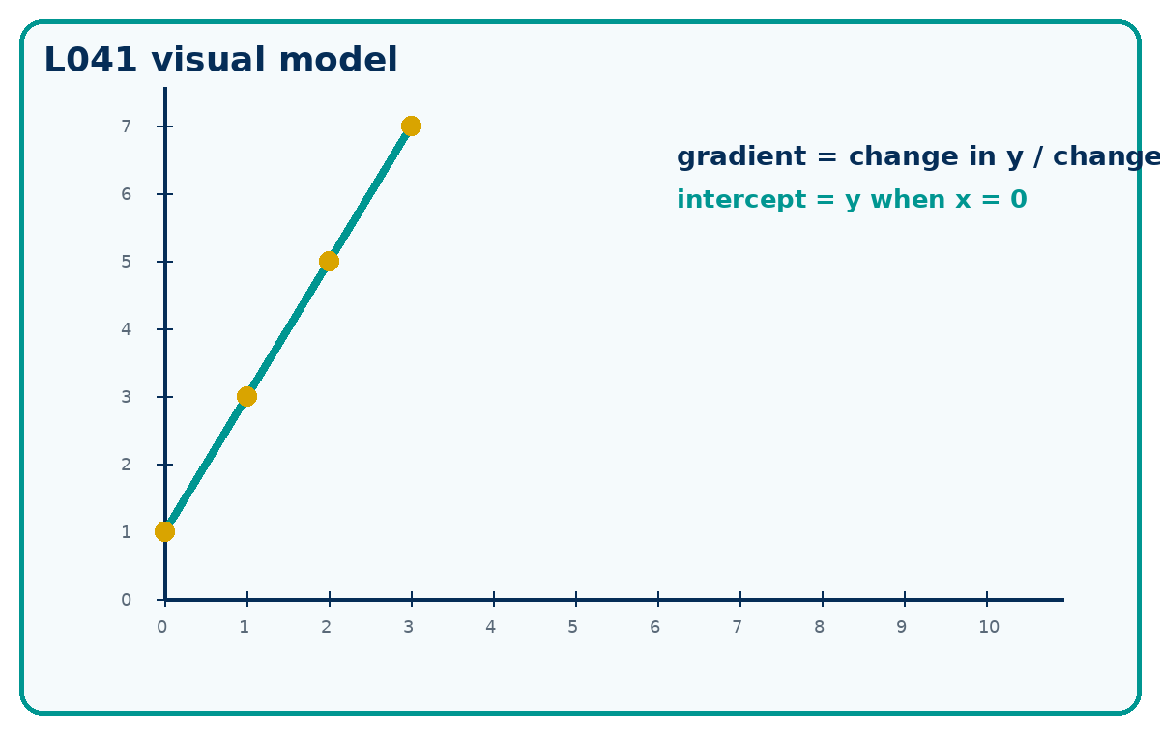
COORDINATES, GRADIENT AND INTERCEPT
GCSE Mathematics 1MA1 · L041 · 60 minutes
Week 14 · Reach for the Star Gold Standard

Slide 2
Objective and lesson route
Connect & Check
Plot coordinates and interpret gradient and vertical intercept from tables, graphs and equations.
Running order: Connect & Check -> Share -> Present -> Apply -> Recall & Review
Non-calculator core. Calculator not required.

Slide 3
Baseline: what do you already know?
Connect & Check
Plot (0, 2), (1, 4), (2, 6) and describe the pattern.
Retrieve: what does one horizontal step do to the height?

Slide 4
Choose your route
Share
A - Visual: sketch, annotate or use the diagram.
B - Method: table, formula or calculation chain.
C - Explain: sentences showing why the method works.
Same destination. Different journey.

Slide 5
Model the key method
Present
Gradient is change in y divided by change in x.
The vertical intercept is where the line crosses the y-axis, so x = 0.

Slide 6
Worked example
Present
A straight line passes through (0, -2) and (4, 10). Find the gradient and vertical intercept. Explain the meaning of each on the graph.
What is the first decision? What check proves it?

Slide 7
Misconception check
Present
Where might the first incorrect decision happen?
What would the learner do if they repeated the same method?
What fresh question proves the repair?

Slide 8
Supported practice
Apply
Plot (0,1), (1,3), (2,5), (3,7).
Find the gradient of the line through (2,1) and (6,9).
Use the scaffold first, then remove it.

Slide 9
Independent practice: scaffold removed
Apply
Plot (0,1), (1,3), (2,5), (3,7).
Find the gradient of the line through (2,1) and (6,9).
For y = 3x - 4, state the gradient and y-intercept.
Show working and a separate check.

Slide 10
Exam-style practice
Apply
A straight line passes through (0, -2) and (4, 10). Find the gradient and vertical intercept. Explain the meaning of each on the graph.
Mark the method, answer and check separately.

Slide 11
Stretch and deep challenge
Apply
Stretch: A line passes through (-3, 4) and (3, -2). Find gradient and y-intercept.
Deep challenge: Can two distinct parallel lines have different gradients? Explain using y = mx + c.

Slide 12
Self-mark and repair
Apply
Identify the first decision that went wrong.
Repair one answer, then solve a fresh matched question without prompts.

Slide 13
Independent exit evidence
Recall & Review
Given two fresh points, find the gradient and y-intercept without prompts.
Correct one plotting or scale error.
This is the evidence against the objective.

Slide 14
Distance travelled
Recall & Review
Compare your baseline with the exit evidence.
WWW: What is now more accurate, complete or clearly explained?
EBI: What one action will improve your next answer?

Slide 15
Core answers
Teacher check
A straight line with y increasing by 2 each step.
Gradient = 2.
Gradient 3; y-intercept -4.
Gradient = 3; intercept = -2.

Slide 16
L041 teacher notes
Check degree/calculator conditions where relevant.
Retain baseline, repair and exit evidence.
Next: L042 Straight line equations

Slide 17

L041 Recall & Review
Coordinates gradient and intercept
Fresh evidence: prove the objective
Solve a new question without prompts. Explain one check, then correct one error in your working.
Objective: Plot coordinates and interpret gradient and vertical intercept.
Write the next practice step before you leave. It must test the method again, not simply copy today’s example.
Reach for the Star · GCSE Maths · Recall & Review

Slide 18
Feedback language
Use the full phrases before the abbreviations.
What Went Well (WWW)
Even Better If (EBI)
I read or constructed the graph accurately, used the scale and axes correctly and linked the relevant gradient, intercept, shape or trend to my conclusion.
I will label units and scale clearly, show the calculation or graphical evidence I used and check that the interpretation fits the context.
Identify the mathematical method, representation, reasoning or check that improved.
Set one precise next-step action and test it on a fresh question.
Reach for the Star · GCSE Maths · Recall & Review

Slide 19
Extension route
Choose this route only after the core evidence is secure.
Stretch
A line passes through (−3, 4) and (3, −2). Find gradient and y-intercept.
Deep challenge
Can two distinct parallel lines have different gradients? Explain using y=mx+c.
Explain your reasoning clearly enough that another learner could check it.
Reach for the Star · GCSE Maths · Recall & Review

