Slide 1

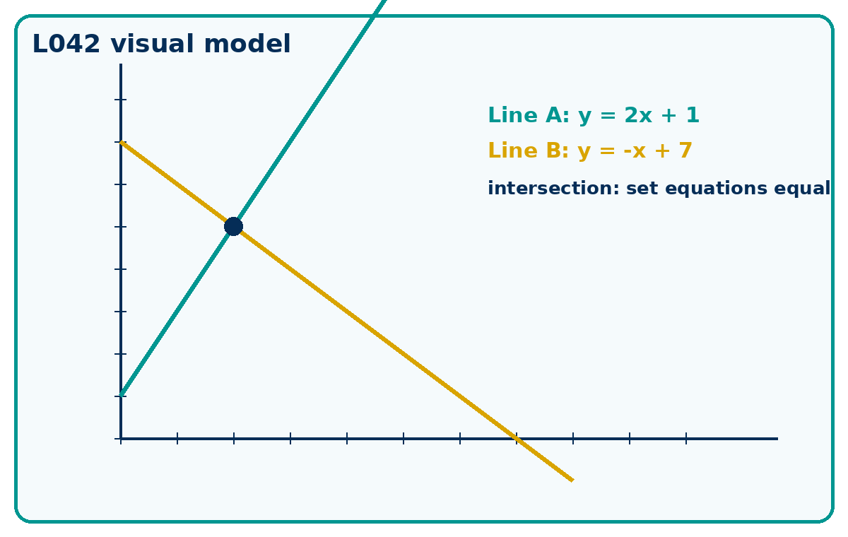
STRAIGHT LINE EQUATIONS
GCSE Mathematics 1MA1 · L042 · 60 minutes
Week 14 · Reach for the Star Gold Standard

Slide 2
Objective and lesson route
Connect & Check
Form and use straight-line equations, check whether points lie on a line and locate intersections.
Running order: Connect & Check -> Share -> Present -> Apply -> Recall & Review
Non-calculator core. Calculator optional for checking plotted intersections only.

Slide 3
Baseline: what do you already know?
Connect & Check
Retrieve gradient and intercept from y = 2x + 1 and y = -x + 4.
Predict where two lines might meet before calculating.

Slide 4
Choose your route
Share
A - Visual: sketch, annotate or use the diagram.
B - Method: table, formula or calculation chain.
C - Explain: sentences showing why the method works.
Same destination. Different journey.

Slide 5
Model the key method
Present
Use y = mx + c. Substitute a point to test it.
For intersections, set the two y-values equal, solve for x, then find y.

Slide 6
Worked example
Present
Line A is y = 2x + 1. Line B is y = -x + 7. Find their intersection and check both equations.
What is the first decision? What check proves it?

Slide 7
Misconception check
Present
Where might the first incorrect decision happen?
What would the learner do if they repeated the same method?
What fresh question proves the repair?

Slide 8
Supported practice
Apply
Find the equation of a line with gradient 2 and intercept -3.
Does (4,5) lie on y = 2x - 3?
Use the scaffold first, then remove it.

Slide 9
Independent practice: scaffold removed
Apply
Find the equation of a line with gradient 2 and intercept -3.
Does (4,5) lie on y = 2x - 3?
Are y = 4x + 1 and y = 4x - 6 parallel? Explain.
Show working and a separate check.

Slide 10
Exam-style practice
Apply
Line A is y = 2x + 1. Line B is y = -x + 7. Find their intersection and check both equations.
Mark the method, answer and check separately.

Slide 11
Stretch and deep challenge
Apply
Stretch: Find the equation of the line through (2, -1) and (6, 7).
Deep challenge: The lines y = 3x - 4 and 6x - 2y = 8 are claimed to intersect. Test the claim.

Slide 12
Self-mark and repair
Apply
Identify the first decision that went wrong.
Repair one answer, then solve a fresh matched question without prompts.

Slide 13
Independent exit evidence
Recall & Review
Check a point against a fresh line equation.
Decide if two lines intersect, are parallel or are the same line.
This is the evidence against the objective.

Slide 14
Distance travelled
Recall & Review
Compare your baseline with the exit evidence.
WWW: What is now more accurate, complete or clearly explained?
EBI: What one action will improve your next answer?

Slide 15
Core answers
Teacher check
y = 2x - 3.
Yes: 2(4)-3 = 5.
Yes. Same gradient, different intercepts.
Intersection (2, 5).

Slide 16
L042 teacher notes
Check degree/calculator conditions where relevant.
Retain baseline, repair and exit evidence.
Next: L043 Sequences and nth term

Slide 17

L042 Recall & Review
Straight line equations
Fresh evidence: prove the objective
Solve a new question without prompts. Explain one check, then correct one error in your working.
Objective: Form and use straight-line equations and locate intersections.
Write the next practice step before you leave. It must test the method again, not simply copy today’s example.
Reach for the Star · GCSE Maths · Recall & Review

Slide 18
Feedback language
Use the full phrases before the abbreviations.
What Went Well (WWW)
Even Better If (EBI)
I represented the algebraic structure accurately, kept each transformation valid and checked the result by substitution, graph or equivalent reasoning.
I will show the missing inverse operation or algebraic step, keep signs and brackets accurate and test the result in the original relationship.
Identify the mathematical method, representation, reasoning or check that improved.
Set one precise next-step action and test it on a fresh question.
Reach for the Star · GCSE Maths · Recall & Review

Slide 19
Extension route
Choose this route only after the core evidence is secure.
Stretch
Find the equation of the line through (2,−1) and (6,7).
Deep challenge
The lines y=3x−4 and 6x−2y=8 are claimed to intersect. Test the claim.
Explain your reasoning clearly enough that another learner could check it.
Reach for the Star · GCSE Maths · Recall & Review

