Slide 1

Distance time and speed graphs
L043 · GCSE Mathematics 1MA1 · 60 minutes

Slide 2
The goal
Interpret distance–time and speed–time graphs in context.
Connect & Check
2/11

Slide 3
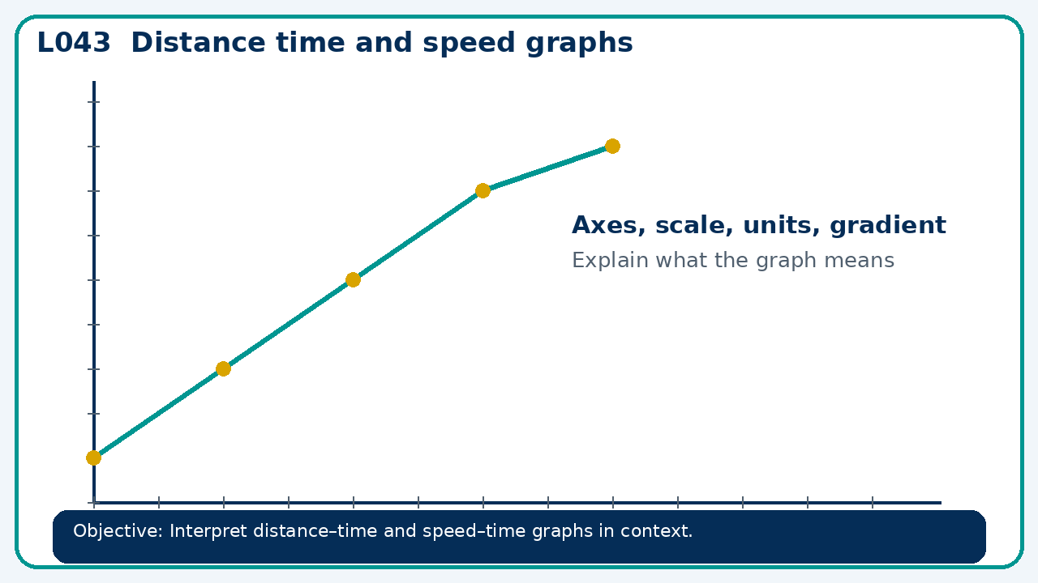
Connect & Check
Complete the starter in your workbook. Retrieve the prior skill, then identify one likely error before you use today's method.
Connect & Check
3/11

Slide 4
Share
Compare your method with a partner. Agree on one reliable step and one check. Be ready to explain your reasoning, not just your answer.
Share
4/11

Slide 5
Build the method
Use the worked model to distinguish height from gradient; connect area under a speed graph to distance. Record the key step and one check that proves the answer.
Present
5/11

Slide 6
Choose your route
Choose your route: A - visual model, B - method first, or C - explain first. Whichever route you choose, your final answer must prove the lesson objective.
Apply
6/11

Slide 7
Guided practice
A runner covers 400 m in 80 s, rests for 20 s, then covers 200 m in 40 s. Find average speed for the whole journey.
Apply
7/11

Slide 8
Independent practice
A distance-time graph has a downward segment. Explain what the vertical axis must represent if the graph is valid.
Apply
8/11

Slide 9
Exam-style practice
A graph is drawn for a real context. Interpret the gradient, intercept or area as appropriate. State units and justify your answer.
Apply
9/11

Slide 10
Recall & Review
Complete a fresh question without notes. Check your answer, correct one error if needed, and record the next practice step.
Recall & Review
10/11

Slide 11
Before next lesson
Correct one error, record one target and complete the flipped learning task.
Recall & Review
11/11

Slide 12

L043 Recall & Review
Distance time and speed graphs
Fresh evidence: prove the objective
Solve a new question without prompts. Explain one check, then correct one error in your working.
Objective: Interpret distance–time and speed–time graphs in context.
Write the next practice step before you leave. It must test the method again, not simply copy today’s example.
Reach for the Star · GCSE Maths · Recall & Review

Slide 13
Feedback language
Use the full phrases before the abbreviations.
What Went Well (WWW)
Even Better If (EBI)
I read or constructed the graph accurately, used the scale and axes correctly and linked the relevant gradient, intercept, shape or trend to my conclusion.
I will label units and scale clearly, show the calculation or graphical evidence I used and check that the interpretation fits the context.
Identify the mathematical method, representation, reasoning or check that improved.
Set one precise next-step action and test it on a fresh question.
Reach for the Star · GCSE Maths · Recall & Review

Slide 14
Extension route
Choose this route only after the core evidence is secure.
Stretch
A runner covers 400 m in 80 s, rests for 20 s, then covers 200 m in 40 s. Find average speed for the whole journey.
Deep challenge
A distance-time graph has a downward segment. Explain what the vertical axis must represent if the graph is valid.
Explain your reasoning clearly enough that another learner could check it.
Reach for the Star · GCSE Maths · Recall & Review

