Slide 1

Sampling and data quality
L045 · GCSE Mathematics 1MA1 · 60 minutes

Slide 2
The goal
Recognise populations, samples, bias and limits of conclusions.
Connect & Check
2/11

Slide 3
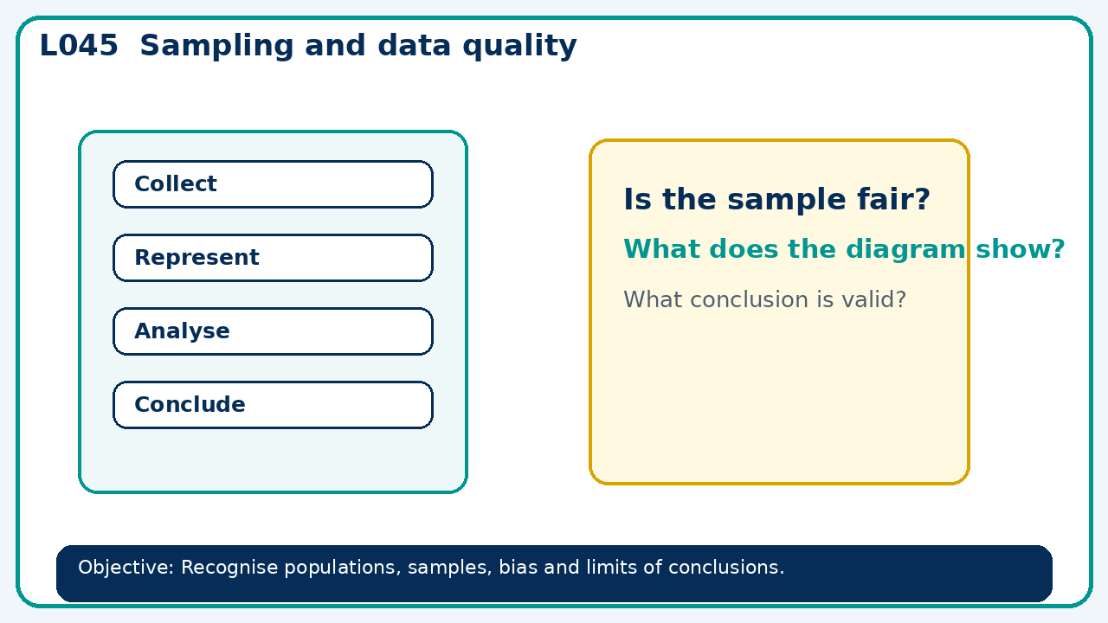
Connect & Check
Complete the starter in your workbook. Retrieve the prior skill, then identify one likely error before you use today's method.
Connect & Check
3/11

Slide 4
Share
Compare your method with a partner. Agree on one reliable step and one check. Be ready to explain your reasoning, not just your answer.
Share
4/11

Slide 5
Build the method
Use the worked model to compare survey designs and identify which groups may be excluded. Record the key step and one check that proves the answer.
Present
5/11

Slide 6
Choose your route
Choose your route: A - visual model, B - method first, or C - explain first. Whichever route you choose, your final answer must prove the lesson objective.
Apply
6/11

Slide 7
Guided practice
A school has 800 learners, 200 in Year 11. How many Year 11 learners belong in a proportional sample of 64?
Apply
7/11

Slide 8
Independent practice
A survey about canteen food is sent only to the school's sports team. Give two distinct sources of bias and improve selection.
Apply
8/11

Slide 9
Exam-style practice
Evaluate a data collection method. Identify one source of bias, improve the method and state one remaining limitation.
Apply
9/11

Slide 10
Recall & Review
Complete a fresh question without notes. Check your answer, correct one error if needed, and record the next practice step.
Recall & Review
10/11

Slide 11
Before next lesson
Correct one error, record one target and complete the flipped learning task.
Recall & Review
11/11

Slide 12

L045 Recall & Review
Sampling and data quality
Fresh evidence: prove the objective
Solve a new question without prompts. Explain one check, then correct one error in your working.
Objective: Recognise populations, samples, bias and limits of conclusions.
Write the next practice step before you leave. It must test the method again, not simply copy today’s example.
Reach for the Star · GCSE Maths · Recall & Review

Slide 13
Feedback language
Use the full phrases before the abbreviations.
What Went Well (WWW)
Even Better If (EBI)
I selected an appropriate statistic or representation and supported my comparison or interpretation with specific evidence from the data.
I will quote the relevant values or features, compare like with like and explain what the evidence shows without making an unsupported claim.
Identify the mathematical method, representation, reasoning or check that improved.
Set one precise next-step action and test it on a fresh question.
Reach for the Star · GCSE Maths · Recall & Review

Slide 14
Extension route
Choose this route only after the core evidence is secure.
Stretch
A school has 800 learners, 200 in Year 11. How many Year 11 learners belong in a proportional sample of 64?
Deep challenge
A survey about canteen food is sent only to the school's sports team. Give two distinct sources of bias and improve selection.
Explain your reasoning clearly enough that another learner could check it.
Reach for the Star · GCSE Maths · Recall & Review

