Slide 1

Tables charts and time series
L046 · GCSE Mathematics 1MA1 · 60 minutes

Slide 2
The goal
Represent and interpret categorical data, grouped data and time series.
Connect & Check
2/11

Slide 3
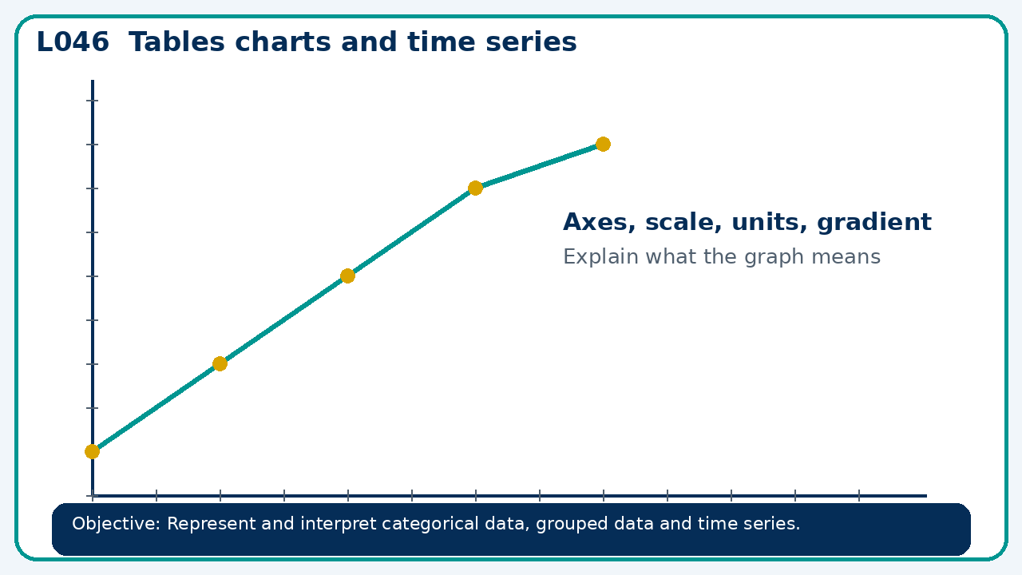
Connect & Check
Complete the starter in your workbook. Retrieve the prior skill, then identify one likely error before you use today's method.
Connect & Check
3/11

Slide 4
Share
Compare your method with a partner. Agree on one reliable step and one check. Be ready to explain your reasoning, not just your answer.
Share
4/11

Slide 5
Build the method
Use the worked model to choose a suitable chart; check labels, scale and misleading presentation. Record the key step and one check that proves the answer.
Present
5/11

Slide 6
Choose your route
Choose your route: A - visual model, B - method first, or C - explain first. Whichever route you choose, your final answer must prove the lesson objective.
Apply
6/11

Slide 7
Guided practice
A pie chart represents 72 people. A sector angle is 135°. Find its frequency.
Apply
7/11

Slide 8
Independent practice
A time-series graph starts its vertical axis at 90 instead of 0. Does this make the data wrong? Explain the risk.
Apply
8/11

Slide 9
Exam-style practice
Solve an exam-style problem involving tables charts and time series. Show working, include a check and interpret your answer.
Apply
9/11

Slide 10
Recall & Review
Complete a fresh question without notes. Check your answer, correct one error if needed, and record the next practice step.
Recall & Review
10/11

Slide 11
Before next lesson
Correct one error, record one target and complete the flipped learning task.
Recall & Review
11/11

Slide 12

L046 Recall & Review
Tables charts and time series
Fresh evidence: prove the objective
Solve a new question without prompts. Explain one check, then correct one error in your working.
Objective: Represent and interpret categorical data, grouped data and time series.
Write the next practice step before you leave. It must test the method again, not simply copy today’s example.
Reach for the Star · GCSE Maths · Recall & Review

Slide 13
Feedback language
Use the full phrases before the abbreviations.
What Went Well (WWW)
Even Better If (EBI)
I selected an appropriate statistic or representation and supported my comparison or interpretation with specific evidence from the data.
I will quote the relevant values or features, compare like with like and explain what the evidence shows without making an unsupported claim.
Identify the mathematical method, representation, reasoning or check that improved.
Set one precise next-step action and test it on a fresh question.
Reach for the Star · GCSE Maths · Recall & Review

Slide 14
Extension route
Choose this route only after the core evidence is secure.
Stretch
A pie chart represents 72 people. A sector angle is 135°. Find its frequency.
Deep challenge
A time-series graph starts its vertical axis at 90 instead of 0. Does this make the data wrong? Explain the risk.
Explain your reasoning clearly enough that another learner could check it.
Reach for the Star · GCSE Maths · Recall & Review

