Slide 1

Statistical comparisons
L048 · GCSE Mathematics 1MA1 · 60 minutes

Slide 2
The goal
Compare distributions using context, a typical value and spread.
Connect & Check
2/11

Slide 3
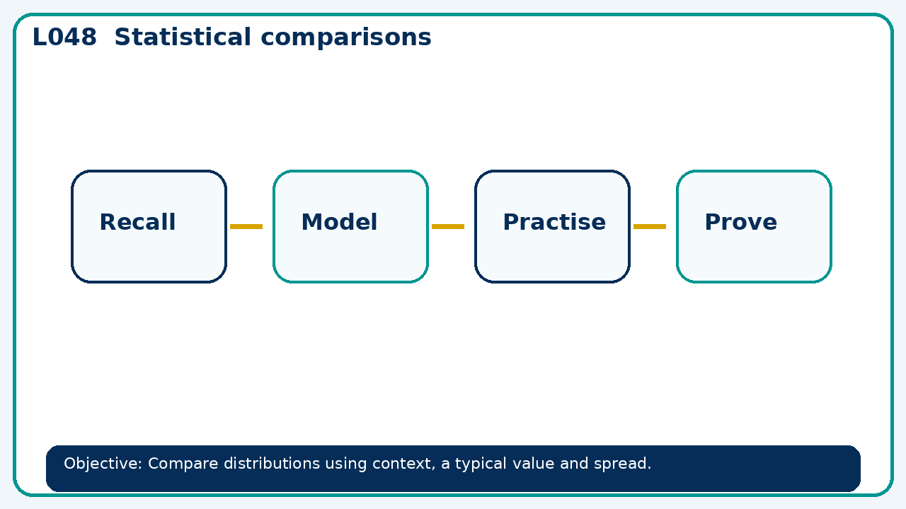
Connect & Check
Complete the starter in your workbook. Retrieve the prior skill, then identify one likely error before you use today's method.
Connect & Check
3/11

Slide 4
Share
Compare your method with a partner. Agree on one reliable step and one check. Be ready to explain your reasoning, not just your answer.
Share
4/11

Slide 5
Build the method
Use the worked model to model a comparison supported by two statistics; critique an unsupported claim. Record the key step and one check that proves the answer.
Present
5/11

Slide 6
Choose your route
Choose your route: A - visual model, B - method first, or C - explain first. Whichever route you choose, your final answer must prove the lesson objective.
Apply
6/11

Slide 7
Guided practice
Class A has median 14 and IQR 3; class B median 16 and IQR 9. Compare typical score and consistency.
Apply
7/11

Slide 8
Independent practice
Two groups share mean 20. One has range 2 and the other 30. What can and cannot be concluded?
Apply
8/11

Slide 9
Exam-style practice
Solve an exam-style problem involving statistical comparisons. Show working, include a check and interpret your answer.
Apply
9/11

Slide 10
Recall & Review
Complete a fresh question without notes. Check your answer, correct one error if needed, and record the next practice step.
Recall & Review
10/11

Slide 11
Before next lesson
Correct one error, record one target and complete the flipped learning task.
Recall & Review
11/11

Slide 12

L048 Recall & Review
Statistical comparisons
Fresh evidence: prove the objective
Solve a new question without prompts. Explain one check, then correct one error in your working.
Objective: Compare distributions using context, a typical value and spread.
Write the next practice step before you leave. It must test the method again, not simply copy today’s example.
Reach for the Star · GCSE Maths · Recall & Review

Slide 13
Feedback language
Use the full phrases before the abbreviations.
What Went Well (WWW)
Even Better If (EBI)
I selected an appropriate statistic or representation and supported my comparison or interpretation with specific evidence from the data.
I will quote the relevant values or features, compare like with like and explain what the evidence shows without making an unsupported claim.
Identify the mathematical method, representation, reasoning or check that improved.
Set one precise next-step action and test it on a fresh question.
Reach for the Star · GCSE Maths · Recall & Review

Slide 14
Extension route
Choose this route only after the core evidence is secure.
Stretch
Class A has median 14 and IQR 3; class B median 16 and IQR 9. Compare typical score and consistency.
Deep challenge
Two groups share mean 20. One has range 2 and the other 30. What can and cannot be concluded?
Explain your reasoning clearly enough that another learner could check it.
Reach for the Star · GCSE Maths · Recall & Review

