Slide 1

Venn diagrams and set notation
L051 · GCSE Mathematics 1MA1 · 60 minutes

Slide 2
The goal
Interpret Venn diagrams and use set notation in probability.
Connect & Check
2/11

Slide 3
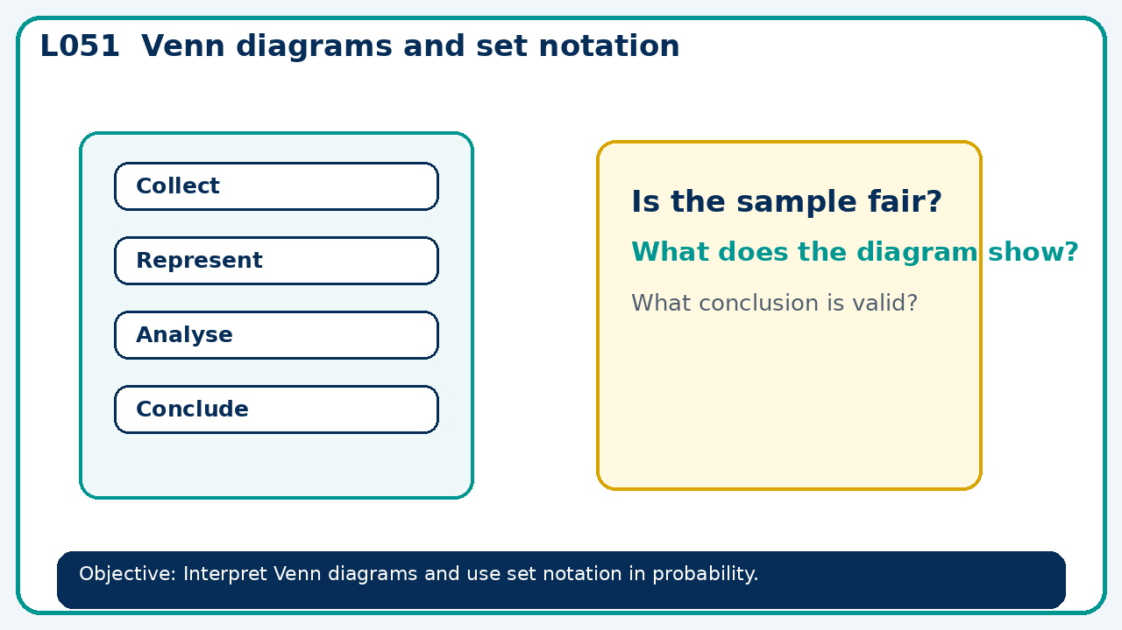
Connect & Check
Complete the starter in your workbook. Retrieve the prior skill, then identify one likely error before you use today's method.
Connect & Check
3/11

Slide 4
Share
Compare your method with a partner. Agree on one reliable step and one check. Be ready to explain your reasoning, not just your answer.
Share
4/11

Slide 5
Build the method
Use the worked model to place overlaps first and account for outcomes outside the sets. Record the key step and one check that proves the answer.
Present
5/11

Slide 6
Choose your route
Choose your route: A - visual model, B - method first, or C - explain first. Whichever route you choose, your final answer must prove the lesson objective.
Apply
6/11

Slide 7
Guided practice
Of 50 learners, 24 study art, 22 music and 8 both. Find how many study exactly one.
Apply
7/11

Slide 8
Independent practice
If P(A)=0.6, P(B)=0.5 and P(A∩B)=0.2, find P(neither).
Apply
8/11

Slide 9
Exam-style practice
Solve an exam-style problem involving venn diagrams and set notation. Show working, include a check and interpret your answer.
Apply
9/11

Slide 10
Recall & Review
Complete a fresh question without notes. Check your answer, correct one error if needed, and record the next practice step.
Recall & Review
10/11

Slide 11
Before next lesson
Correct one error, record one target and complete the flipped learning task.
Recall & Review
11/11

Slide 12

L051 Recall & Review
Venn diagrams and set notation
Fresh evidence: prove the objective
Solve a new question without prompts. Explain one check, then correct one error in your working.
Objective: Interpret Venn diagrams and use set notation in probability.
Write the next practice step before you leave. It must test the method again, not simply copy today’s example.
Reach for the Star · GCSE Maths · Recall & Review

Slide 13
Feedback language
Use the full phrases before the abbreviations.
What Went Well (WWW)
Even Better If (EBI)
I represented the outcomes systematically, used the correct probability rule and checked that the probabilities or frequencies were consistent.
I will show the sample space, branch or set reasoning explicitly, state any dependence or condition and check totals before giving the final probability.
Identify the mathematical method, representation, reasoning or check that improved.
Set one precise next-step action and test it on a fresh question.
Reach for the Star · GCSE Maths · Recall & Review

Slide 14
Extension route
Choose this route only after the core evidence is secure.
Stretch
Of 50 learners, 24 study art, 22 music and 8 both. Find how many study exactly one.
Deep challenge
If P(A)=0.6, P(B)=0.5 and P(A∩B)=0.2, find P(neither).
Explain your reasoning clearly enough that another learner could check it.
Reach for the Star · GCSE Maths · Recall & Review

