Slide 1

Rounding error intervals and bounds
L055 · GCSE Mathematics 1MA1 · 60 minutes

Slide 2
The goal
Describe rounding intervals and reason about limits of accuracy.
Connect & Check
2/11

Slide 3
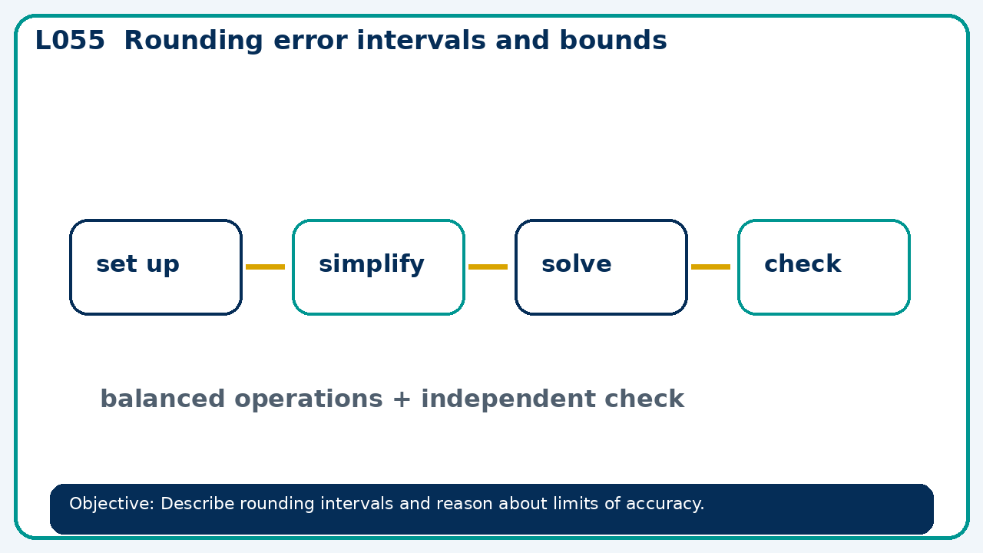
Connect & Check
Complete the starter in your workbook. Retrieve the prior skill, then identify one likely error before you use today's method.
Connect & Check
3/11

Slide 4
Share
Compare your method with a partner. Agree on one reliable step and one check. Be ready to explain your reasoning, not just your answer.
Share
4/11

Slide 5
Build the method
Use the worked model to use number lines to distinguish included and excluded endpoints. Record the key step and one check that proves the answer.
Present
5/11

Slide 6
Choose your route
Choose your route: A - visual model, B - method first, or C - explain first. Whichever route you choose, your final answer must prove the lesson objective.
Apply
6/11

Slide 7
Guided practice
A rectangle is 8.2 cm by 5.6 cm to the nearest 0.1 cm. Find its lower area bound.
Apply
7/11

Slide 8
Independent practice
A rounded length is 10 cm to nearest cm. Is 10.5 cm included? Explain.
Apply
8/11

Slide 9
Exam-style practice
Solve an exam-style problem involving rounding error intervals and bounds. Show working, include a check and interpret your answer.
Apply
9/11

Slide 10
Recall & Review
Complete a fresh question without notes. Check your answer, correct one error if needed, and record the next practice step.
Recall & Review
10/11

Slide 11
Before next lesson
Correct one error, record one target and complete the flipped learning task.
Recall & Review
11/11

Slide 12

L055 Recall & Review
Rounding error intervals and bounds
Fresh evidence: prove the objective
Solve a new question without prompts. Explain one check, then correct one error in your working.
Objective: Describe rounding intervals and reason about limits of accuracy.
Write the next practice step before you leave. It must test the method again, not simply copy today’s example.
Reach for the Star · GCSE Maths · Recall & Review

Slide 13
Feedback language
Use the full phrases before the abbreviations.
What Went Well (WWW)
Even Better If (EBI)
I selected an efficient numerical method, showed the key steps clearly and checked the sign, size or accuracy of my answer.
I will make the place-value, sign or operation decision explicit and use estimation or an inverse calculation to check a fresh question.
Identify the mathematical method, representation, reasoning or check that improved.
Set one precise next-step action and test it on a fresh question.
Reach for the Star · GCSE Maths · Recall & Review

Slide 14
Extension route
Choose this route only after the core evidence is secure.
Stretch
A rectangle is 8.2 cm by 5.6 cm to the nearest 0.1 cm. Find its lower area bound.
Deep challenge
A rounded length is 10 cm to nearest cm. Is 10.5 cm included? Explain.
Explain your reasoning clearly enough that another learner could check it.
Reach for the Star · GCSE Maths · Recall & Review

