Slide 1

Equations from situations
L062 · GCSE Mathematics 1MA1 · 60 minutes

Slide 2
The goal
Translate a situation into equations and interpret solutions in context.
Connect & Check
2/11

Slide 3
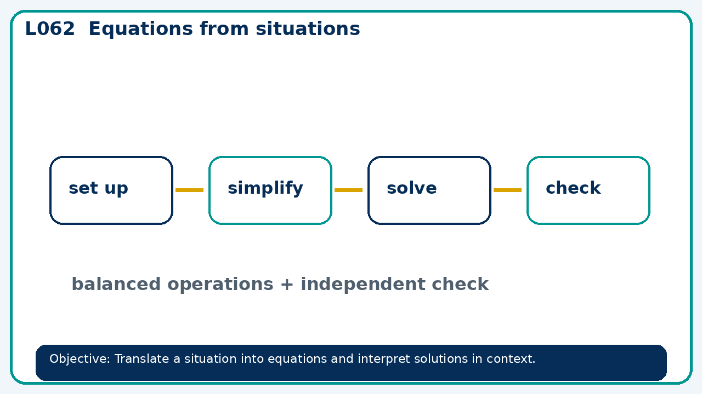
Connect & Check
Complete the starter in your workbook. Retrieve the prior skill, then identify one likely error before you use today's method.
Connect & Check
3/11

Slide 4
Share
Compare your method with a partner. Agree on one reliable step and one check. Be ready to explain your reasoning, not just your answer.
Share
4/11

Slide 5
Build the method
Use the worked model to define variables with units; reject solutions that violate the situation. Record the key step and one check that proves the answer.
Present
5/11

Slide 6
Choose your route
Choose your route: A - visual model, B - method first, or C - explain first. Whichever route you choose, your final answer must prove the lesson objective.
Apply
6/11

Slide 7
Guided practice
Three adult tickets and two child tickets cost £37. Adults cost £9 each. Find child price.
Apply
7/11

Slide 8
Independent practice
A rectangle's length is twice its width and its area is 50 cm². Find positive dimensions.
Apply
8/11

Slide 9
Exam-style practice
Solve an exam-style problem involving equations from situations. Show working, include a check and interpret your answer.
Apply
9/11

Slide 10
Recall & Review
Complete a fresh question without notes. Check your answer, correct one error if needed, and record the next practice step.
Recall & Review
10/11

Slide 11
Before next lesson
Correct one error, record one target and complete the flipped learning task.
Recall & Review
11/11

Slide 12

L062 Recall & Review
Equations from situations
Fresh evidence: prove the objective
Solve a new question without prompts. Explain one check, then correct one error in your working.
Objective: Translate a situation into equations and interpret solutions in context.
Write the next practice step before you leave. It must test the method again, not simply copy today’s example.
Reach for the Star · GCSE Maths · Recall & Review

Slide 13
Feedback language
Use the full phrases before the abbreviations.
What Went Well (WWW)
Even Better If (EBI)
I represented the algebraic structure accurately, kept each transformation valid and checked the result by substitution, graph or equivalent reasoning.
I will show the missing inverse operation or algebraic step, keep signs and brackets accurate and test the result in the original relationship.
Identify the mathematical method, representation, reasoning or check that improved.
Set one precise next-step action and test it on a fresh question.
Reach for the Star · GCSE Maths · Recall & Review

Slide 14
Extension route
Choose this route only after the core evidence is secure.
Stretch
Three adult tickets and two child tickets cost £37. Adults cost £9 each. Find child price.
Deep challenge
A rectangle's length is twice its width and its area is 50 cm². Find positive dimensions.
Explain your reasoning clearly enough that another learner could check it.
Reach for the Star · GCSE Maths · Recall & Review

