Slide 1

Cubic reciprocal and other graphs
L063 · GCSE Mathematics 1MA1 · 60 minutes

Slide 2
The goal
Recognise graph families and estimate solutions graphically.
Connect & Check
2/11

Slide 3
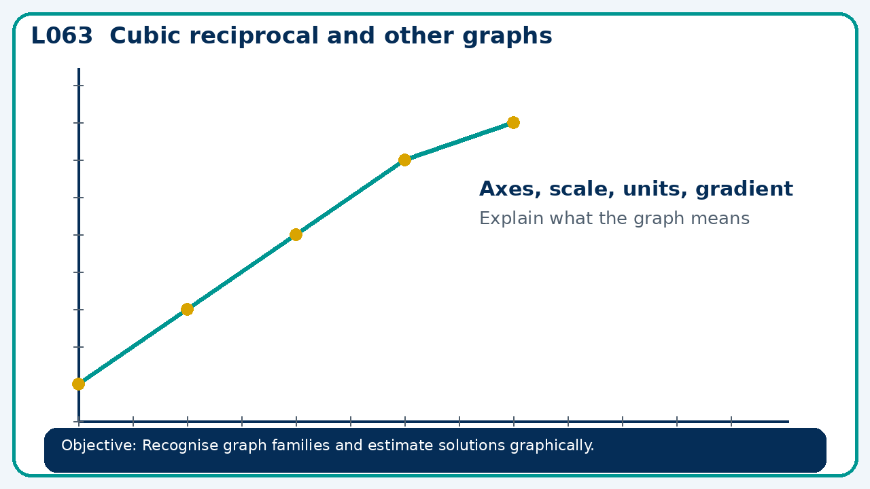
Connect & Check
Complete the starter in your workbook. Retrieve the prior skill, then identify one likely error before you use today's method.
Connect & Check
3/11

Slide 4
Share
Compare your method with a partner. Agree on one reliable step and one check. Be ready to explain your reasoning, not just your answer.
Share
4/11

Slide 5
Build the method
Use the worked model to compare cubic and reciprocal graphs; Higher: exponential and trigonometric forms. Record the key step and one check that proves the answer.
Present
5/11

Slide 6
Choose your route
Choose your route: A - visual model, B - method first, or C - explain first. Whichever route you choose, your final answer must prove the lesson objective.
Apply
6/11

Slide 7
Guided practice
For y=12/x, find points when x=−3 and x=4, and identify the missing x-value.
Apply
7/11

Slide 8
Independent practice
Compare y=x³ and y=−x³ at x=−2 and x=2. What symmetry relates them?
Apply
8/11

Slide 9
Exam-style practice
A graph is drawn for a real context. Interpret the gradient, intercept or area as appropriate. State units and justify your answer.
Apply
9/11

Slide 10
Recall & Review
Complete a fresh question without notes. Check your answer, correct one error if needed, and record the next practice step.
Recall & Review
10/11

Slide 11
Before next lesson
Correct one error, record one target and complete the flipped learning task.
Recall & Review
11/11

Slide 12

L063 Recall & Review
Cubic reciprocal and other graphs
Fresh evidence: prove the objective
Solve a new question without prompts. Explain one check, then correct one error in your working.
Objective: Recognise graph families and estimate solutions graphically.
Write the next practice step before you leave. It must test the method again, not simply copy today’s example.
Reach for the Star · GCSE Maths · Recall & Review

Slide 13
Feedback language
Use the full phrases before the abbreviations.
What Went Well (WWW)
Even Better If (EBI)
I represented the algebraic structure accurately, kept each transformation valid and checked the result by substitution, graph or equivalent reasoning.
I will show the missing inverse operation or algebraic step, keep signs and brackets accurate and test the result in the original relationship.
Identify the mathematical method, representation, reasoning or check that improved.
Set one precise next-step action and test it on a fresh question.
Reach for the Star · GCSE Maths · Recall & Review

Slide 14
Extension route
Choose this route only after the core evidence is secure.
Stretch
For y=12/x, find points when x=−3 and x=4, and identify the missing x-value.
Deep challenge
Compare y=x³ and y=−x³ at x=−2 and x=2. What symmetry relates them?
Explain your reasoning clearly enough that another learner could check it.
Reach for the Star · GCSE Maths · Recall & Review

