Slide 1

Direct and inverse proportion
L065 · GCSE Mathematics 1MA1 · 60 minutes

Slide 2
The goal
Solve direct and inverse proportion problems and represent relationships.
Connect & Check
2/11

Slide 3
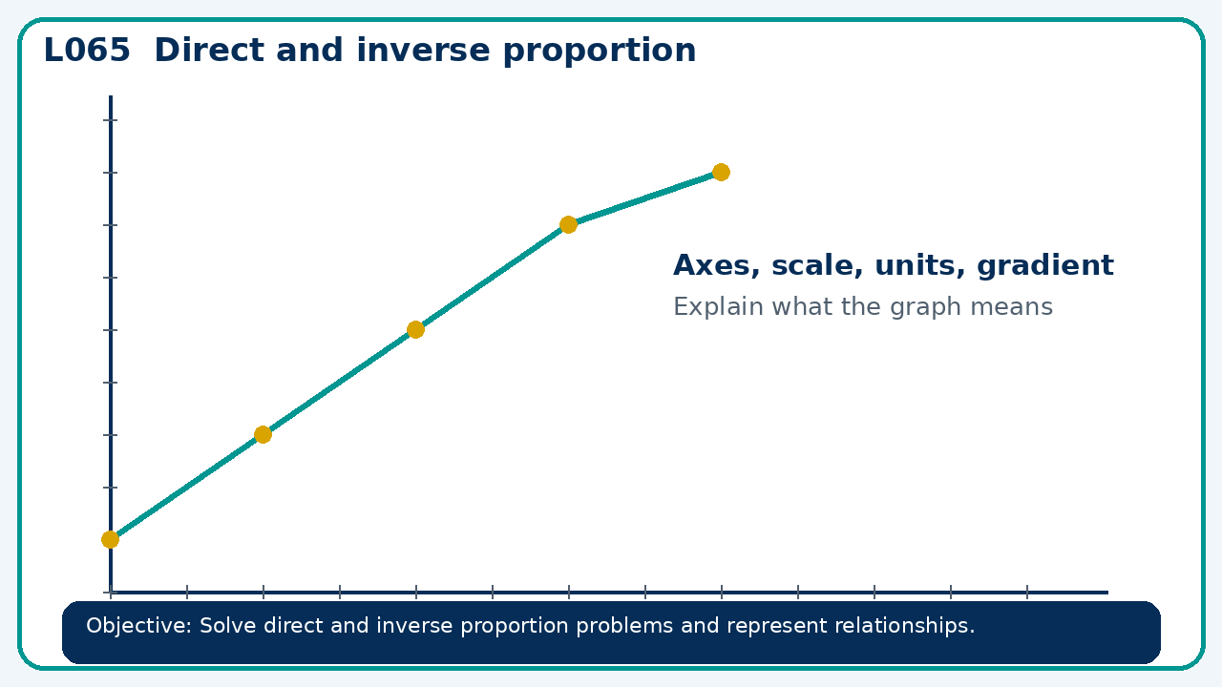
Connect & Check
Complete the starter in your workbook. Retrieve the prior skill, then identify one likely error before you use today's method.
Connect & Check
3/11

Slide 4
Share
Compare your method with a partner. Agree on one reliable step and one check. Be ready to explain your reasoning, not just your answer.
Share
4/11

Slide 5
Build the method
Use the worked model to use tables, graphs and equations; distinguish proportional from merely increasing relationships. Record the key step and one check that proves the answer.
Present
5/11

Slide 6
Choose your route
Choose your route: A - visual model, B - method first, or C - explain first. Whichever route you choose, your final answer must prove the lesson objective.
Apply
6/11

Slide 7
Guided practice
y is inversely proportional to x². If y=12 at x=2, find y at x=4.
Apply
7/11

Slide 8
Independent practice
A graph through the origin appears curved upward. Can y be directly proportional to x? Explain.
Apply
8/11

Slide 9
Exam-style practice
Solve an exam-style problem involving direct and inverse proportion. Show working, include a check and interpret your answer.
Apply
9/11

Slide 10
Recall & Review
Complete a fresh question without notes. Check your answer, correct one error if needed, and record the next practice step.
Recall & Review
10/11

Slide 11
Before next lesson
Correct one error, record one target and complete the flipped learning task.
Recall & Review
11/11

Slide 12

L065 Recall & Review
Direct and inverse proportion
Fresh evidence: prove the objective
Solve a new question without prompts. Explain one check, then correct one error in your working.
Objective: Solve direct and inverse proportion problems and represent relationships.
Write the next practice step before you leave. It must test the method again, not simply copy today’s example.
Reach for the Star · GCSE Maths · Recall & Review

Slide 13
Feedback language
Use the full phrases before the abbreviations.
What Went Well (WWW)
Even Better If (EBI)
I identified the correct reference quantity, ratio, rate or multiplier and kept the units and proportional relationship clear.
I will state the whole or reference quantity, show the multiplier or unit-rate step and check whether the result is sensible in context.
Identify the mathematical method, representation, reasoning or check that improved.
Set one precise next-step action and test it on a fresh question.
Reach for the Star · GCSE Maths · Recall & Review

Slide 14
Extension route
Choose this route only after the core evidence is secure.
Stretch
y is inversely proportional to x². If y=12 at x=2, find y at x=4.
Deep challenge
A graph through the origin appears curved upward. Can y be directly proportional to x? Explain.
Explain your reasoning clearly enough that another learner could check it.
Reach for the Star · GCSE Maths · Recall & Review

