Slide 1

Growth decay and compound interest
L067 · GCSE Mathematics 1MA1 · 60 minutes

Slide 2
The goal
Model repeated percentage change, growth, decay and compound interest.
Connect & Check
2/11

Slide 3
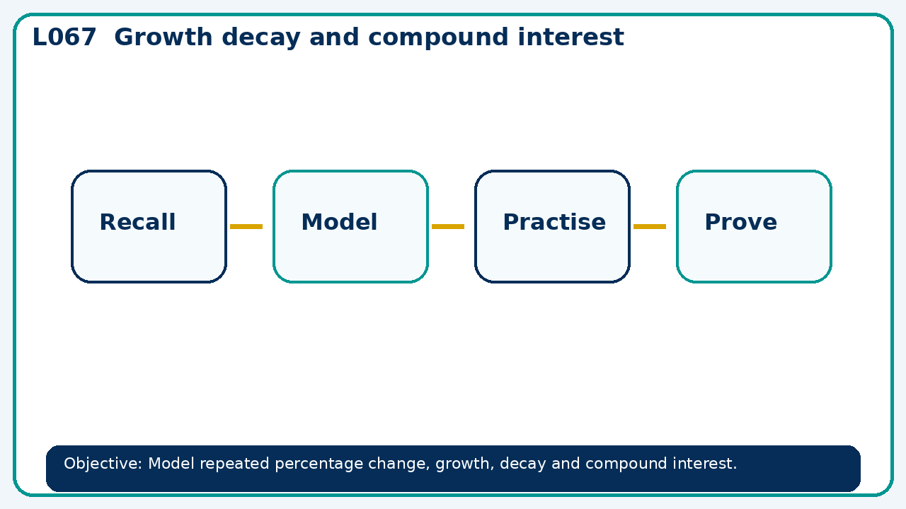
Connect & Check
Complete the starter in your workbook. Retrieve the prior skill, then identify one likely error before you use today's method.
Connect & Check
3/11

Slide 4
Share
Compare your method with a partner. Agree on one reliable step and one check. Be ready to explain your reasoning, not just your answer.
Share
4/11

Slide 5
Build the method
Use the worked model to compare additive and multiplicative change using successive periods. Record the key step and one check that proves the answer.
Present
5/11

Slide 6
Choose your route
Choose your route: A - visual model, B - method first, or C - explain first. Whichever route you choose, your final answer must prove the lesson objective.
Apply
6/11

Slide 7
Guided practice
£1,000 grows 4% annually for three years. Find final value to the nearest penny.
Apply
7/11

Slide 8
Independent practice
A price rises 20% then falls 20%. Prove it does not return to the starting price.
Apply
8/11

Slide 9
Exam-style practice
Solve an exam-style problem involving growth decay and compound interest. Show working, include a check and interpret your answer.
Apply
9/11

Slide 10
Recall & Review
Complete a fresh question without notes. Check your answer, correct one error if needed, and record the next practice step.
Recall & Review
10/11

Slide 11
Before next lesson
Correct one error, record one target and complete the flipped learning task.
Recall & Review
11/11

Slide 12

L067 Recall & Review
Growth decay and compound interest
Fresh evidence: prove the objective
Solve a new question without prompts. Explain one check, then correct one error in your working.
Objective: Model repeated percentage change, growth, decay and compound interest.
Write the next practice step before you leave. It must test the method again, not simply copy today’s example.
Reach for the Star · GCSE Maths · Recall & Review

Slide 13
Feedback language
Use the full phrases before the abbreviations.
What Went Well (WWW)
Even Better If (EBI)
I identified the correct reference quantity, ratio, rate or multiplier and kept the units and proportional relationship clear.
I will state the whole or reference quantity, show the multiplier or unit-rate step and check whether the result is sensible in context.
Identify the mathematical method, representation, reasoning or check that improved.
Set one precise next-step action and test it on a fresh question.
Reach for the Star · GCSE Maths · Recall & Review

Slide 14
Extension route
Choose this route only after the core evidence is secure.
Stretch
£1,000 grows 4% annually for three years. Find final value to the nearest penny.
Deep challenge
A price rises 20% then falls 20%. Prove it does not return to the starting price.
Explain your reasoning clearly enough that another learner could check it.
Reach for the Star · GCSE Maths · Recall & Review

