Slide 1

Similarity and lengths
L069 · GCSE Mathematics 1MA1 · 60 minutes

Slide 2
The goal
Use similarity to calculate missing lengths and justify scale factors.
Connect & Check
2/11

Slide 3
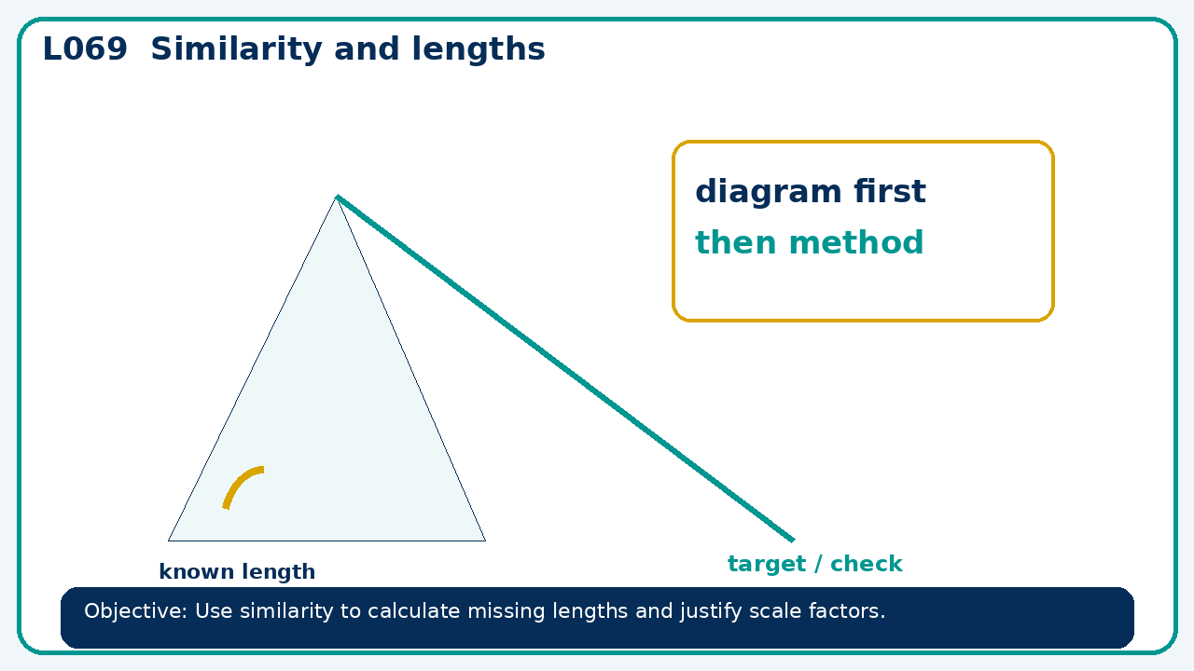
Connect & Check
Complete the starter in your workbook. Retrieve the prior skill, then identify one likely error before you use today's method.
Connect & Check
3/11

Slide 4
Share
Compare your method with a partner. Agree on one reliable step and one check. Be ready to explain your reasoning, not just your answer.
Share
4/11

Slide 5
Build the method
Use the worked model to match corresponding vertices before calculating; contrast similarity with congruence. Record the key step and one check that proves the answer.
Present
5/11

Slide 6
Choose your route
Choose your route: A - visual model, B - method first, or C - explain first. Whichever route you choose, your final answer must prove the lesson objective.
Apply
6/11

Slide 7
Guided practice
Similar triangles have corresponding sides 6 cm and 15 cm. A 9 cm side corresponds to what length?
Apply
7/11

Slide 8
Independent practice
Are triangles with side sets 3,4,5 and 6,8,11 similar? Explain.
Apply
8/11

Slide 9
Exam-style practice
Solve an exam-style problem involving similarity and lengths. Show working, include a check and interpret your answer.
Apply
9/11

Slide 10
Recall & Review
Complete a fresh question without notes. Check your answer, correct one error if needed, and record the next practice step.
Recall & Review
10/11

Slide 11
Before next lesson
Correct one error, record one target and complete the flipped learning task.
Recall & Review
11/11

Slide 12

L069 Recall & Review
Similarity and lengths
Fresh evidence: prove the objective
Solve a new question without prompts. Explain one check, then correct one error in your working.
Objective: Use similarity to calculate missing lengths and justify scale factors.
Write the next practice step before you leave. It must test the method again, not simply copy today’s example.
Reach for the Star · GCSE Maths · Recall & Review

Slide 13
Feedback language
Use the full phrases before the abbreviations.
What Went Well (WWW)
Even Better If (EBI)
I selected the correct geometric fact, theorem, formula or transformation and used a clear diagram with appropriate labels and units.
I will name the fact or theorem, show the substitution or construction step and check whether the size, direction and units of the result are reasonable.
Identify the mathematical method, representation, reasoning or check that improved.
Set one precise next-step action and test it on a fresh question.
Reach for the Star · GCSE Maths · Recall & Review

Slide 14
Extension route
Choose this route only after the core evidence is secure.
Stretch
Similar triangles have corresponding sides 6 cm and 15 cm. A 9 cm side corresponds to what length?
Deep challenge
Are triangles with side sets 3,4,5 and 6,8,11 similar? Explain.
Explain your reasoning clearly enough that another learner could check it.
Reach for the Star · GCSE Maths · Recall & Review

