Slide 1

Triangle problems and bearings
L071 · GCSE Mathematics 1MA1 · 60 minutes

Slide 2
The goal
Combine triangle methods, scale drawings and bearings appropriately.
Connect & Check
2/11

Slide 3
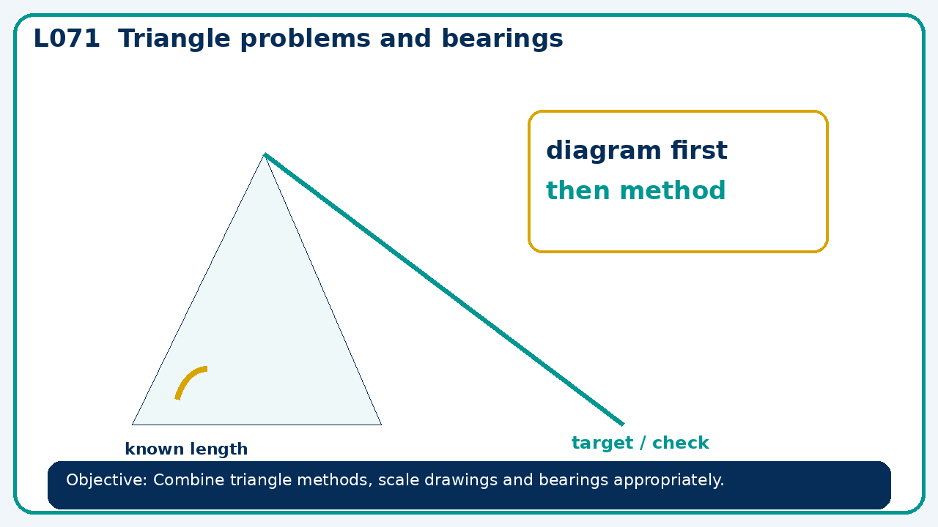
Connect & Check
Complete the starter in your workbook. Retrieve the prior skill, then identify one likely error before you use today's method.
Connect & Check
3/11

Slide 4
Share
Compare your method with a partner. Agree on one reliable step and one check. Be ready to explain your reasoning, not just your answer.
Share
4/11

Slide 5
Build the method
Use the worked model to foundation: right triangles and bearings. Higher: sine rule, cosine rule and non-right-triangle area. Record the key step and one check that proves the answer.
Present
5/11

Slide 6
Choose your route
Choose your route: A - visual model, B - method first, or C - explain first. Whichever route you choose, your final answer must prove the lesson objective.
Apply
6/11

Slide 7
Guided practice
A traveller goes north 12 km and east 5 km. Find distance and bearing from start to nearest degree.
Apply
7/11

Slide 8
Independent practice
A bearing from A to B is 315°. State reverse bearing and explain the 180° change.
Apply
8/11

Slide 9
Exam-style practice
Use a labelled diagram to calculate the missing value. State the theorem or formula and include units where needed.
Apply
9/11

Slide 10
Recall & Review
Complete a fresh question without notes. Check your answer, correct one error if needed, and record the next practice step.
Recall & Review
10/11

Slide 11
Before next lesson
Correct one error, record one target and complete the flipped learning task.
Recall & Review
11/11

Slide 12

L071 Recall & Review
Triangle problems and bearings
Fresh evidence: prove the objective
Solve a new question without prompts. Explain one check, then correct one error in your working.
Objective: Combine triangle methods, scale drawings and bearings appropriately.
Write the next practice step before you leave. It must test the method again, not simply copy today’s example.
Reach for the Star · GCSE Maths · Recall & Review

Slide 13
Feedback language
Use the full phrases before the abbreviations.
What Went Well (WWW)
Even Better If (EBI)
I selected the correct geometric fact, theorem, formula or transformation and used a clear diagram with appropriate labels and units.
I will name the fact or theorem, show the substitution or construction step and check whether the size, direction and units of the result are reasonable.
Identify the mathematical method, representation, reasoning or check that improved.
Set one precise next-step action and test it on a fresh question.
Reach for the Star · GCSE Maths · Recall & Review

Slide 14
Extension route
Choose this route only after the core evidence is secure.
Stretch
A traveller goes north 12 km and east 5 km. Find distance and bearing from start to nearest degree.
Deep challenge
A bearing from A to B is 315°. State reverse bearing and explain the 180° change.
Explain your reasoning clearly enough that another learner could check it.
Reach for the Star · GCSE Maths · Recall & Review

