Slide 1

Probability trees and combined events
L073 · GCSE Mathematics 1MA1 · 60 minutes

Slide 2
The goal
Use probability trees and combine event probabilities.
Connect & Check
2/11

Slide 3
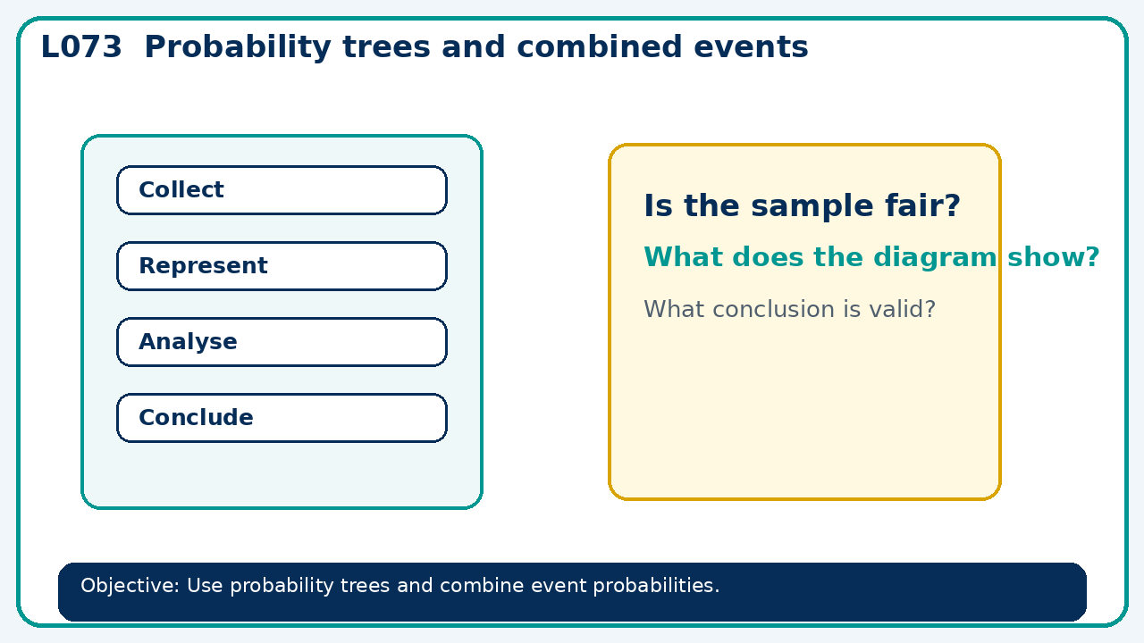
Connect & Check
Complete the starter in your workbook. Retrieve the prior skill, then identify one likely error before you use today's method.
Connect & Check
3/11

Slide 4
Share
Compare your method with a partner. Agree on one reliable step and one check. Be ready to explain your reasoning, not just your answer.
Share
4/11

Slide 5
Build the method
Use the worked model to label branches, check totals and identify whether to add or multiply. Record the key step and one check that proves the answer.
Present
5/11

Slide 6
Choose your route
Choose your route: A - visual model, B - method first, or C - explain first. Whichever route you choose, your final answer must prove the lesson objective.
Apply
6/11

Slide 7
Guided practice
Two independent events have probabilities 0.4 and 0.7. Find P(both) and P(neither).
Apply
7/11

Slide 8
Independent practice
Toss a biased coin with P(H)=0.7 three times. Find P(exactly two heads).
Apply
8/11

Slide 9
Exam-style practice
A probability problem is presented with two stages. Complete the representation, calculate the probability and explain any assumption.
Apply
9/11

Slide 10
Recall & Review
Complete a fresh question without notes. Check your answer, correct one error if needed, and record the next practice step.
Recall & Review
10/11

Slide 11
Before next lesson
Correct one error, record one target and complete the flipped learning task.
Recall & Review
11/11

Slide 12

L073 Recall & Review
Probability trees and combined events
Fresh evidence: prove the objective
Solve a new question without prompts. Explain one check, then correct one error in your working.
Objective: Use probability trees and combine event probabilities.
Write the next practice step before you leave. It must test the method again, not simply copy today’s example.
Reach for the Star · GCSE Maths · Recall & Review

Slide 13
Feedback language
Use the full phrases before the abbreviations.
What Went Well (WWW)
Even Better If (EBI)
I represented the outcomes systematically, used the correct probability rule and checked that the probabilities or frequencies were consistent.
I will show the sample space, branch or set reasoning explicitly, state any dependence or condition and check totals before giving the final probability.
Identify the mathematical method, representation, reasoning or check that improved.
Set one precise next-step action and test it on a fresh question.
Reach for the Star · GCSE Maths · Recall & Review

Slide 14
Extension route
Choose this route only after the core evidence is secure.
Stretch
Two independent events have probabilities 0.4 and 0.7. Find P(both) and P(neither).
Deep challenge
Toss a biased coin with P(H)=0.7 three times. Find P(exactly two heads).
Explain your reasoning clearly enough that another learner could check it.
Reach for the Star · GCSE Maths · Recall & Review

