Slide 1

Probability pathway and repair
L076 · GCSE Mathematics 1MA1 · 60 minutes

Slide 2
The goal
Select a probability representation and repair common errors.
Connect & Check
2/11

Slide 3
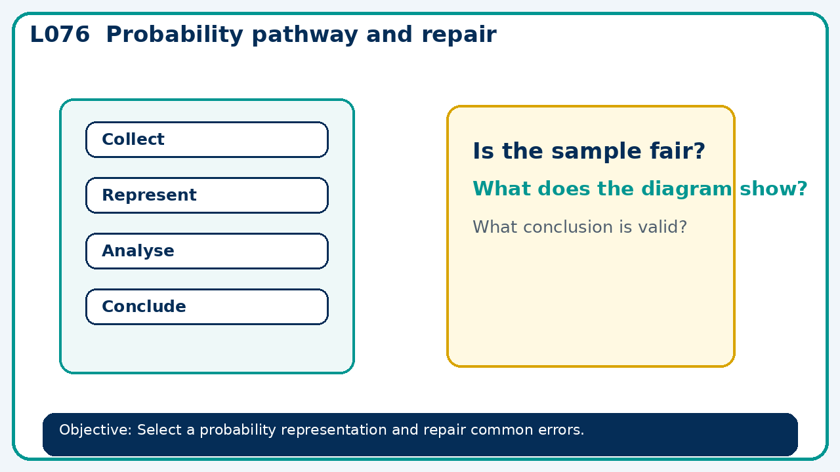
Connect & Check
Complete the starter in your workbook. Retrieve the prior skill, then identify one likely error before you use today's method.
Connect & Check
3/11

Slide 4
Share
Compare your method with a partner. Agree on one reliable step and one check. Be ready to explain your reasoning, not just your answer.
Share
4/11

Slide 5
Build the method
Use the worked model to foundation: sample spaces and frequency trees. Higher: conditional and dependent events. Record the key step and one check that proves the answer.
Present
5/11

Slide 6
Choose your route
Choose your route: A - visual model, B - method first, or C - explain first. Whichever route you choose, your final answer must prove the lesson objective.
Apply
6/11

Slide 7
Guided practice
Two fair dice are rolled. Find P(at least one six).
Apply
7/11

Slide 8
Independent practice
A bag with 3 red and 2 blue is drawn twice without replacement. Are the events independent? Show with probabilities.
Apply
8/11

Slide 9
Exam-style practice
A probability problem is presented with two stages. Complete the representation, calculate the probability and explain any assumption.
Apply
9/11

Slide 10
Recall & Review
Complete a fresh question without notes. Check your answer, correct one error if needed, and record the next practice step.
Recall & Review
10/11

Slide 11
Before next lesson
Correct one error, record one target and complete the flipped learning task.
Recall & Review
11/11

Slide 12

L076 Recall & Review
Probability pathway and repair
Fresh evidence: prove the objective
Solve a new question without prompts. Explain one check, then correct one error in your working.
Objective: Select a probability representation and repair common errors.
Write the next practice step before you leave. It must test the method again, not simply copy today’s example.
Reach for the Star · GCSE Maths · Recall & Review

Slide 13
Feedback language
Use the full phrases before the abbreviations.
What Went Well (WWW)
Even Better If (EBI)
I used my working and assessment evidence to identify the exact mathematical step that was secure and the specific misconception that needs attention.
I will correct one precise step, explain why the correction works and complete a fresh delayed question without the original scaffold.
Identify the mathematical method, representation, reasoning or check that improved.
Set one precise next-step action and test it on a fresh question.
Reach for the Star · GCSE Maths · Recall & Review

Slide 14
Extension route
Choose this route only after the core evidence is secure.
Stretch
Two fair dice are rolled. Find P(at least one six).
Deep challenge
A bag with 3 red and 2 blue is drawn twice without replacement. Are the events independent? Show with probabilities.
Explain your reasoning clearly enough that another learner could check it.
Reach for the Star · GCSE Maths · Recall & Review

