Slide 1

Scatter graphs and correlation
L077 · GCSE Mathematics 1MA1 · 60 minutes

Slide 2
The goal
Describe correlation, use a line of best fit and recognise limits of prediction.
Connect & Check
2/11

Slide 3
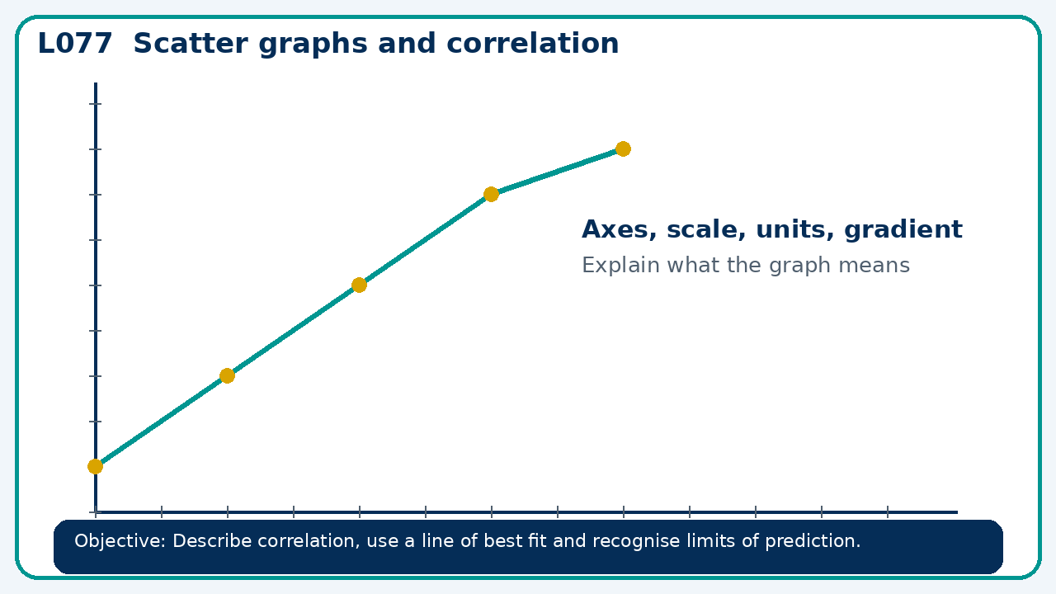
Connect & Check
Complete the starter in your workbook. Retrieve the prior skill, then identify one likely error before you use today's method.
Connect & Check
3/11

Slide 4
Share
Compare your method with a partner. Agree on one reliable step and one check. Be ready to explain your reasoning, not just your answer.
Share
4/11

Slide 5
Build the method
Use the worked model to distinguish association from cause; contrast interpolation and extrapolation. Record the key step and one check that proves the answer.
Present
5/11

Slide 6
Choose your route
Choose your route: A - visual model, B - method first, or C - explain first. Whichever route you choose, your final answer must prove the lesson objective.
Apply
6/11

Slide 7
Guided practice
A trend line predicts 45 at x=8 from data spanning x=2 to 10. Is this interpolation or extrapolation?
Apply
7/11

Slide 8
Independent practice
A scatter graph shows strong negative correlation between screen time and sleep. Can it prove screen time causes less sleep?
Apply
8/11

Slide 9
Exam-style practice
A graph is drawn for a real context. Interpret the gradient, intercept or area as appropriate. State units and justify your answer.
Apply
9/11

Slide 10
Recall & Review
Complete a fresh question without notes. Check your answer, correct one error if needed, and record the next practice step.
Recall & Review
10/11

Slide 11
Before next lesson
Correct one error, record one target and complete the flipped learning task.
Recall & Review
11/11

Slide 12

L077 Recall & Review
Scatter graphs and correlation
Fresh evidence: prove the objective
Solve a new question without prompts. Explain one check, then correct one error in your working.
Objective: Describe correlation, use a line of best fit and recognise limits of prediction.
Write the next practice step before you leave. It must test the method again, not simply copy today’s example.
Reach for the Star · GCSE Maths · Recall & Review

Slide 13
Feedback language
Use the full phrases before the abbreviations.
What Went Well (WWW)
Even Better If (EBI)
I read or constructed the graph accurately, used the scale and axes correctly and linked the relevant gradient, intercept, shape or trend to my conclusion.
I will label units and scale clearly, show the calculation or graphical evidence I used and check that the interpretation fits the context.
Identify the mathematical method, representation, reasoning or check that improved.
Set one precise next-step action and test it on a fresh question.
Reach for the Star · GCSE Maths · Recall & Review

Slide 14
Extension route
Choose this route only after the core evidence is secure.
Stretch
A trend line predicts 45 at x=8 from data spanning x=2 to 10. Is this interpolation or extrapolation?
Deep challenge
A scatter graph shows strong negative correlation between screen time and sleep. Can it prove screen time causes less sleep?
Explain your reasoning clearly enough that another learner could check it.
Reach for the Star · GCSE Maths · Recall & Review

