Slide 1

Cumulative checkpoint 6 and feedback
L080 · GCSE Mathematics 1MA1 · 60 minutes

Slide 2
The goal
Apply probability and statistics with earlier number and algebra.
Connect & Check
2/11

Slide 3
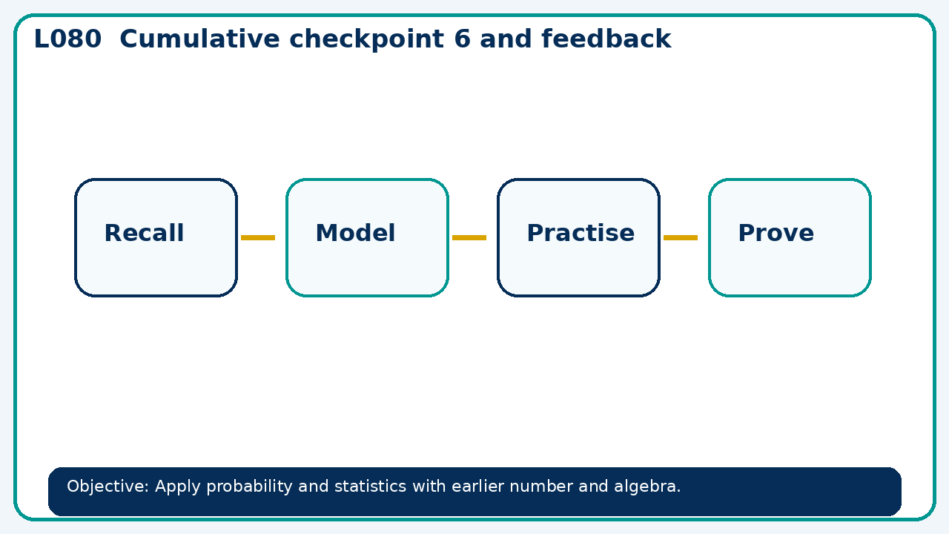
Connect & Check
Complete the starter in your workbook. Retrieve the prior skill, then identify one likely error before you use today's method.
Connect & Check
3/11

Slide 4
Share
Compare your method with a partner. Agree on one reliable step and one check. Be ready to explain your reasoning, not just your answer.
Share
4/11

Slide 5
Build the method
Use the worked model to use a cumulative diagnostic followed by targeted repair and a fresh check. Record the key step and one check that proves the answer.
Present
5/11

Slide 6
Choose your route
Choose your route: A - visual model, B - method first, or C - explain first. Whichever route you choose, your final answer must prove the lesson objective.
Apply
6/11

Slide 7
Guided practice
A class interval width 6 has frequency 27. Find density, then expected frequency for width 10 at the same density.
Apply
7/11

Slide 8
Independent practice
Explain why a single experimental probability estimate may change when more trials are added.
Apply
8/11

Slide 9
Exam-style practice
Solve an exam-style problem involving cumulative checkpoint 6 and feedback. Show working, include a check and interpret your answer.
Apply
9/11

Slide 10
Recall & Review
Complete a fresh question without notes. Check your answer, correct one error if needed, and record the next practice step.
Recall & Review
10/11

Slide 11
Before next lesson
Correct one error, record one target and complete the flipped learning task.
Recall & Review
11/11

Slide 12

L080 Recall & Review
Cumulative checkpoint 6 and feedback
Fresh evidence: prove the objective
Solve a new question without prompts. Explain one check, then correct one error in your working.
Objective: Apply probability and statistics with earlier number and algebra.
Write the next practice step before you leave. It must test the method again, not simply copy today’s example.
Reach for the Star · GCSE Maths · Recall & Review

Slide 13
Feedback language
Use the full phrases before the abbreviations.
What Went Well (WWW)
Even Better If (EBI)
I used my working and assessment evidence to identify the exact mathematical step that was secure and the specific misconception that needs attention.
I will correct one precise step, explain why the correction works and complete a fresh delayed question without the original scaffold.
Identify the mathematical method, representation, reasoning or check that improved.
Set one precise next-step action and test it on a fresh question.
Reach for the Star · GCSE Maths · Recall & Review

Slide 14
Extension route
Choose this route only after the core evidence is secure.
Stretch
A class interval width 6 has frequency 27. Find density, then expected frequency for width 10 at the same density.
Deep challenge
Explain why a single experimental probability estimate may change when more trials are added.
Explain your reasoning clearly enough that another learner could check it.
Reach for the Star · GCSE Maths · Recall & Review

