Slide 1

Circle geometry pathway
L081 · GCSE Mathematics 1MA1 · 60 minutes

Slide 2
The goal
Use circle geometry at the appropriate tier and explain angle reasoning.
Connect & Check
2/11

Slide 3
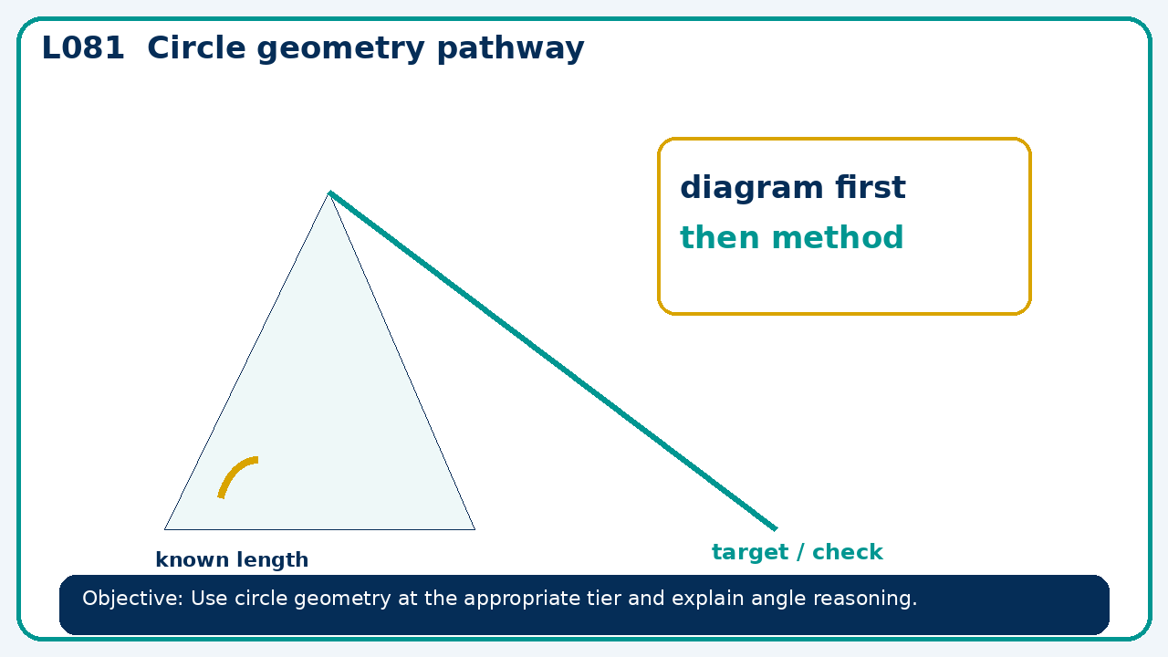
Connect & Check
Complete the starter in your workbook. Retrieve the prior skill, then identify one likely error before you use today's method.
Connect & Check
3/11

Slide 4
Share
Compare your method with a partner. Agree on one reliable step and one check. Be ready to explain your reasoning, not just your answer.
Share
4/11

Slide 5
Build the method
Use the worked model to foundation: circle measures and general angle facts. Higher: circle theorems and proof chains. Record the key step and one check that proves the answer.
Present
5/11

Slide 6
Choose your route
Choose your route: A - visual model, B - method first, or C - explain first. Whichever route you choose, your final answer must prove the lesson objective.
Apply
6/11

Slide 7
Guided practice
A central angle is 146°. Find the circumference angle subtending the same arc.
Apply
7/11

Slide 8
Independent practice
In a cyclic quadrilateral, opposite angles are 2x+10 and 3x−5. Find x and both angles.
Apply
8/11

Slide 9
Exam-style practice
Use a labelled diagram to calculate the missing value. State the theorem or formula and include units where needed.
Apply
9/11

Slide 10
Recall & Review
Complete a fresh question without notes. Check your answer, correct one error if needed, and record the next practice step.
Recall & Review
10/11

Slide 11
Before next lesson
Correct one error, record one target and complete the flipped learning task.
Recall & Review
11/11

Slide 12

L081 Recall & Review
Circle geometry pathway
Fresh evidence: prove the objective
Solve a new question without prompts. Explain one check, then correct one error in your working.
Objective: Use circle geometry at the appropriate tier and explain angle reasoning.
Write the next practice step before you leave. It must test the method again, not simply copy today’s example.
Reach for the Star · GCSE Maths · Recall & Review

Slide 13
Feedback language
Use the full phrases before the abbreviations.
What Went Well (WWW)
Even Better If (EBI)
I selected the correct geometric fact, theorem, formula or transformation and used a clear diagram with appropriate labels and units.
I will name the fact or theorem, show the substitution or construction step and check whether the size, direction and units of the result are reasonable.
Identify the mathematical method, representation, reasoning or check that improved.
Set one precise next-step action and test it on a fresh question.
Reach for the Star · GCSE Maths · Recall & Review

Slide 14
Extension route
Choose this route only after the core evidence is secure.
Stretch
A central angle is 146°. Find the circumference angle subtending the same arc.
Deep challenge
In a cyclic quadrilateral, opposite angles are 2x+10 and 3x−5. Find x and both angles.
Explain your reasoning clearly enough that another learner could check it.
Reach for the Star · GCSE Maths · Recall & Review

