Slide 1

Mock paper 1 non-calculator
L097 · GCSE Mathematics 1MA1 · 60 minutes

Slide 2
The goal
Apply the chosen tier’s content independently in mock Paper 1.
Connect & Check
2/11

Slide 3
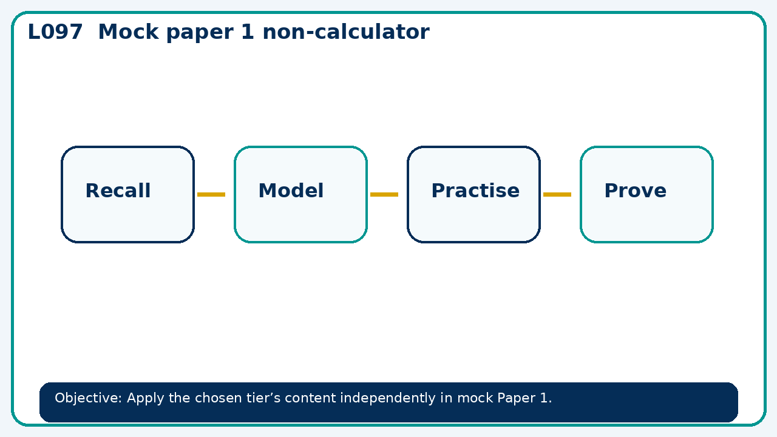
Connect & Check
Complete the starter in your workbook. Retrieve the prior skill, then identify one likely error before you use today's method.
Connect & Check
3/11

Slide 4
Share
Before timing begins, share one exam strategy and clarify how method marks are evidenced; do not discuss answers during the assessment.
Share
4/11

Slide 5
Build the method
Use the worked model to explain paper instructions, time allocation and permitted equipment. Distribute the selected 45 minute tier section; maintain exam conditions. Record the key step and one check that proves the answer.
Present
5/11

Slide 6
Choose your route
Choose your route: A - visual model, B - method first, or C - explain first. Whichever route you choose, your final answer must prove the lesson objective.
Apply
6/11

Slide 7
Guided practice
For later feedback, not during timed work. Stretch: Without a calculator, find 7/12 of 84 and show a division-first method. Deep challenge: A learner gets 49 but writes only the answer on a two-mark question. Explain what evidence of method to add.
Apply
7/11

Slide 8
Independent practice
A learner gets 49 but writes only the answer on a two-mark question. Explain what evidence of method to add.
Apply
8/11

Slide 9
Exam-style practice
Solve an exam-style problem involving mock paper 1 non-calculator. Show working, include a check and interpret your answer.
Apply
9/11

Slide 10
Recall & Review
Collect scripts. Learners note confidence and one time-management decision; mark and give method feedback at the next lesson.
Recall & Review
10/11

Slide 11
Before next lesson
Correct one error, record one target and complete the flipped learning task.
Recall & Review
11/11

Slide 12

L097 Recall & Review
Mock paper 1 non-calculator
Fresh evidence: prove the objective
Solve a new question without prompts. Explain one check, then correct one error in your working.
Objective: Apply the chosen tier’s content independently in mock Paper 1.
Write the next practice step before you leave. It must test the method again, not simply copy today’s example.
Reach for the Star · GCSE Maths · Recall & Review

Slide 13
Feedback language
Use the full phrases before the abbreviations.
What Went Well (WWW)
Even Better If (EBI)
I used my working and assessment evidence to identify the exact mathematical step that was secure and the specific misconception that needs attention.
I will correct one precise step, explain why the correction works and complete a fresh delayed question without the original scaffold.
Identify the mathematical method, representation, reasoning or check that improved.
Set one precise next-step action and test it on a fresh question.
Reach for the Star · GCSE Maths · Recall & Review

Slide 14
Extension route
Choose this route only after the core evidence is secure.
Stretch
Without a calculator, find 7/12 of 84 and show a division-first method.
Deep challenge
A learner gets 49 but writes only the answer on a two-mark question. Explain what evidence of method to add.
Explain your reasoning clearly enough that another learner could check it.
Reach for the Star · GCSE Maths · Recall & Review

