Slide 1

Paper 2 feedback and repair
L101 · GCSE Mathematics 1MA1 · 60 minutes

Slide 2
The goal
Interpret feedback on mock Paper 2 and repair a priority misconception.
Connect & Check
2/11

Slide 3
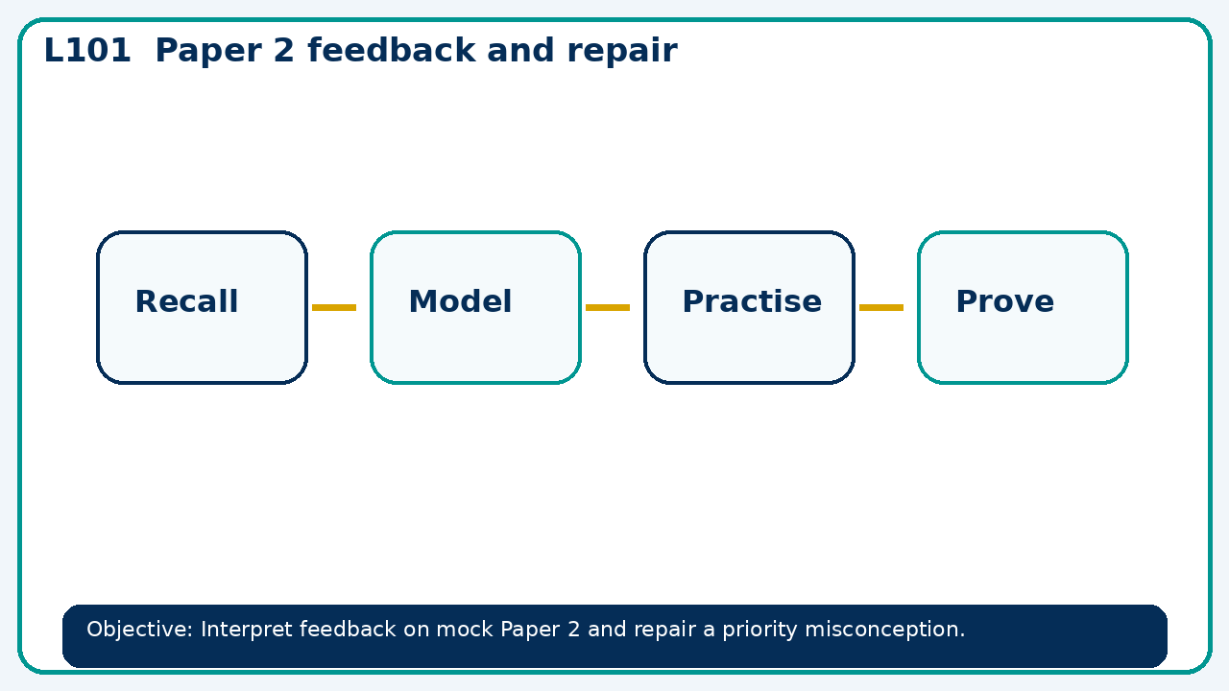
Connect & Check
Complete the starter in your workbook. Retrieve the prior skill, then identify one likely error before you use today's method.
Connect & Check
3/11

Slide 4
Share
Compare your method with a partner. Agree on one reliable step and one check. Be ready to explain your reasoning, not just your answer.
Share
4/11

Slide 5
Build the method
Use the worked model to use a 30 minute feedback conference with a worked-example/problem pair. Agree the next independent check. Record the key step and one check that proves the answer.
Present
5/11

Slide 6
Choose your route
Choose your route: A - visual model, B - method first, or C - explain first. Whichever route you choose, your final answer must prove the lesson objective.
Apply
6/11

Slide 7
Guided practice
£420 grows 7% for two years. Find value to nearest penny.
Apply
7/11

Slide 8
Independent practice
A calculator input 420×1+0.07² is used for growth. Identify the bracket error.
Apply
8/11

Slide 9
Exam-style practice
Solve an exam-style problem involving paper 2 feedback and repair. Show working, include a check and interpret your answer.
Apply
9/11

Slide 10
Recall & Review
Complete a fresh question without notes. Check your answer, correct one error if needed, and record the next practice step.
Recall & Review
10/11

Slide 11
Before next lesson
Correct one error, record one target and complete the flipped learning task.
Recall & Review
11/11

Slide 12

L101 Recall & Review
Paper 2 feedback and repair
Fresh evidence: prove the objective
Solve a new question without prompts. Explain one check, then correct one error in your working.
Objective: Interpret feedback on mock Paper 2 and repair a priority misconception.
Write the next practice step before you leave. It must test the method again, not simply copy today’s example.
Reach for the Star · GCSE Maths · Recall & Review

Slide 13
Feedback language
Use the full phrases before the abbreviations.
What Went Well (WWW)
Even Better If (EBI)
I used my working and assessment evidence to identify the exact mathematical step that was secure and the specific misconception that needs attention.
I will correct one precise step, explain why the correction works and complete a fresh delayed question without the original scaffold.
Identify the mathematical method, representation, reasoning or check that improved.
Set one precise next-step action and test it on a fresh question.
Reach for the Star · GCSE Maths · Recall & Review

Slide 14
Extension route
Choose this route only after the core evidence is secure.
Stretch
£420 grows 7% for two years. Find value to nearest penny.
Deep challenge
A calculator input 420×1+0.07² is used for growth. Identify the bracket error.
Explain your reasoning clearly enough that another learner could check it.
Reach for the Star · GCSE Maths · Recall & Review

