Slide 1

Personal revision plan and flexible repair
L108 · GCSE Mathematics 1MA1 · 60 minutes

Slide 2
The goal
Plan spaced revision and choose manageable next steps from evidence.
Connect & Check
2/11

Slide 3
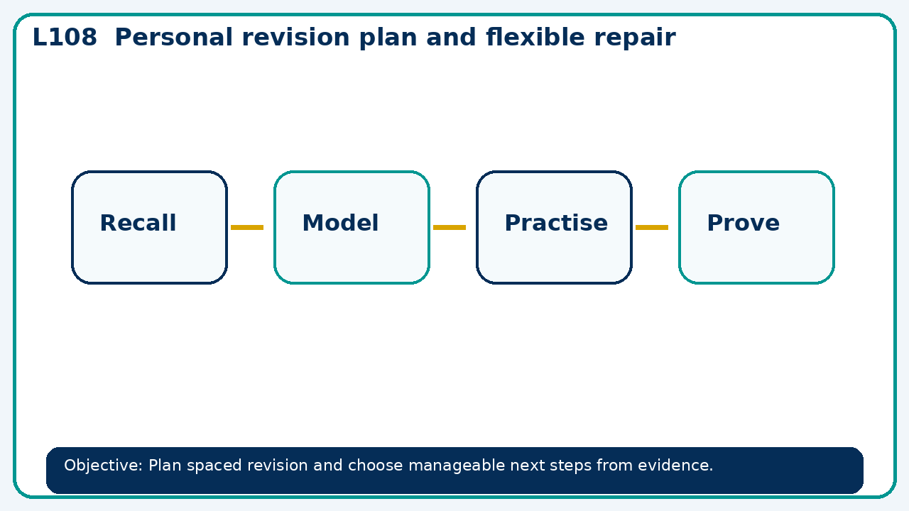
Connect & Check
Complete the starter in your workbook. Retrieve the prior skill, then identify one likely error before you use today's method.
Connect & Check
3/11

Slide 4
Share
Compare your method with a partner. Agree on one reliable step and one check. Be ready to explain your reasoning, not just your answer.
Share
4/11

Slide 5
Build the method
Use the worked model to use assessment evidence to select a worked-example/problem pair. Fade prompts and review a fresh independent response with the learner. Record the key step and one check that proves the answer.
Present
5/11

Slide 6
Choose your route
Choose your route: A - visual model, B - method first, or C - explain first. Whichever route you choose, your final answer must prove the lesson objective.
Apply
6/11

Slide 7
Guided practice
Plan three short spaced checks for fractions over two weeks, with one fresh question in each.
Apply
7/11

Slide 8
Independent practice
A learner can answer only when following a model. What evidence would justify removing the scaffold?
Apply
8/11

Slide 9
Exam-style practice
Solve an exam-style problem involving personal revision plan and flexible repair. Show working, include a check and interpret your answer.
Apply
9/11

Slide 10
Recall & Review
Complete a fresh question without notes. Check your answer, correct one error if needed, and record the next practice step.
Recall & Review
10/11

Slide 11
Before next lesson
Correct one error, record one target and complete the flipped learning task.
Recall & Review
11/11

Slide 12

L108 Recall & Review
Personal revision plan and flexible repair
Fresh evidence: prove the objective
Solve a new question without prompts. Explain one check, then correct one error in your working.
Objective: Plan spaced revision and choose manageable next steps from evidence.
Write the next practice step before you leave. It must test the method again, not simply copy today’s example.
Reach for the Star · GCSE Maths · Recall & Review

Slide 13
Feedback language
Use the full phrases before the abbreviations.
What Went Well (WWW)
Even Better If (EBI)
I used my working and assessment evidence to identify the exact mathematical step that was secure and the specific misconception that needs attention.
I will correct one precise step, explain why the correction works and complete a fresh delayed question without the original scaffold.
Identify the mathematical method, representation, reasoning or check that improved.
Set one precise next-step action and test it on a fresh question.
Reach for the Star · GCSE Maths · Recall & Review

Slide 14
Extension route
Choose this route only after the core evidence is secure.
Stretch
Plan three short spaced checks for fractions over two weeks, with one fresh question in each.
Deep challenge
A learner can answer only when following a model. What evidence would justify removing the scaffold?
Explain your reasoning clearly enough that another learner could check it.
Reach for the Star · GCSE Maths · Recall & Review

